Slide 1
Chapter 11 C File Processing

Slide 2
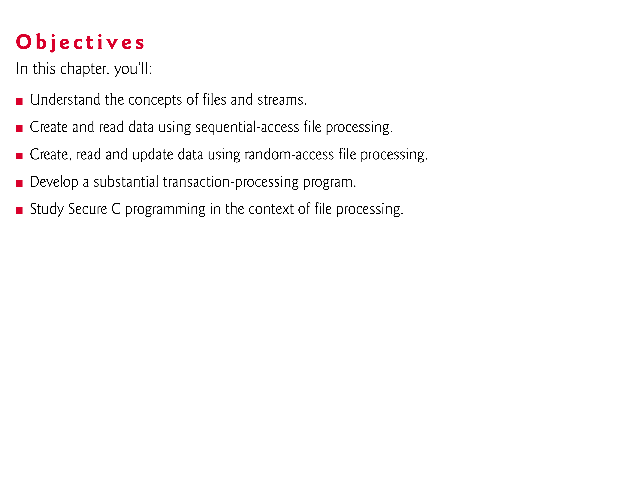

Slide 3
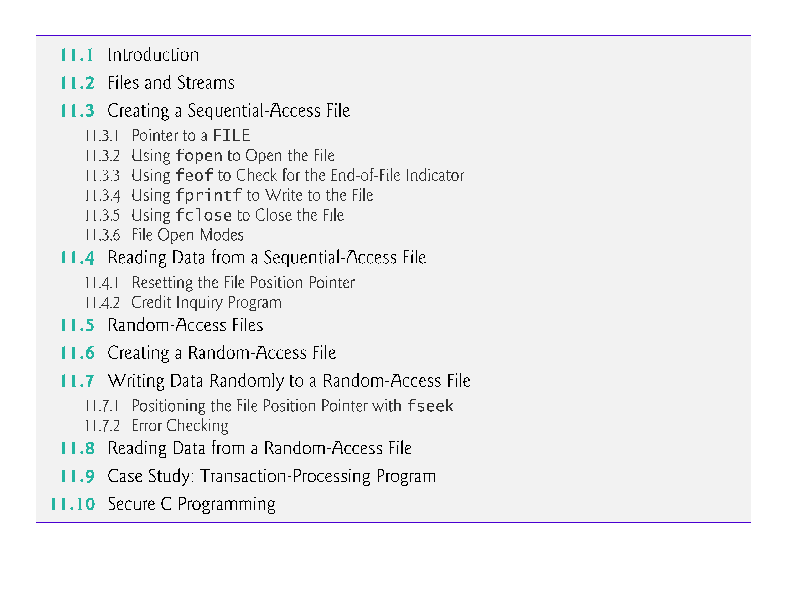

Slide 4
11.1 Introduction
Storage of data in variables and arrays is temporary—such data is lost when a program terminates.
Files are used for permanent retention of data.
Computers store files on secondary storage devices, such as hard drives, CDs, DVDs and flash drives.
In this chapter, we explain how data files are created, updated and processed by C programs.
We both consider sequential-access and random-access file processing.

Slide 5
11.2 Files and Streams
C views each file simply as a sequential stream of bytes (Fig. 11.1).
Each file ends either with an end-of-file marker or at a specific byte number recorded in a system-maintained, administrative data structure.
When a file is opened, a stream is associated with it.
Three files and their associated streams are automatically opened when program execution begins—the standard input, the standard output and the standard error.
Streams provide communication channels between files and programs.

Slide 6
11.2 Files and Streams (Cont.)
For example, the standard input stream enables a program to read data from the keyboard, and the standard output stream enables a program to print data on the screen.
Opening a file returns a pointer to a FILE structure (defined in <stdio.h>) that contains information used to process the file.
Tin some systems, this structure includes a file descriptor, i.e., an index into an operating system array called the open file table.
Each array element contains a file control block (FCB) that the operating system uses to administer a particular file.
The standard input, standard output and standard error are manipulated using file pointers stdin, stdout and stderr.

Slide 7
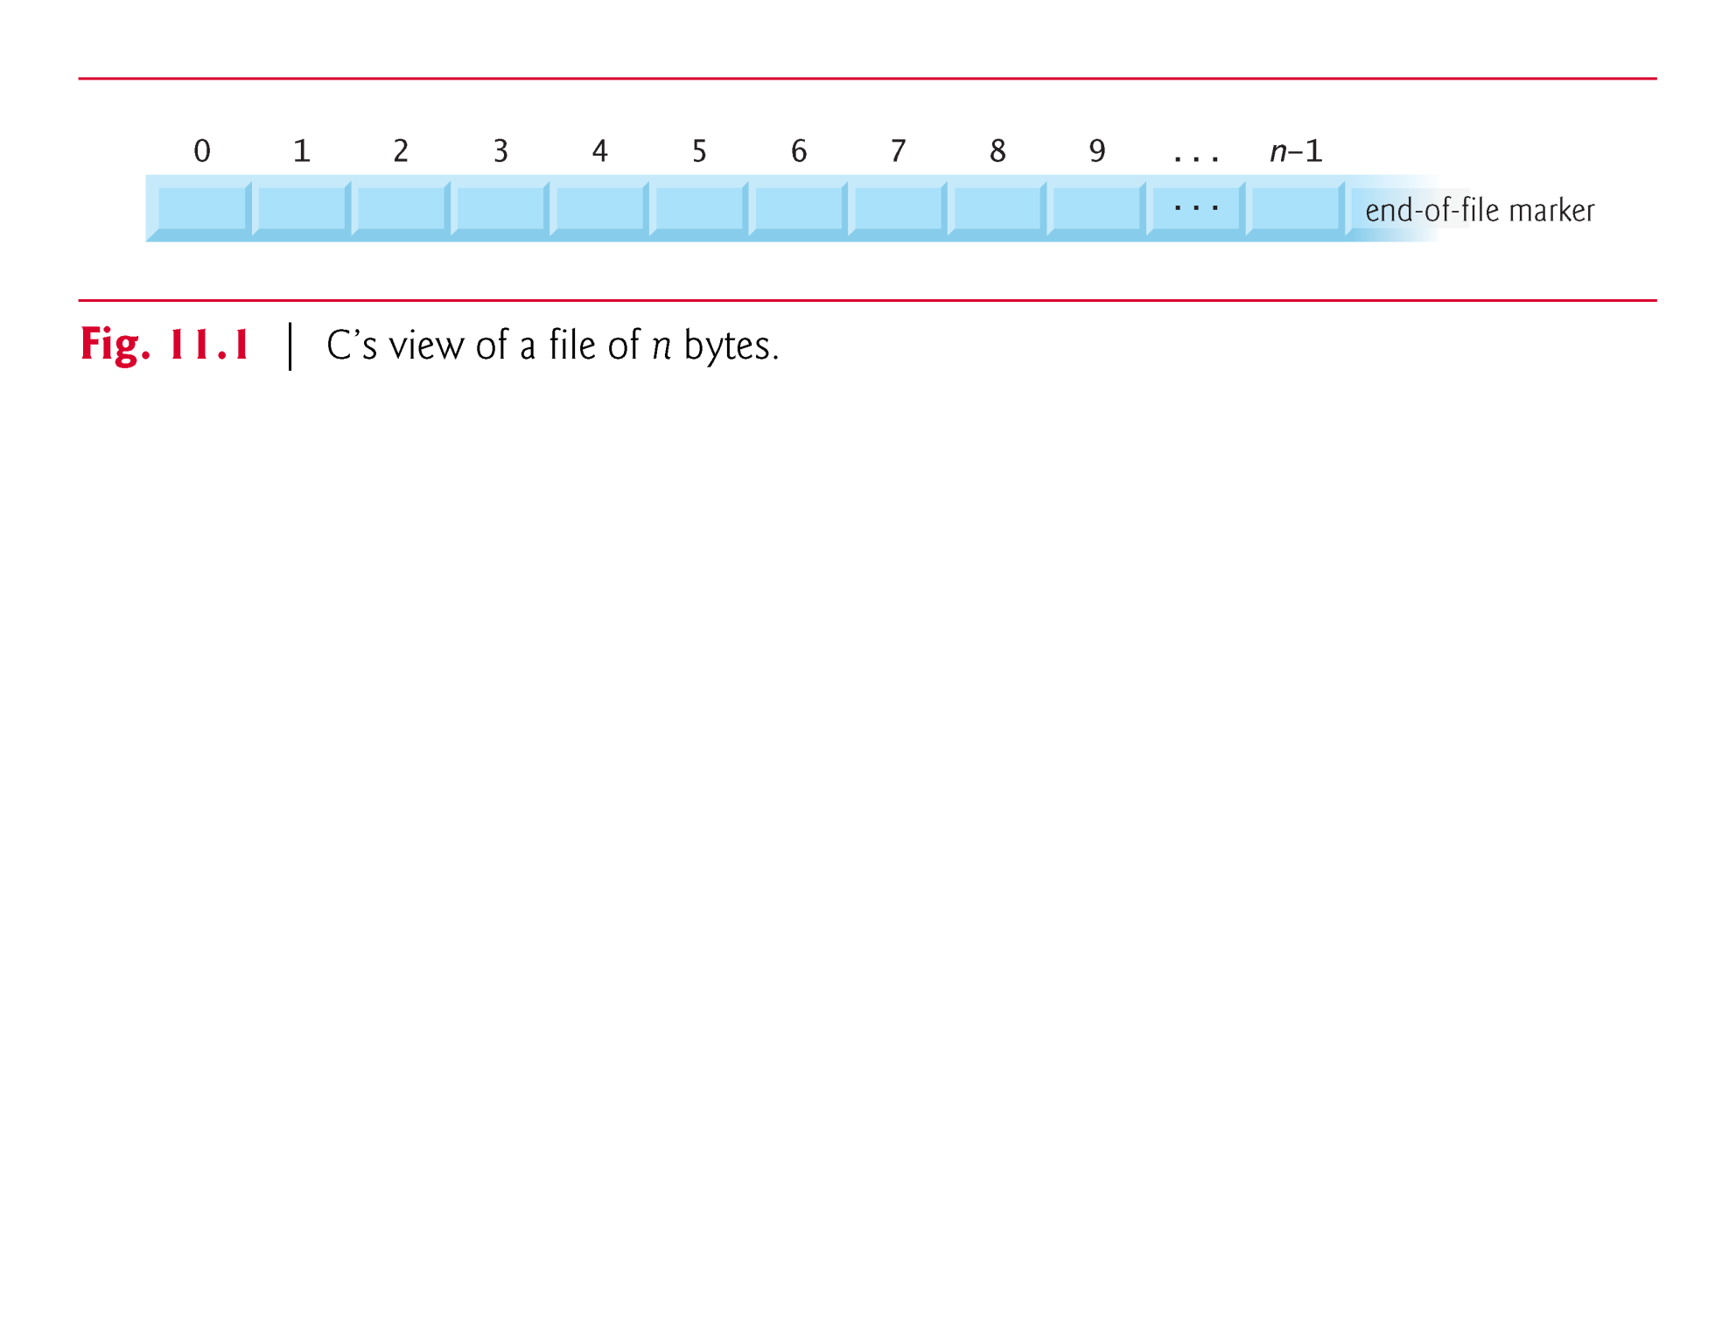

Slide 8
11.2 Files and Streams (Cont.)
The standard library provides many functions for reading data from files and for writing data to files.
Function fgetc, like getchar, reads one character from a file.
Function fgetc receives as an argument a FILE pointer for the file from which a character will be read.
The call fgetc(stdin) reads one character from stdin—the standard input.
This call is equivalent to the call getchar().
Function fputc, like putchar, writes one character to a file.
Function fputc receives as arguments a character to be written and a pointer for the file to which the character will be written.

Slide 9
11.2 Files and Streams (Cont.)
The function call fputc('a', stdout) writes the character 'a' to stdout—the standard output.
This call is equivalent to putchar('a').
Several other functions used to read data from standard input and write data to standard output have similarly named file-processing functions.
The fgets and fputs functions, for example, can be used to read a line from a file and write a line to a file, respectively.
In the next several sections, we introduce the file-processing equivalents of functions scanf and printf—fscanf and fprintf.

Slide 10
11.3 Creating a Sequential-Access File
C imposes no structure on a file.
Thus, notions such as a record of a file do not exist as part of the C language.
The following example shows how you can impose your own record structure on a file.
Figure 11.2 creates a simple sequential-access file that might be used in an accounts receivable system to help keep track of the amounts owed by a company’s credit clients.

Slide 11
11.3 Creating a Sequential-Access File (Cont.)
For each client, the program obtains an account number, the client’s name and the client’s balance (i.e., the amount the client owes the company for goods and services received in the past).
The data obtained for each client constitutes a “record” for that client.
The account number is used as the record key in this application—the file will be created and maintained in account-number order.

Slide 12
11.3 Creating a Sequential-Access File (Cont.)
This program assumes the user enters the records in account-number order.
In a comprehensive accounts receivable system, a sorting capability would be provided so the user could enter the records in any order.
The records would then be sorted and written to the file.
[Note: Figures 11.6–11.7 use the data file created in Fig. 11.2, so you must run Fig. 11.2 before Figs. 11.6–11.7.]

Slide 13
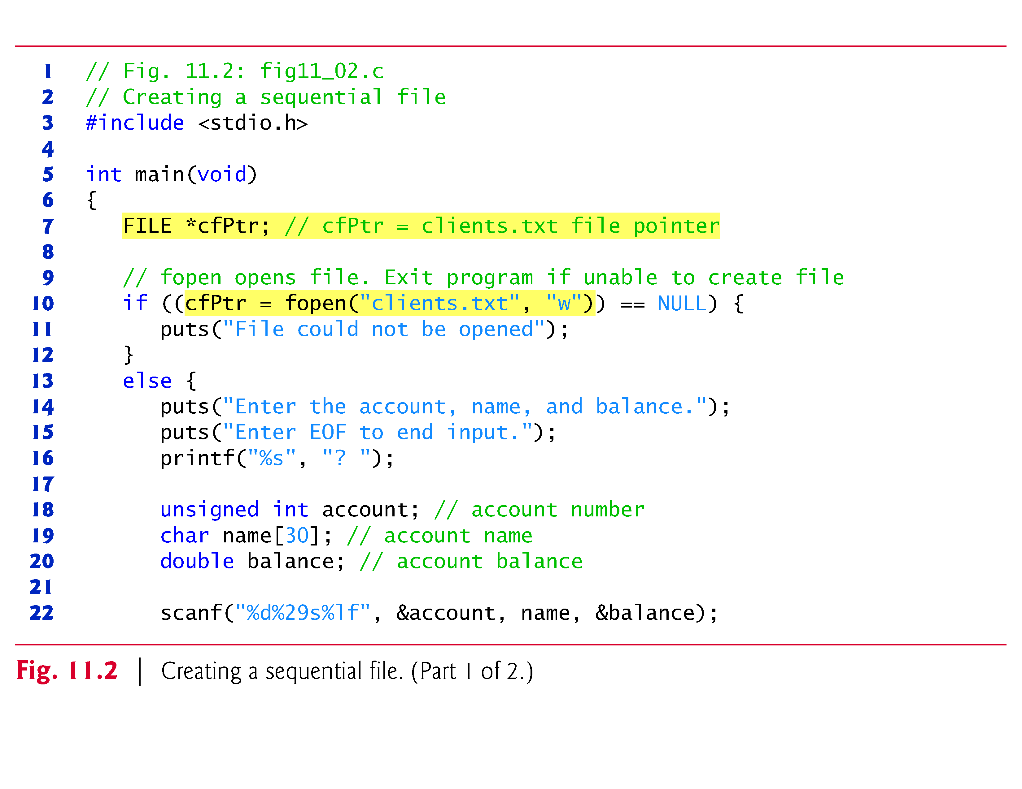

Slide 14
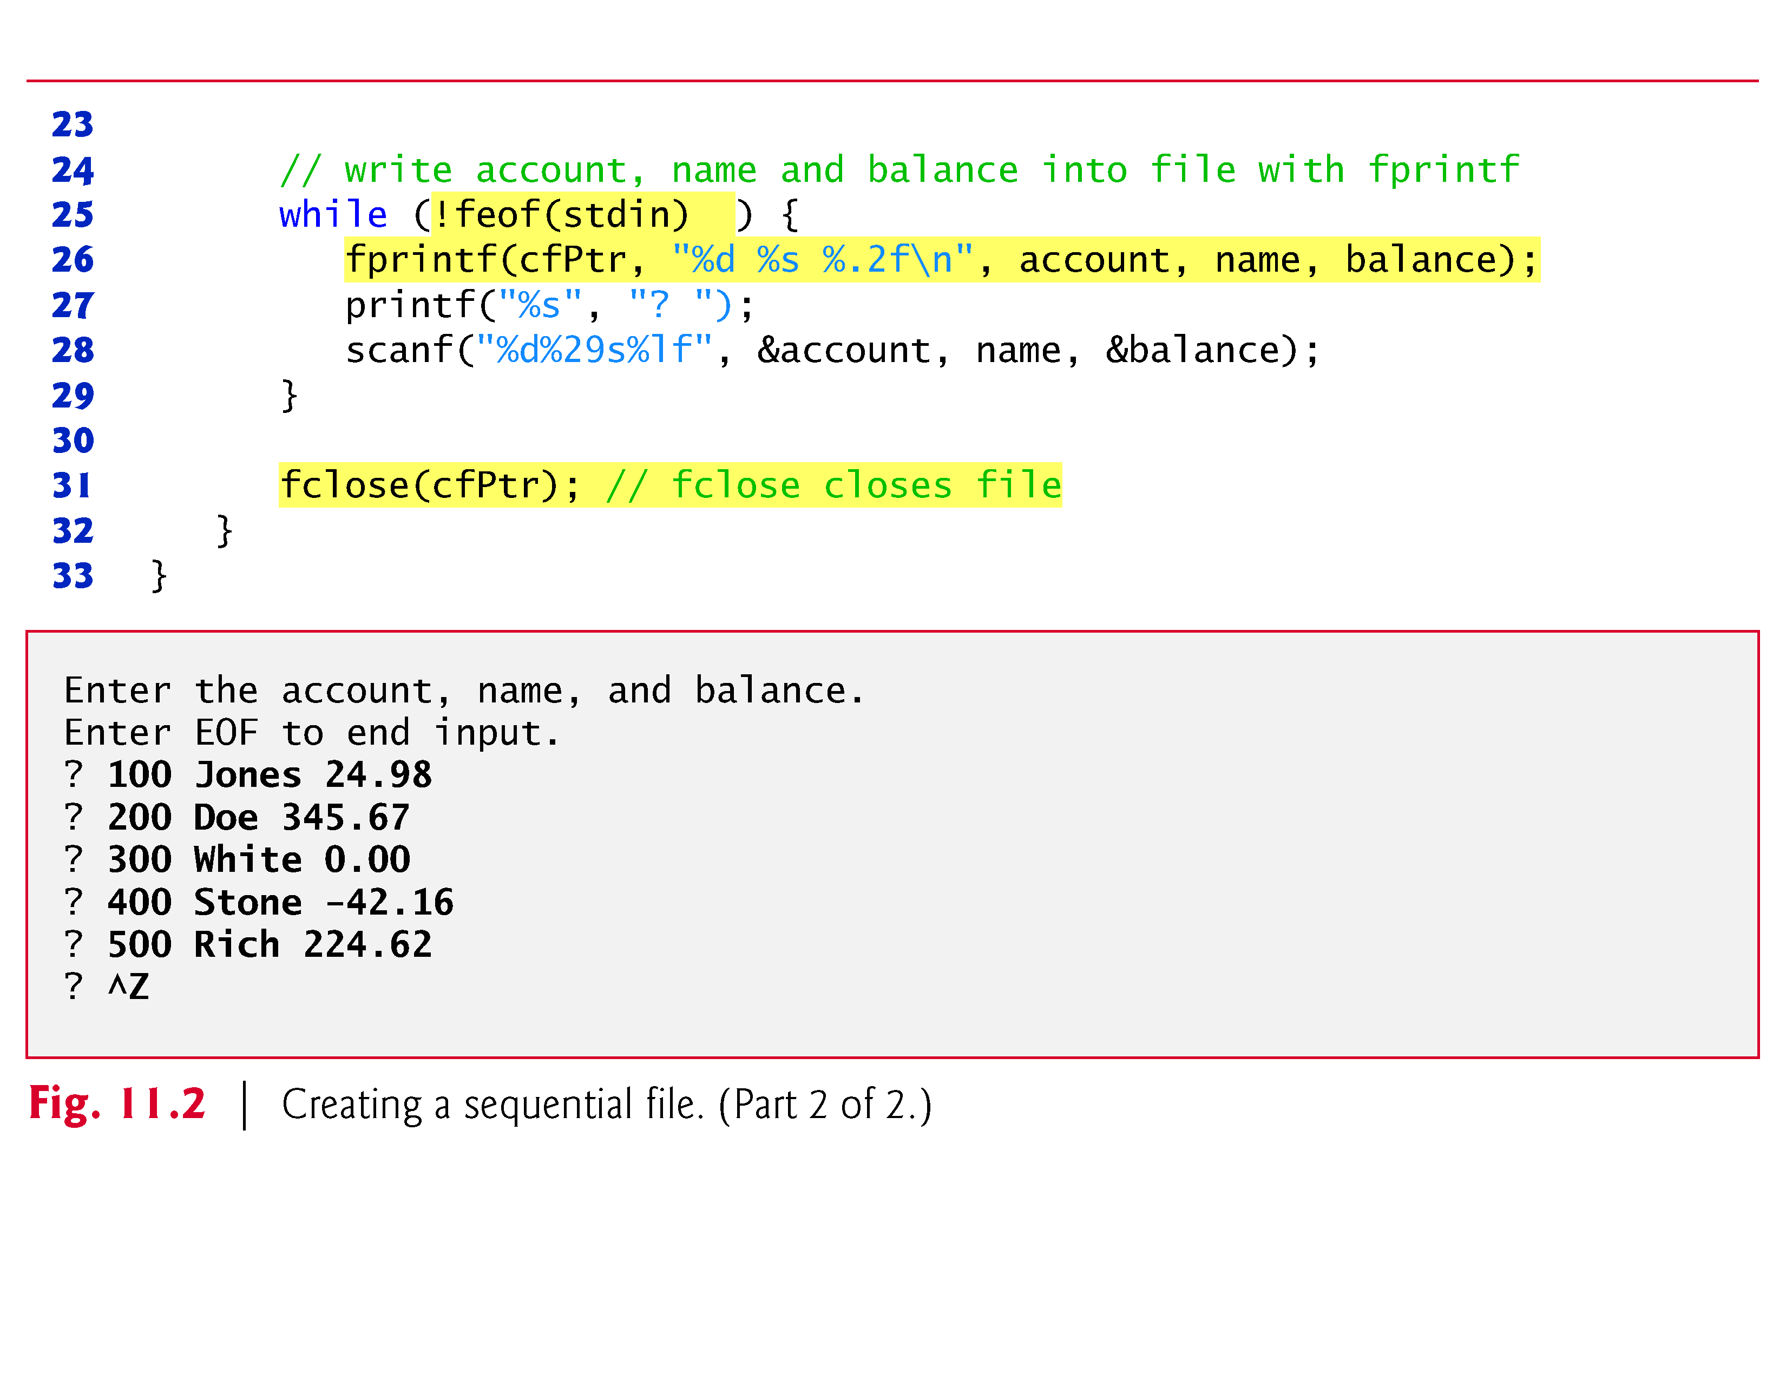

Slide 15
11.3 Creating a Sequential-Access File (Cont.)
Now let’s examine this program.
cfptr is a pointer to a FILE structure.
A C program administers each file with a separate FILE structure.
You need not know the specifics of the FILE structure to use files, but you can study the declaration in stdio.h if you like.
We’ll soon see precisely how the FILE structure leads indirectly to the operating system’s file control block (FCB) for a file.
Each open file must have a separately declared pointer of type FILE that’s used to refer to the file.

Slide 16
11.3 Creating a Sequential-Access File (Cont.)
The file name—"clients.dat"—is used by the program and establishes a “line of communication” with the file.
The file pointer cfPtr is assigned a pointer to the FILE structure for the file opened with fopen.
Function fopen takes two arguments: a filename (which can include path information leading to the file’s location) and a file open mode.
The file open mode "w" indicates that the file is to be opened for writing.
If a file does not exist and it’s opened for writing, fopen creates the file.

Slide 17
11.3 Creating a Sequential-Access File (Cont.)
If an existing file is opened for writing, the contents of the file are discarded without warning.
In the program, the if statement is used to determine whether the file pointer cfPtr is NULL (i.e., the file is not opened).
If it’s NULL, the program prints an error message and terminates.
Otherwise, the program processes the input and writes it to the file.

Slide 18
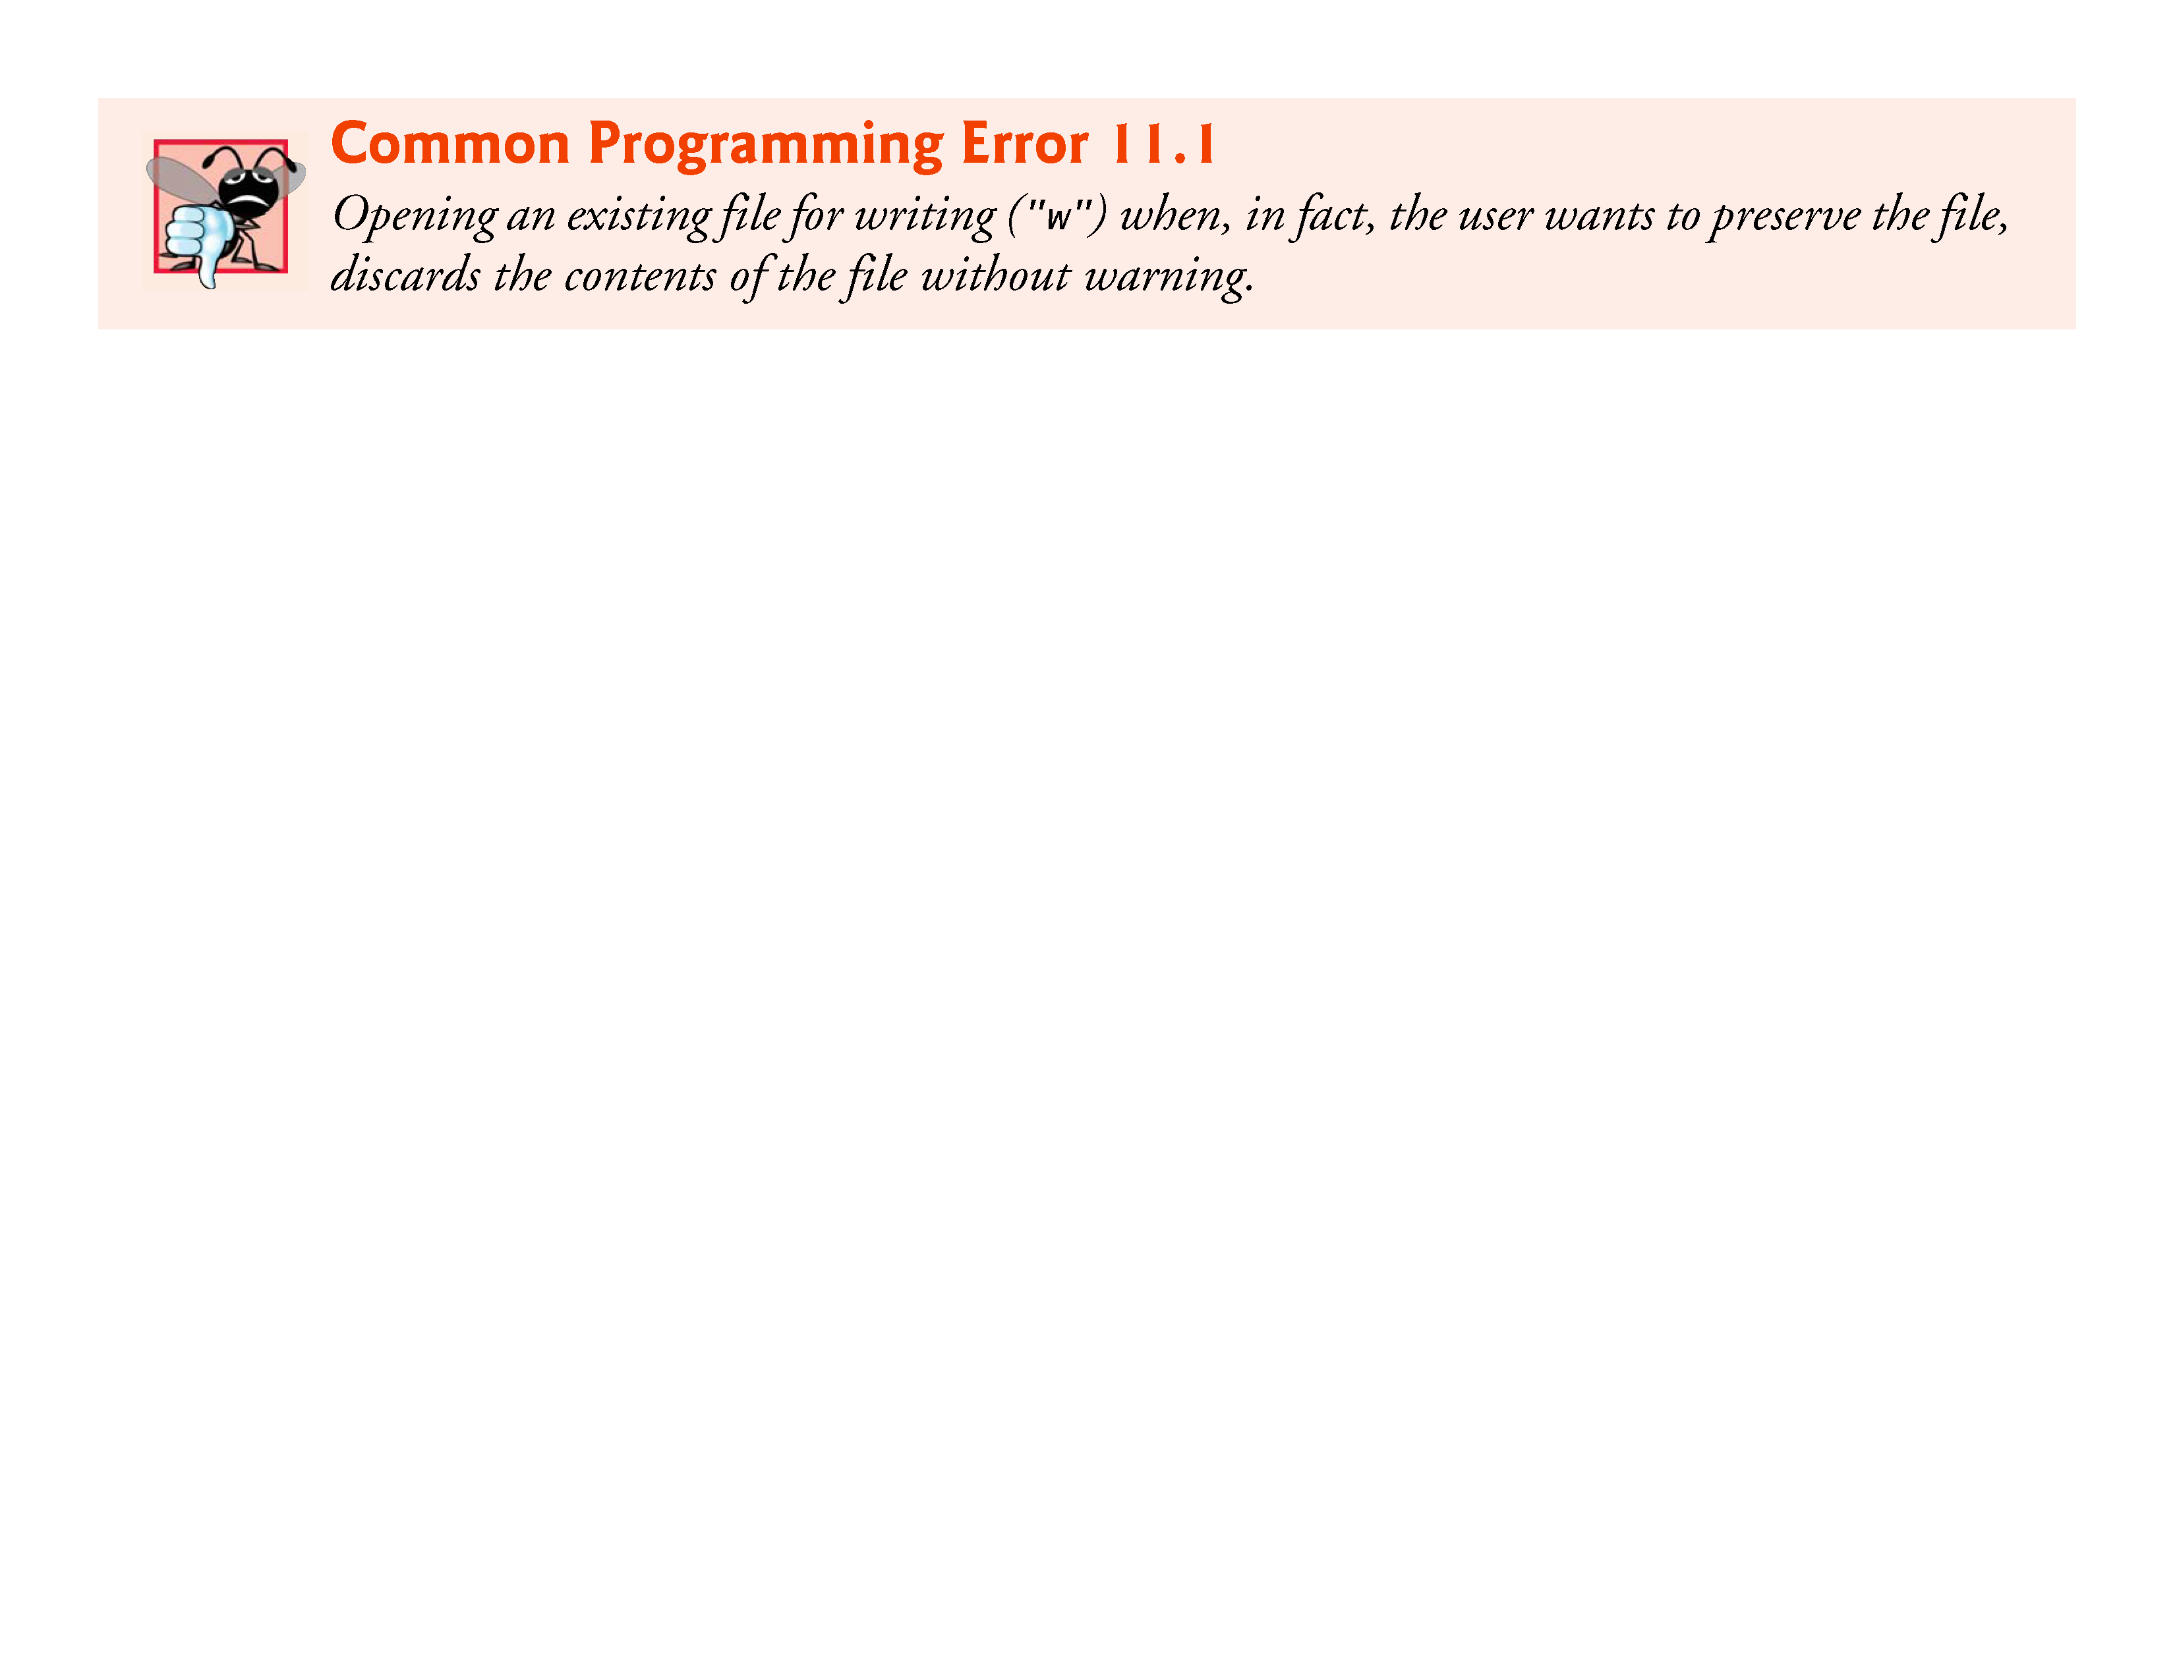

Slide 19
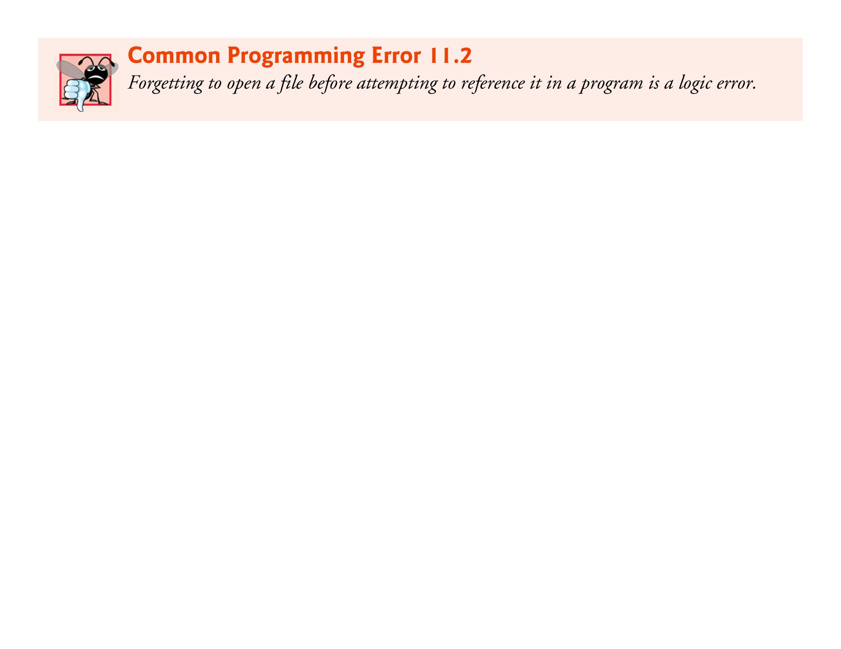

Slide 20
11.3 Creating a Sequential-Access File (Cont.)
The program prompts the user to enter the fields for each record or to enter end-of-file when data entry is complete.
Figure 11.3 lists the key combinations for entering end-of-file for various computer systems.
Function feof to determine whether the end-of-file indicator is set for the file to which stdin refers.
The end-of-file indicator informs the program that there’s no more data to be processed.
In Fig. 11.2, the end-of-file indicator is set for the standard input when the user enters the end-of-file key combination.
The argument to function feof is a pointer to the file being tested for the end-of-file indicator (stdin in this case).

Slide 21
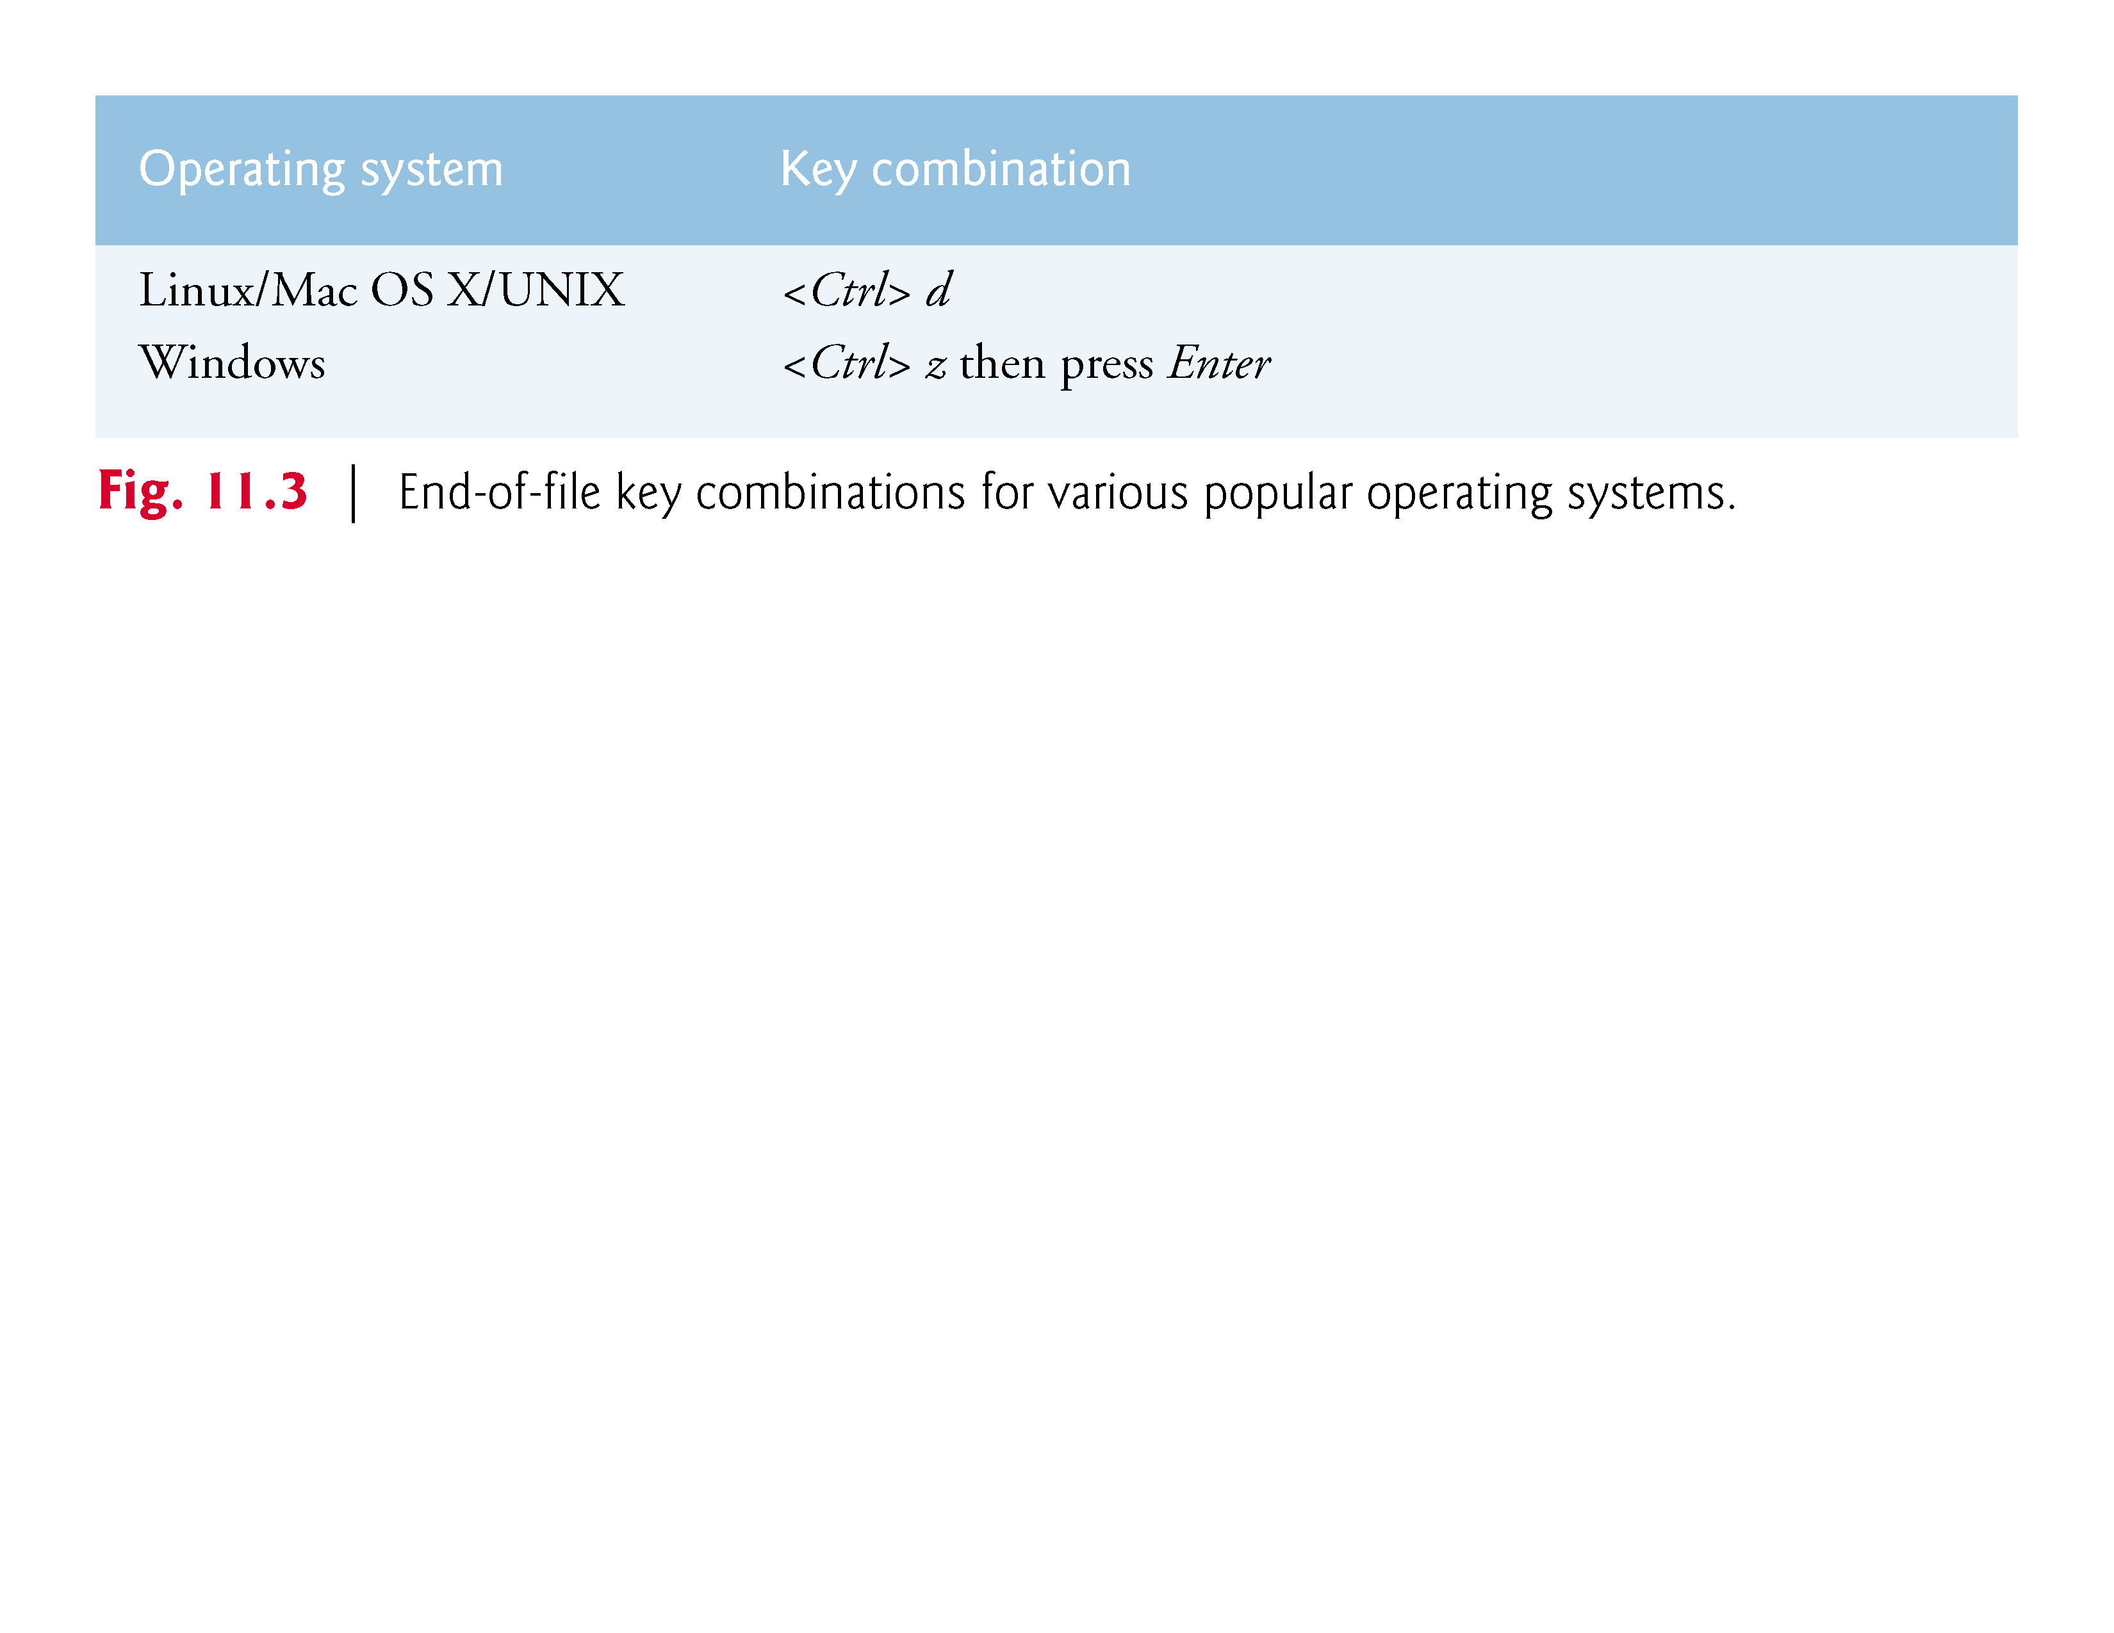

Slide 22
11.3 Creating a Sequential-Access File (Cont.)
The function returns a nonzero (true) value when the end-of-file indicator has been set; otherwise, the function returns zero.
The while statement that includes the feof call in this program continues executing while the end-of-file indicator is not set.
The data may be retrieved later by a program designed to read the file (see Section 11.4).

Slide 23
11.3 Creating a Sequential-Access File (Cont.)
Function fprintf is equivalent to printf except that fprintf also receives as an argument a file pointer for the file to which the data will be written.
Function fprintf can output data to the standard output by using stdout as the file pointer, as in:
fprintf(stdout, "%d %s %.2f\n", account, name, balance);

Slide 24
11.3 Creating a Sequential-Access File (Cont.)
After the user enters end-of-file, the program closes the clients.dat file with fclose and terminates.
Function fclose also receives the file pointer (rather than the filename) as an argument.
If function fclose is not called explicitly, the operating system normally will close the file when program execution terminates.
This is an example of operating system “housekeeping.”

Slide 25
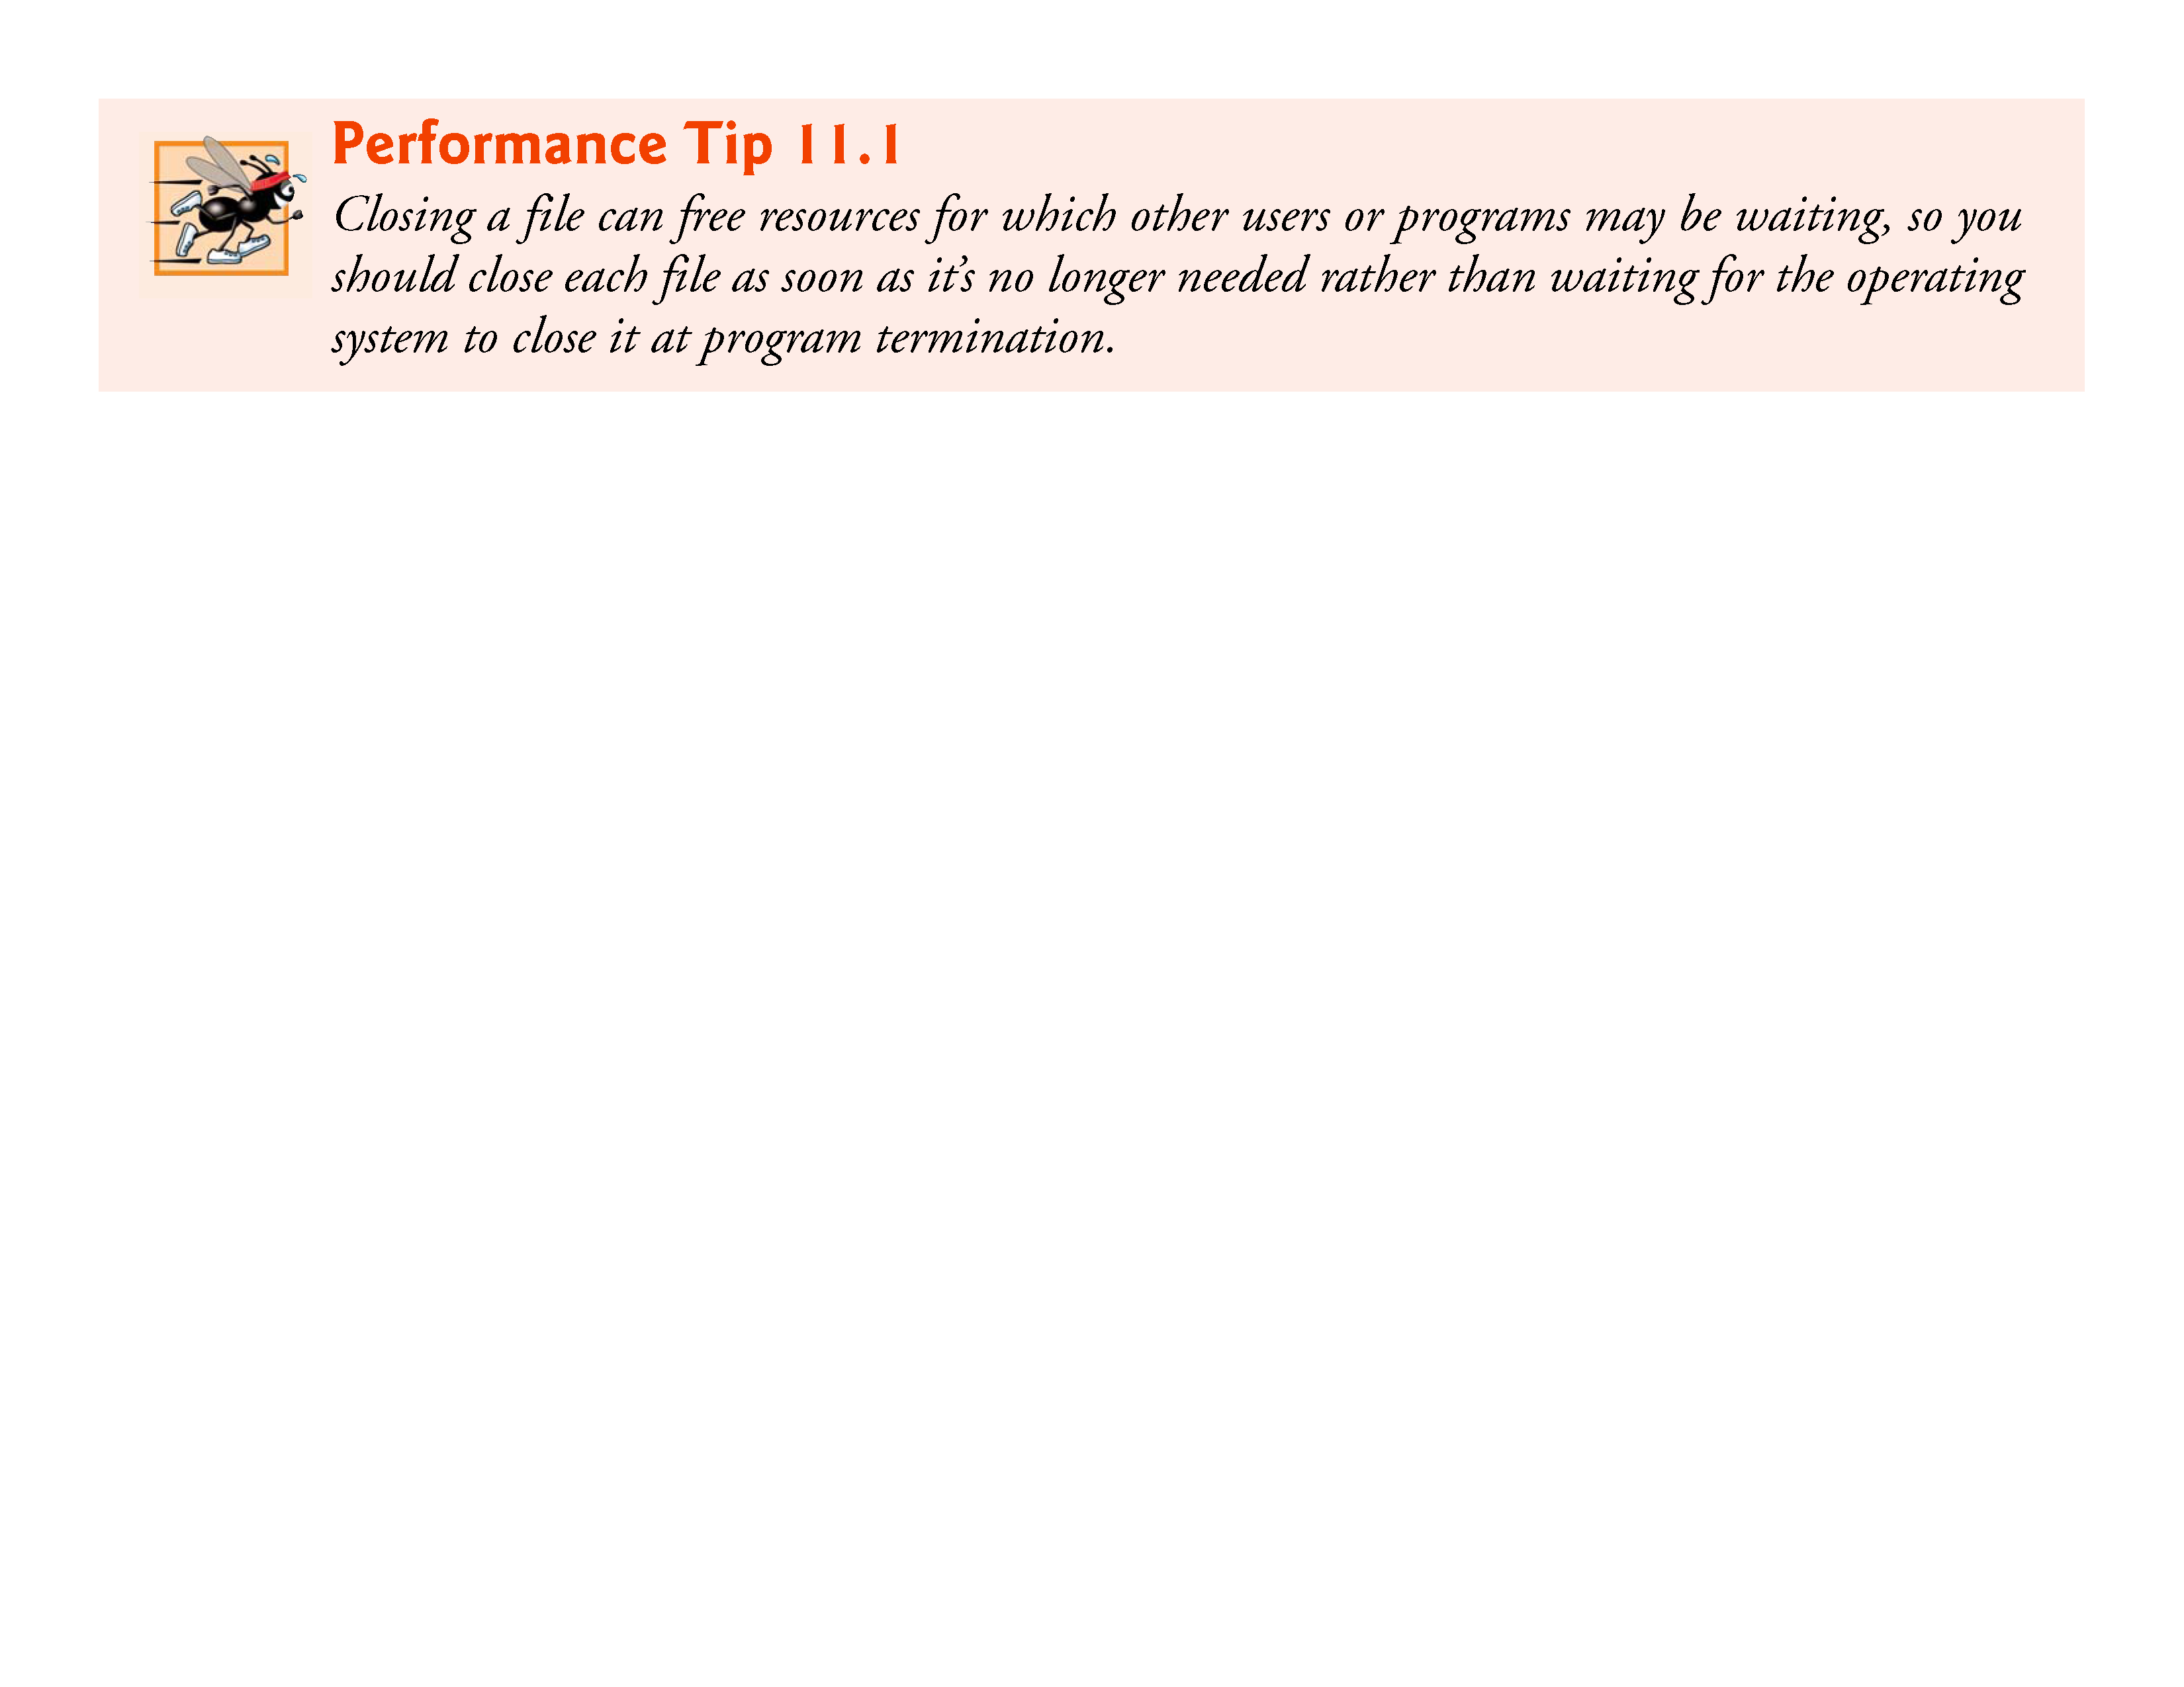

Slide 26
11.3 Creating a Sequential-Access File (Cont.)
In the sample execution for the program of Fig. 11.3, the user enters information for five accounts, then enters end-of-file to signal that data entry is complete.
The sample execution does not show how the data records actually appear in the file.
To verify that the file has been created successfully, in the next section we present a program that reads the file and prints its contents.
Figure 11.4 illustrates the relationship between FILE pointers, FILE structures and FCBs.
When the file "clients.dat" is opened, an FCB for the file is copied into memory.

Slide 27
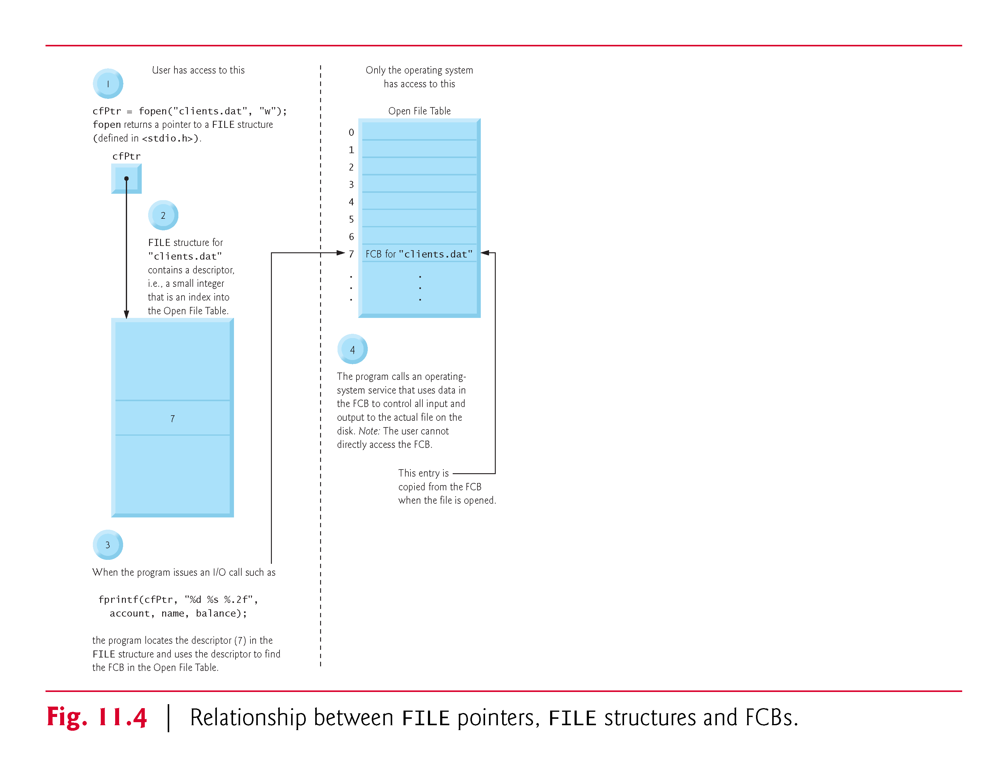

Slide 28
11.3 Creating a Sequential-Access File (Cont.)
The figure shows the connection between the file pointer returned by fopen and the FCB used by the operating system to administer the file.
Programs may process no files, one file or several files.
Each file used in a program will have a different file pointer returned by fopen.
All subsequent file-processing functions after the file is opened must refer to the file with the appropriate file pointer.
Files may be opened in one of several modes (Fig. 11.5).
To create a file, or to discard the contents of a file before writing data, open the file for writing ("w").

Slide 29
11.3 Creating a Sequential-Access File (Cont.)
To read an existing file, open it for reading ("r").
To add records to the end of an existing file, open the file for appending ("a").
To open a file so that it may be written to and read from, open the file for updating in one of the three update modes—"r+", "w+" or "a+".
Mode "r+" opens an existing file for reading and writing.
Mode "w+" creates a file for reading and writing.
If the file already exists, it’s opened and its current contents are discarded.

Slide 30
11.3 Creating a Sequential-Access File (Cont.)
Mode "a+" opens a file for reading and writing—all writing is done at the end of the file.
If the file does not exist, it’s created.
Each file open mode has a corresponding binary mode (containing the letter b) for manipulating binary files.
The binary modes are used in Sections 11.5–11.9 when we introduce random-access files.
In addition, C11 provides exclusive write mode, which you indicate by adding an x to the end of the w, w+, wb or wb+ modes.

Slide 31
11.3 Creating a Sequential-Access File (Cont.)
In exclusive write mode, fopen will fail if the file already exists or cannot be created.
If opening a file in exclusive write mode is successful and the underlying system supports exclusive file access, then only your program can access the file while it’s open.
(Some compilers and platforms do not support exclusive write mode.)
If an error occurs while opening a file in any mode, fopen returns NULL.

Slide 32
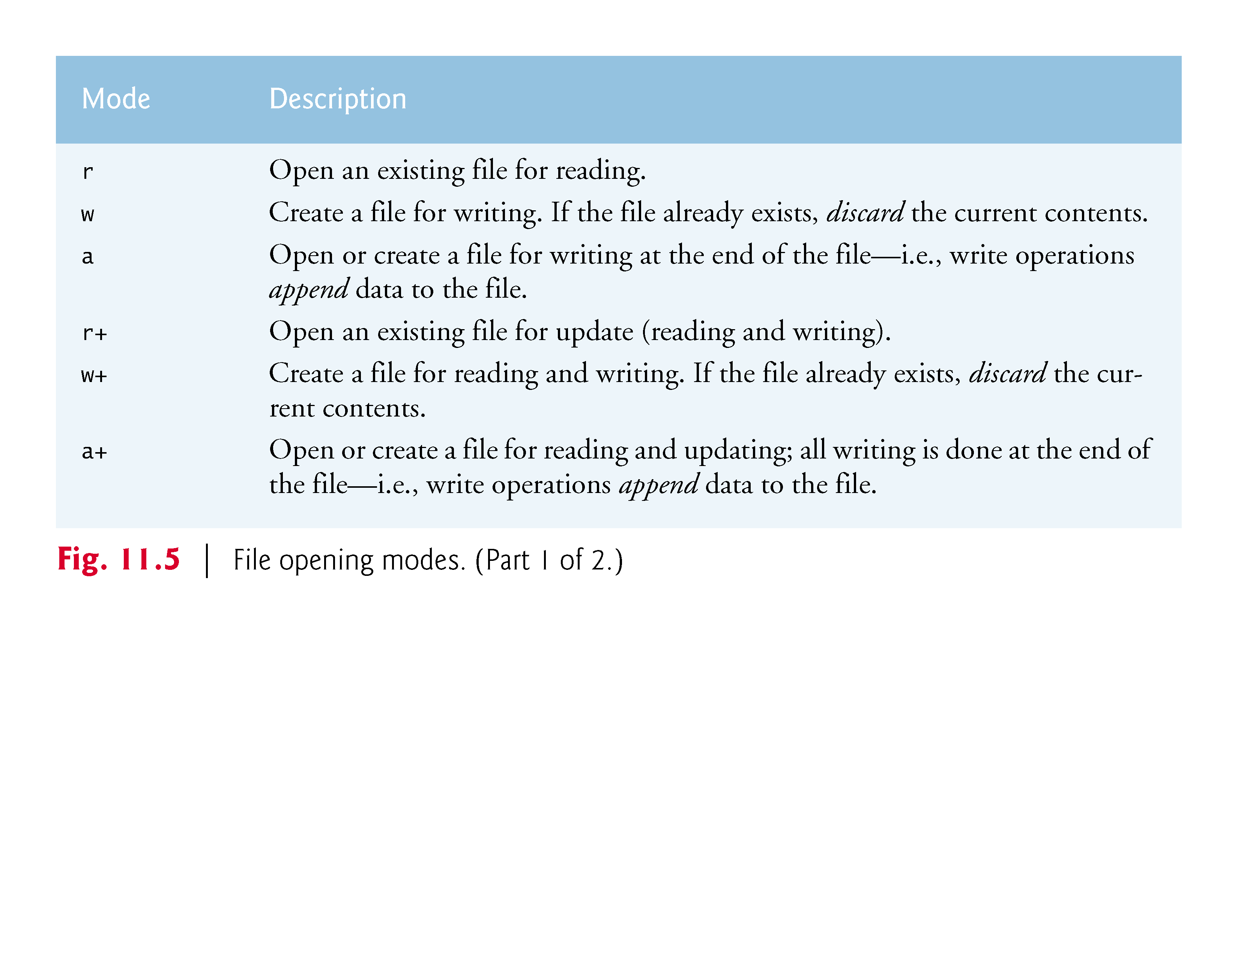

Slide 33
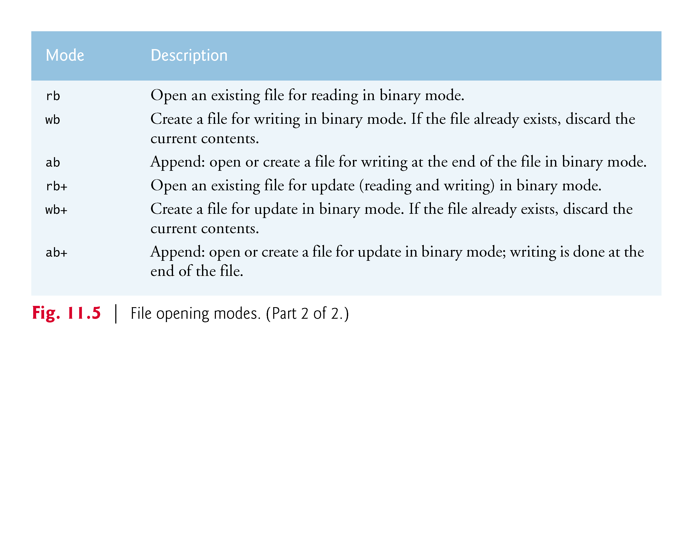

Slide 34
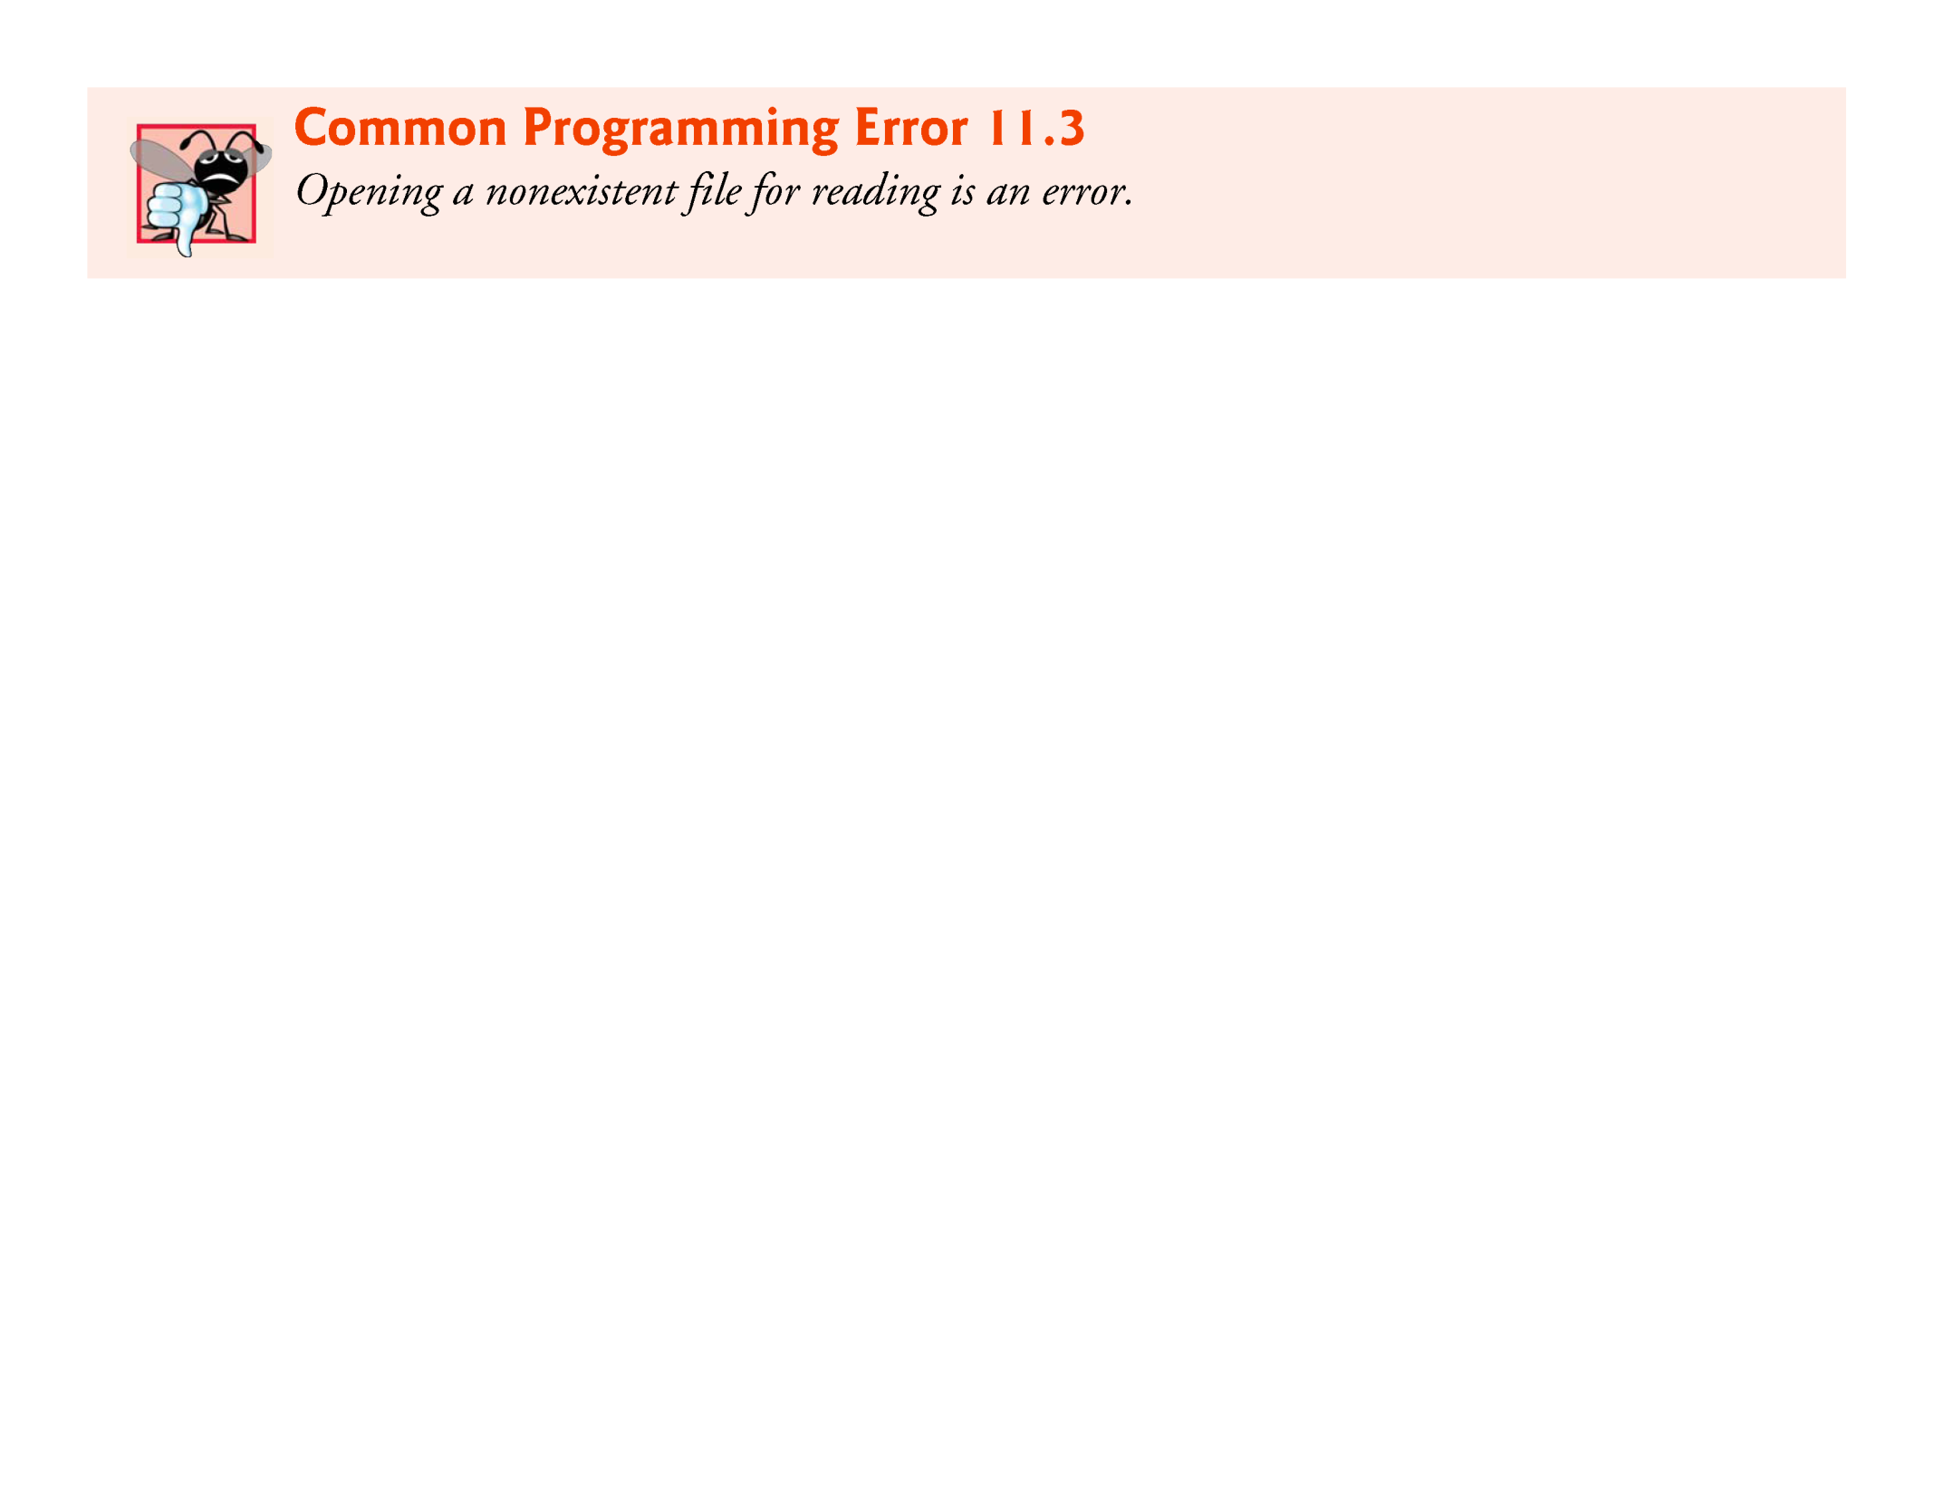

Slide 35
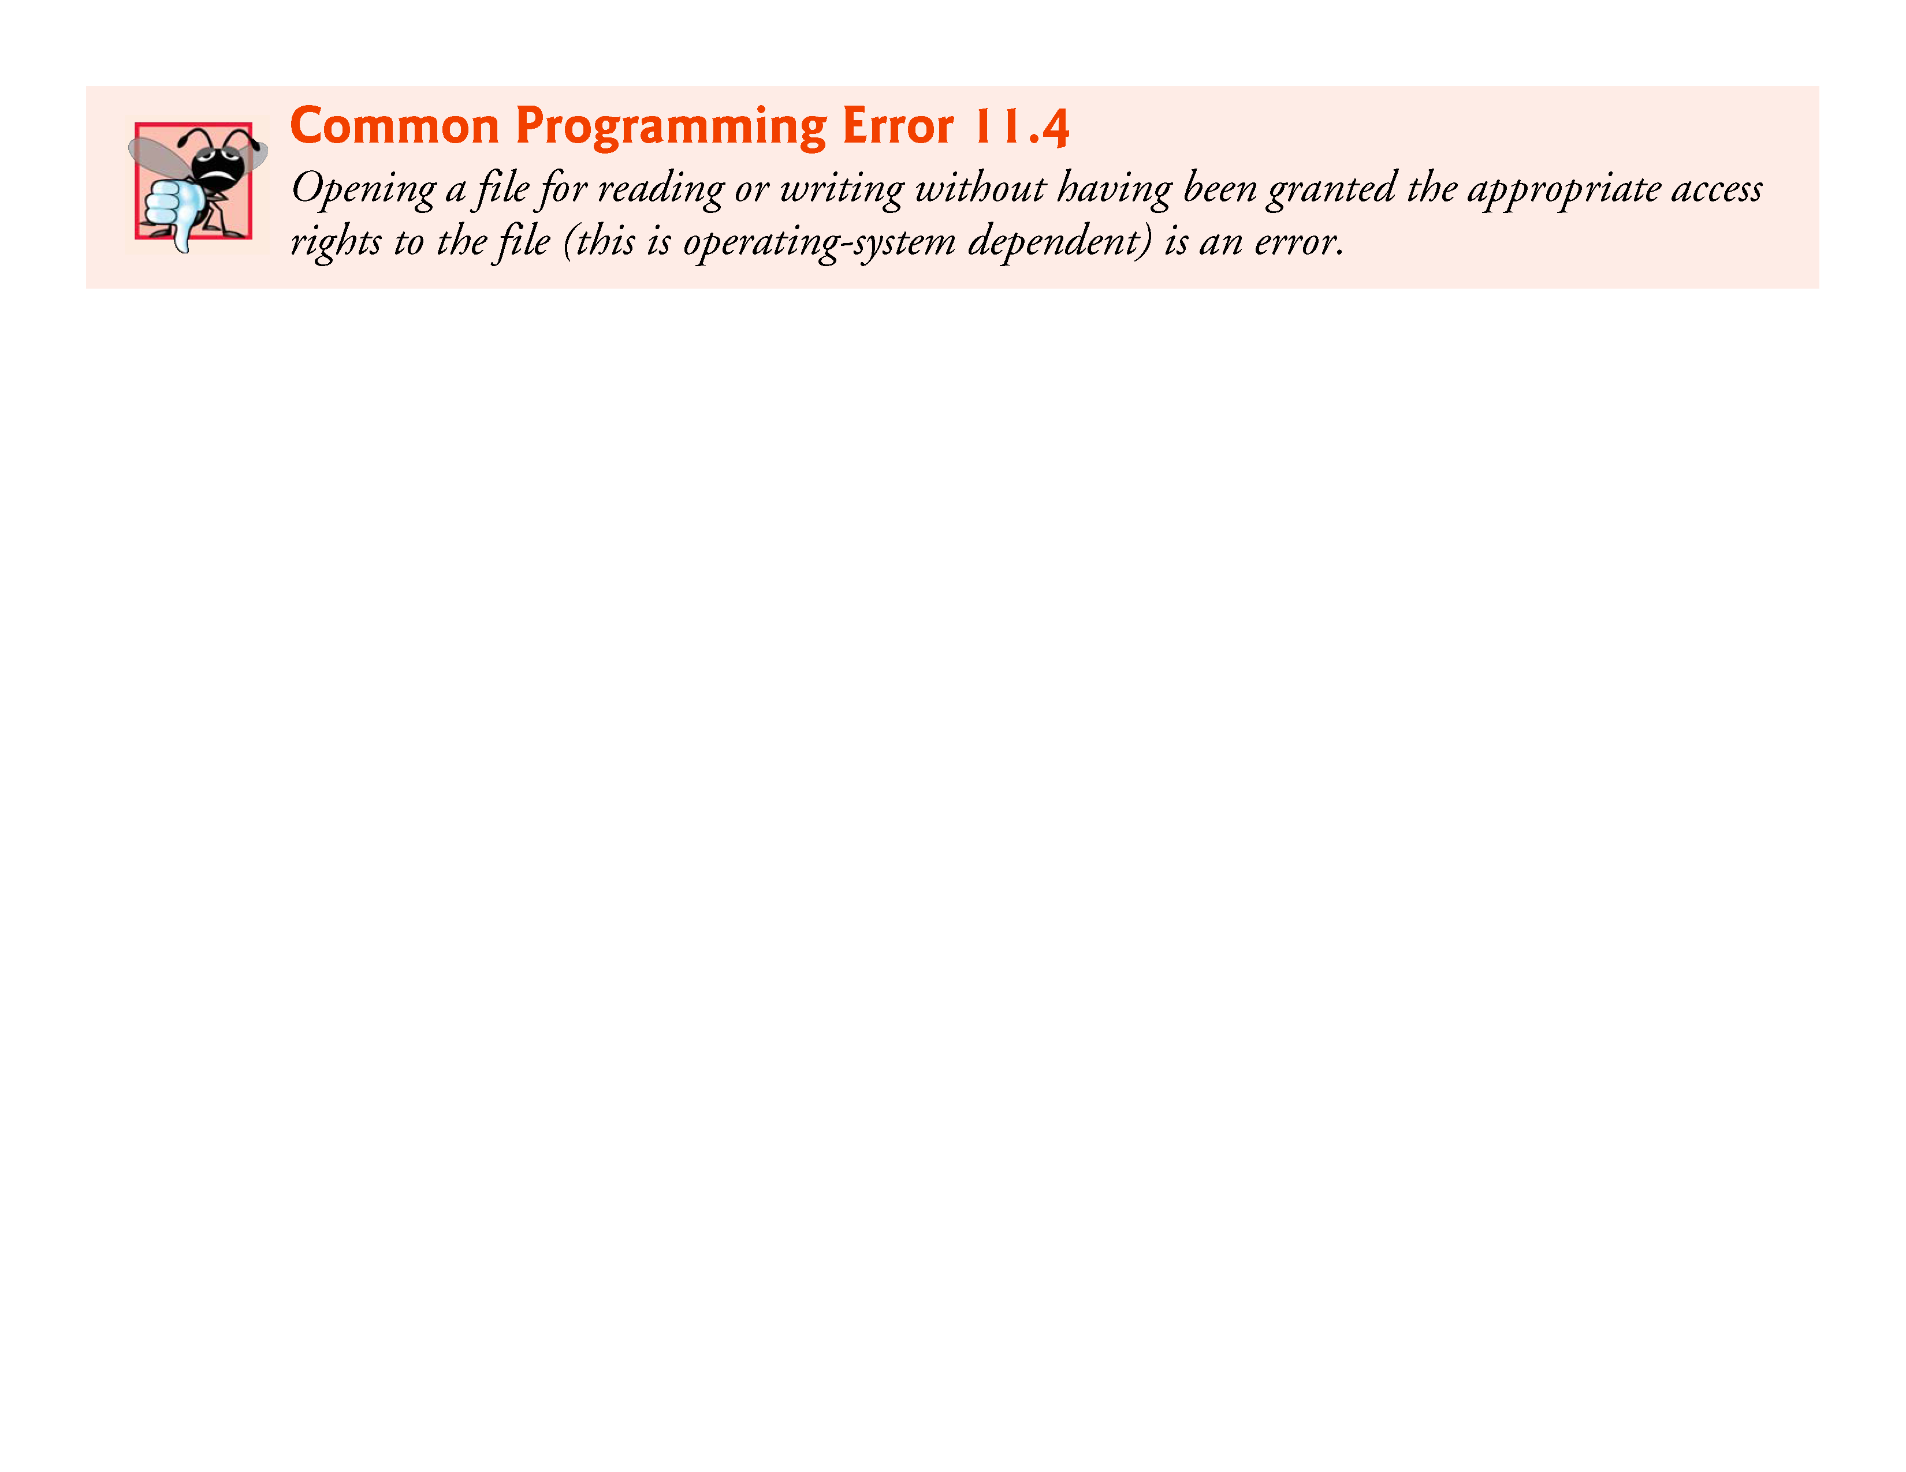

Slide 36
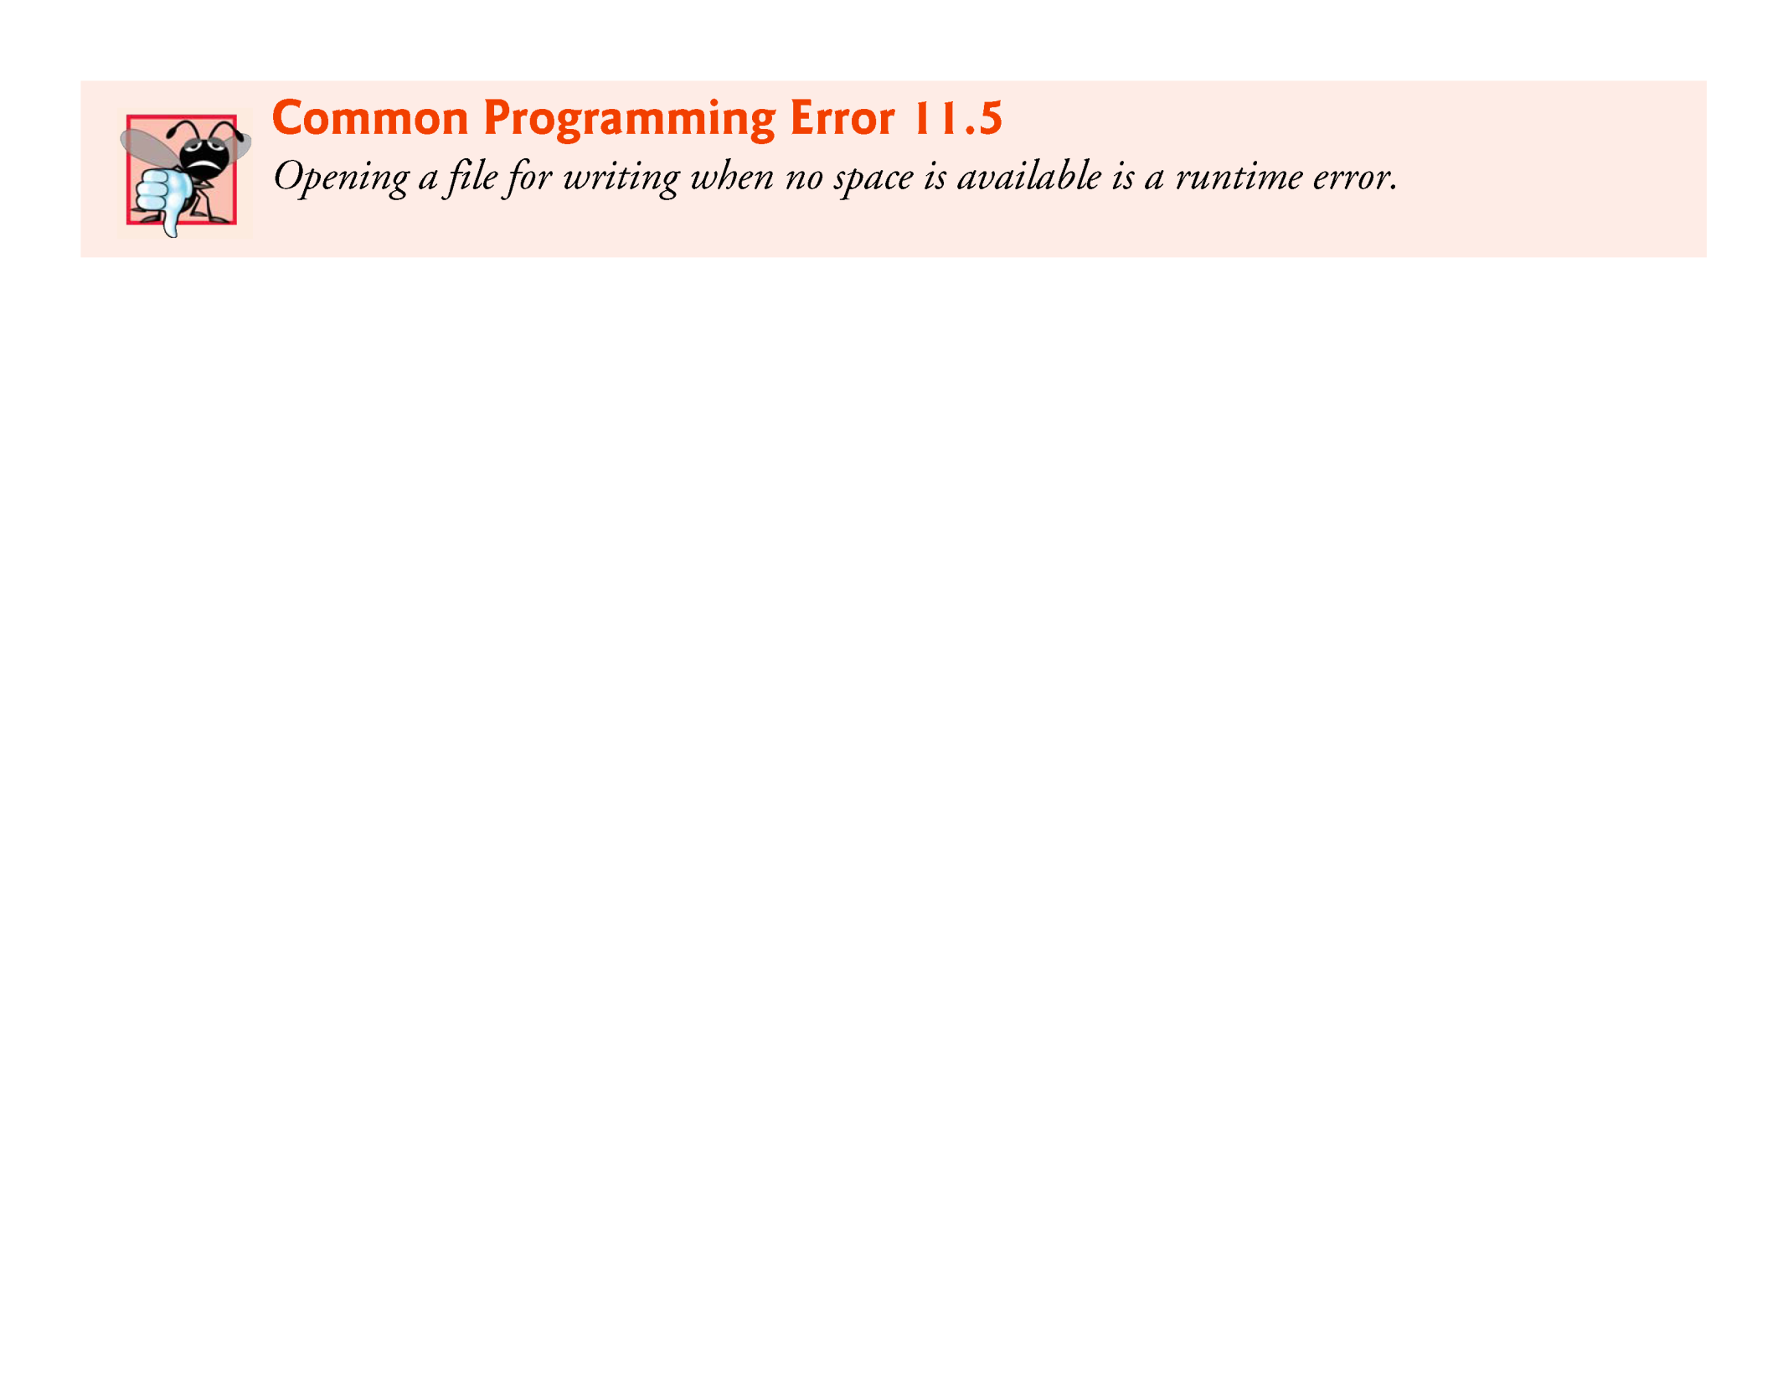

Slide 37
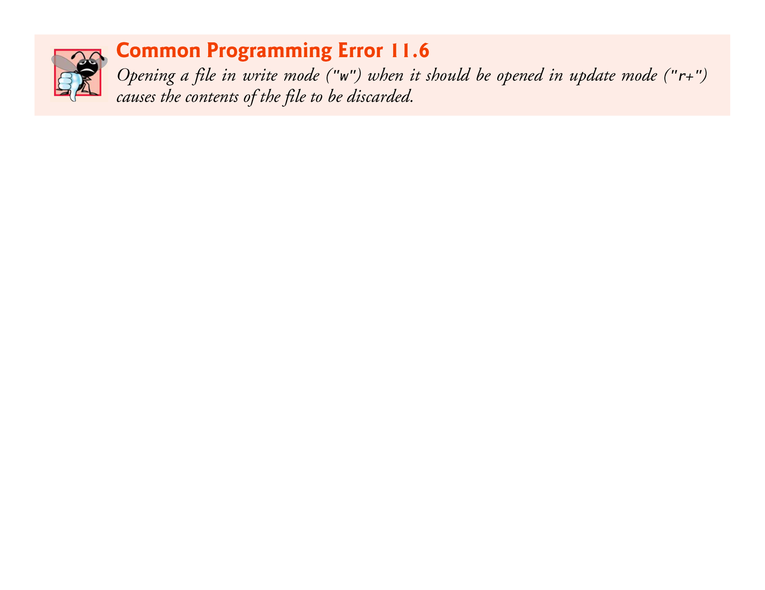

Slide 38
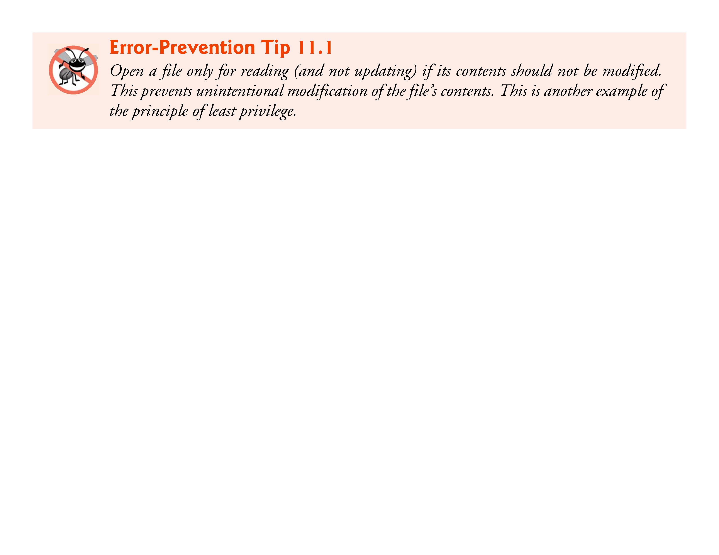

Slide 39
11.4 Reading Data from a Sequential-Access File
Data is stored in files so that the data can be retrieved for processing when needed.
The previous section demonstrated how to create a file for sequential access.
This section shows how to read data sequentially from a file.
Figure 11.6 reads records from the file "clients.dat" created by the program of Fig. 11.2 and prints their contents.
cfPtr is a pointer to a FILE.
We attempt to open the file "clients.dat" for reading ("r") and determine whether it opened successfully (i.e., fopen does not return NULL).

Slide 40
11.4 Reading Data from a Sequential-Access File (Cont.)
Read a “record” from the file.
Function fscanf is equivalent to scanf, except fscanf receives a file pointer for the file being read.
After this statement executes the first time, account will have the value 100, name will have the value "Jones" and balance will have the value 24.98.
Each time the second fscanf statement executes, the program reads another record from the file and account, name and balance take on new values.
When the program reaches the end of the file, the file is closed and the program terminates.
Function feof returns true only after the program attempts to read the nonexistent data following the last line.

Slide 41
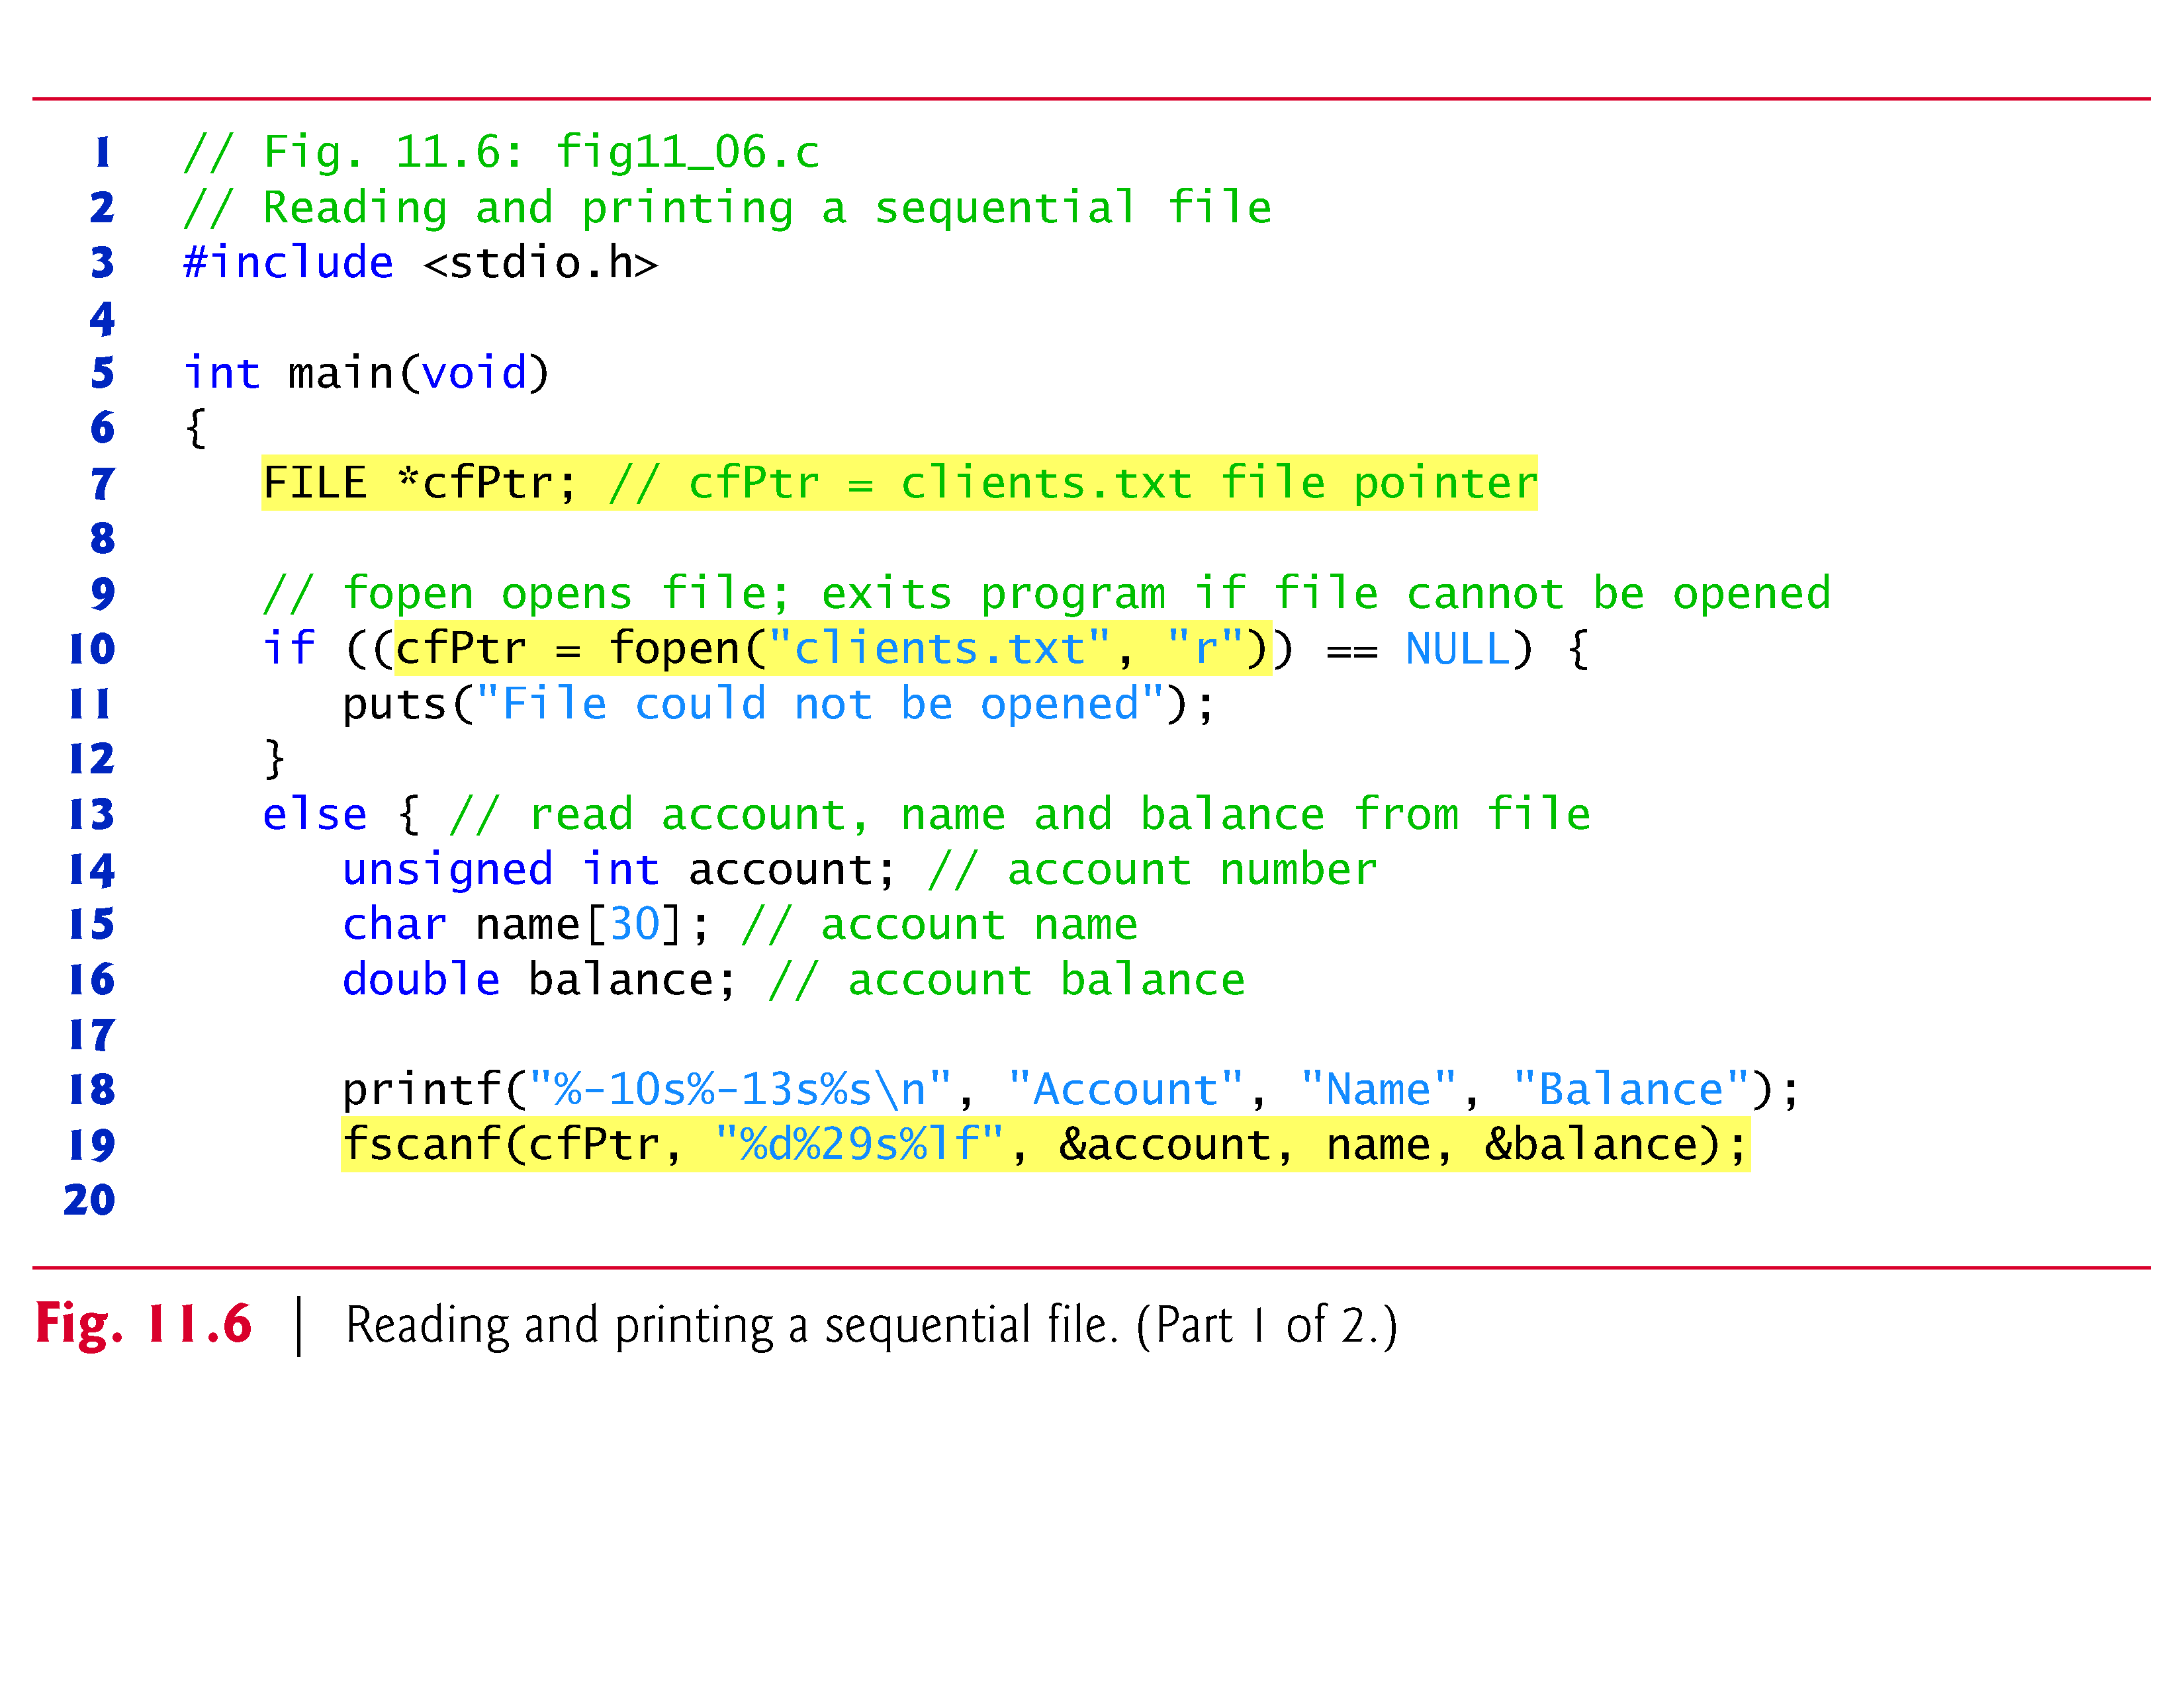

Slide 42
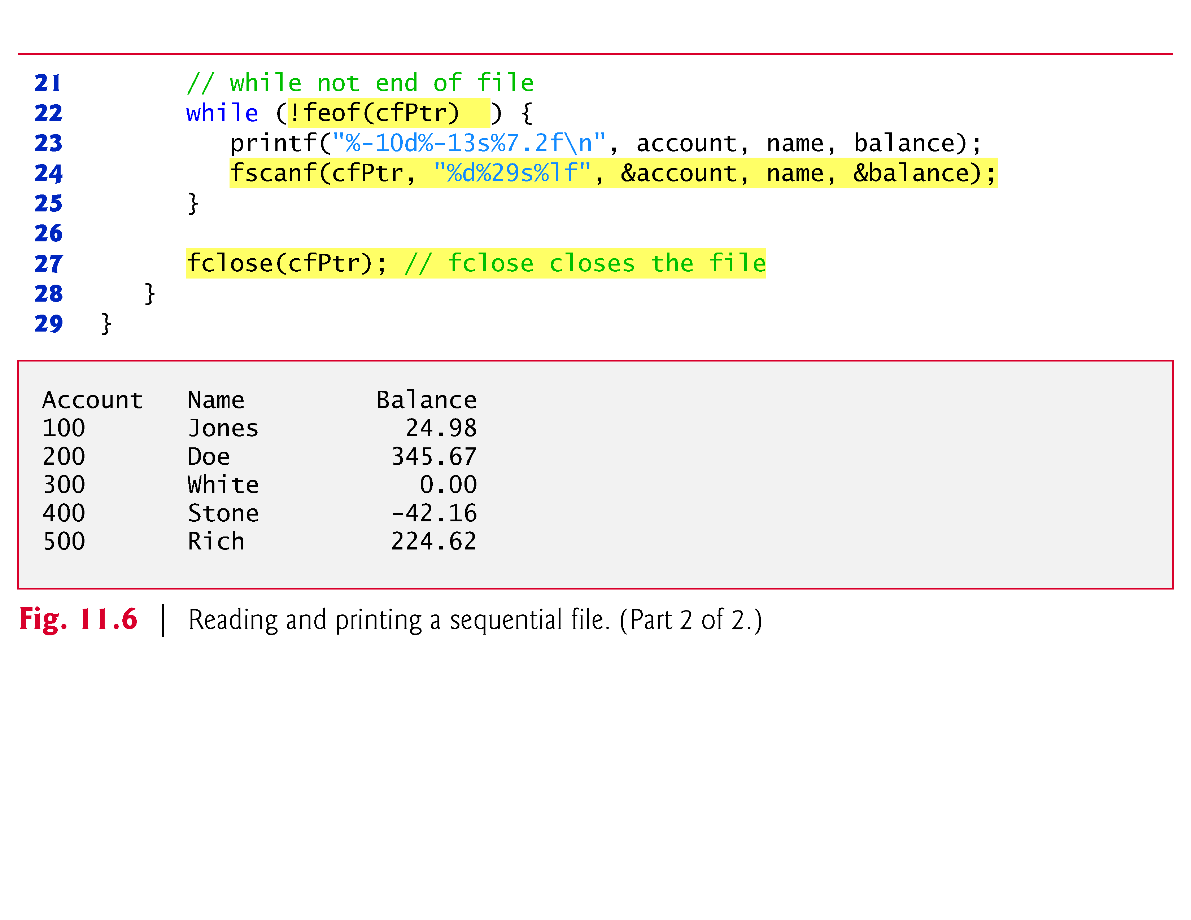

Slide 43
11.4 Reading Data from a Sequential-Access File (Cont.)
Resetting the File Position Pointer
To retrieve data sequentially from a file, a program normally starts reading from the beginning of the file and reads all data consecutively until the desired data is found.
It may be desirable to process the data sequentially in a file several times (from the beginning of the file) during the execution of a program.

Slide 44
11.4 Reading Data from a Sequential-Access File (Cont.)
The statement
rewind(cfPtr);
causes a program’s file position pointer—which indicates the number of the next byte in the file to be read or written—to be repositioned to the beginning of the file (i.e., byte 0) pointed to by cfPtr.
The file position pointer is not really a pointer.
Rather it’s an integer value that specifies the byte in the file at which the next read or write is to occur.
This is sometimes referred to as the file offset.
The file position pointer is a member of the FILE structure associated with each file.

Slide 45
11.4 Reading Data from a Sequential-Access File (Cont.)
Credit Inquiry Program
The program of Fig. 11.7 allows a credit manager to obtain lists of customers with zero balances (i.e., customers who do not owe any money), customers with credit balances (i.e., customers to whom the company owes money) and customers with debit balances (i.e., customers who owe the company money for goods and services received).
A credit balance is a negative amount; a debit balance is a positive amount.

Slide 46
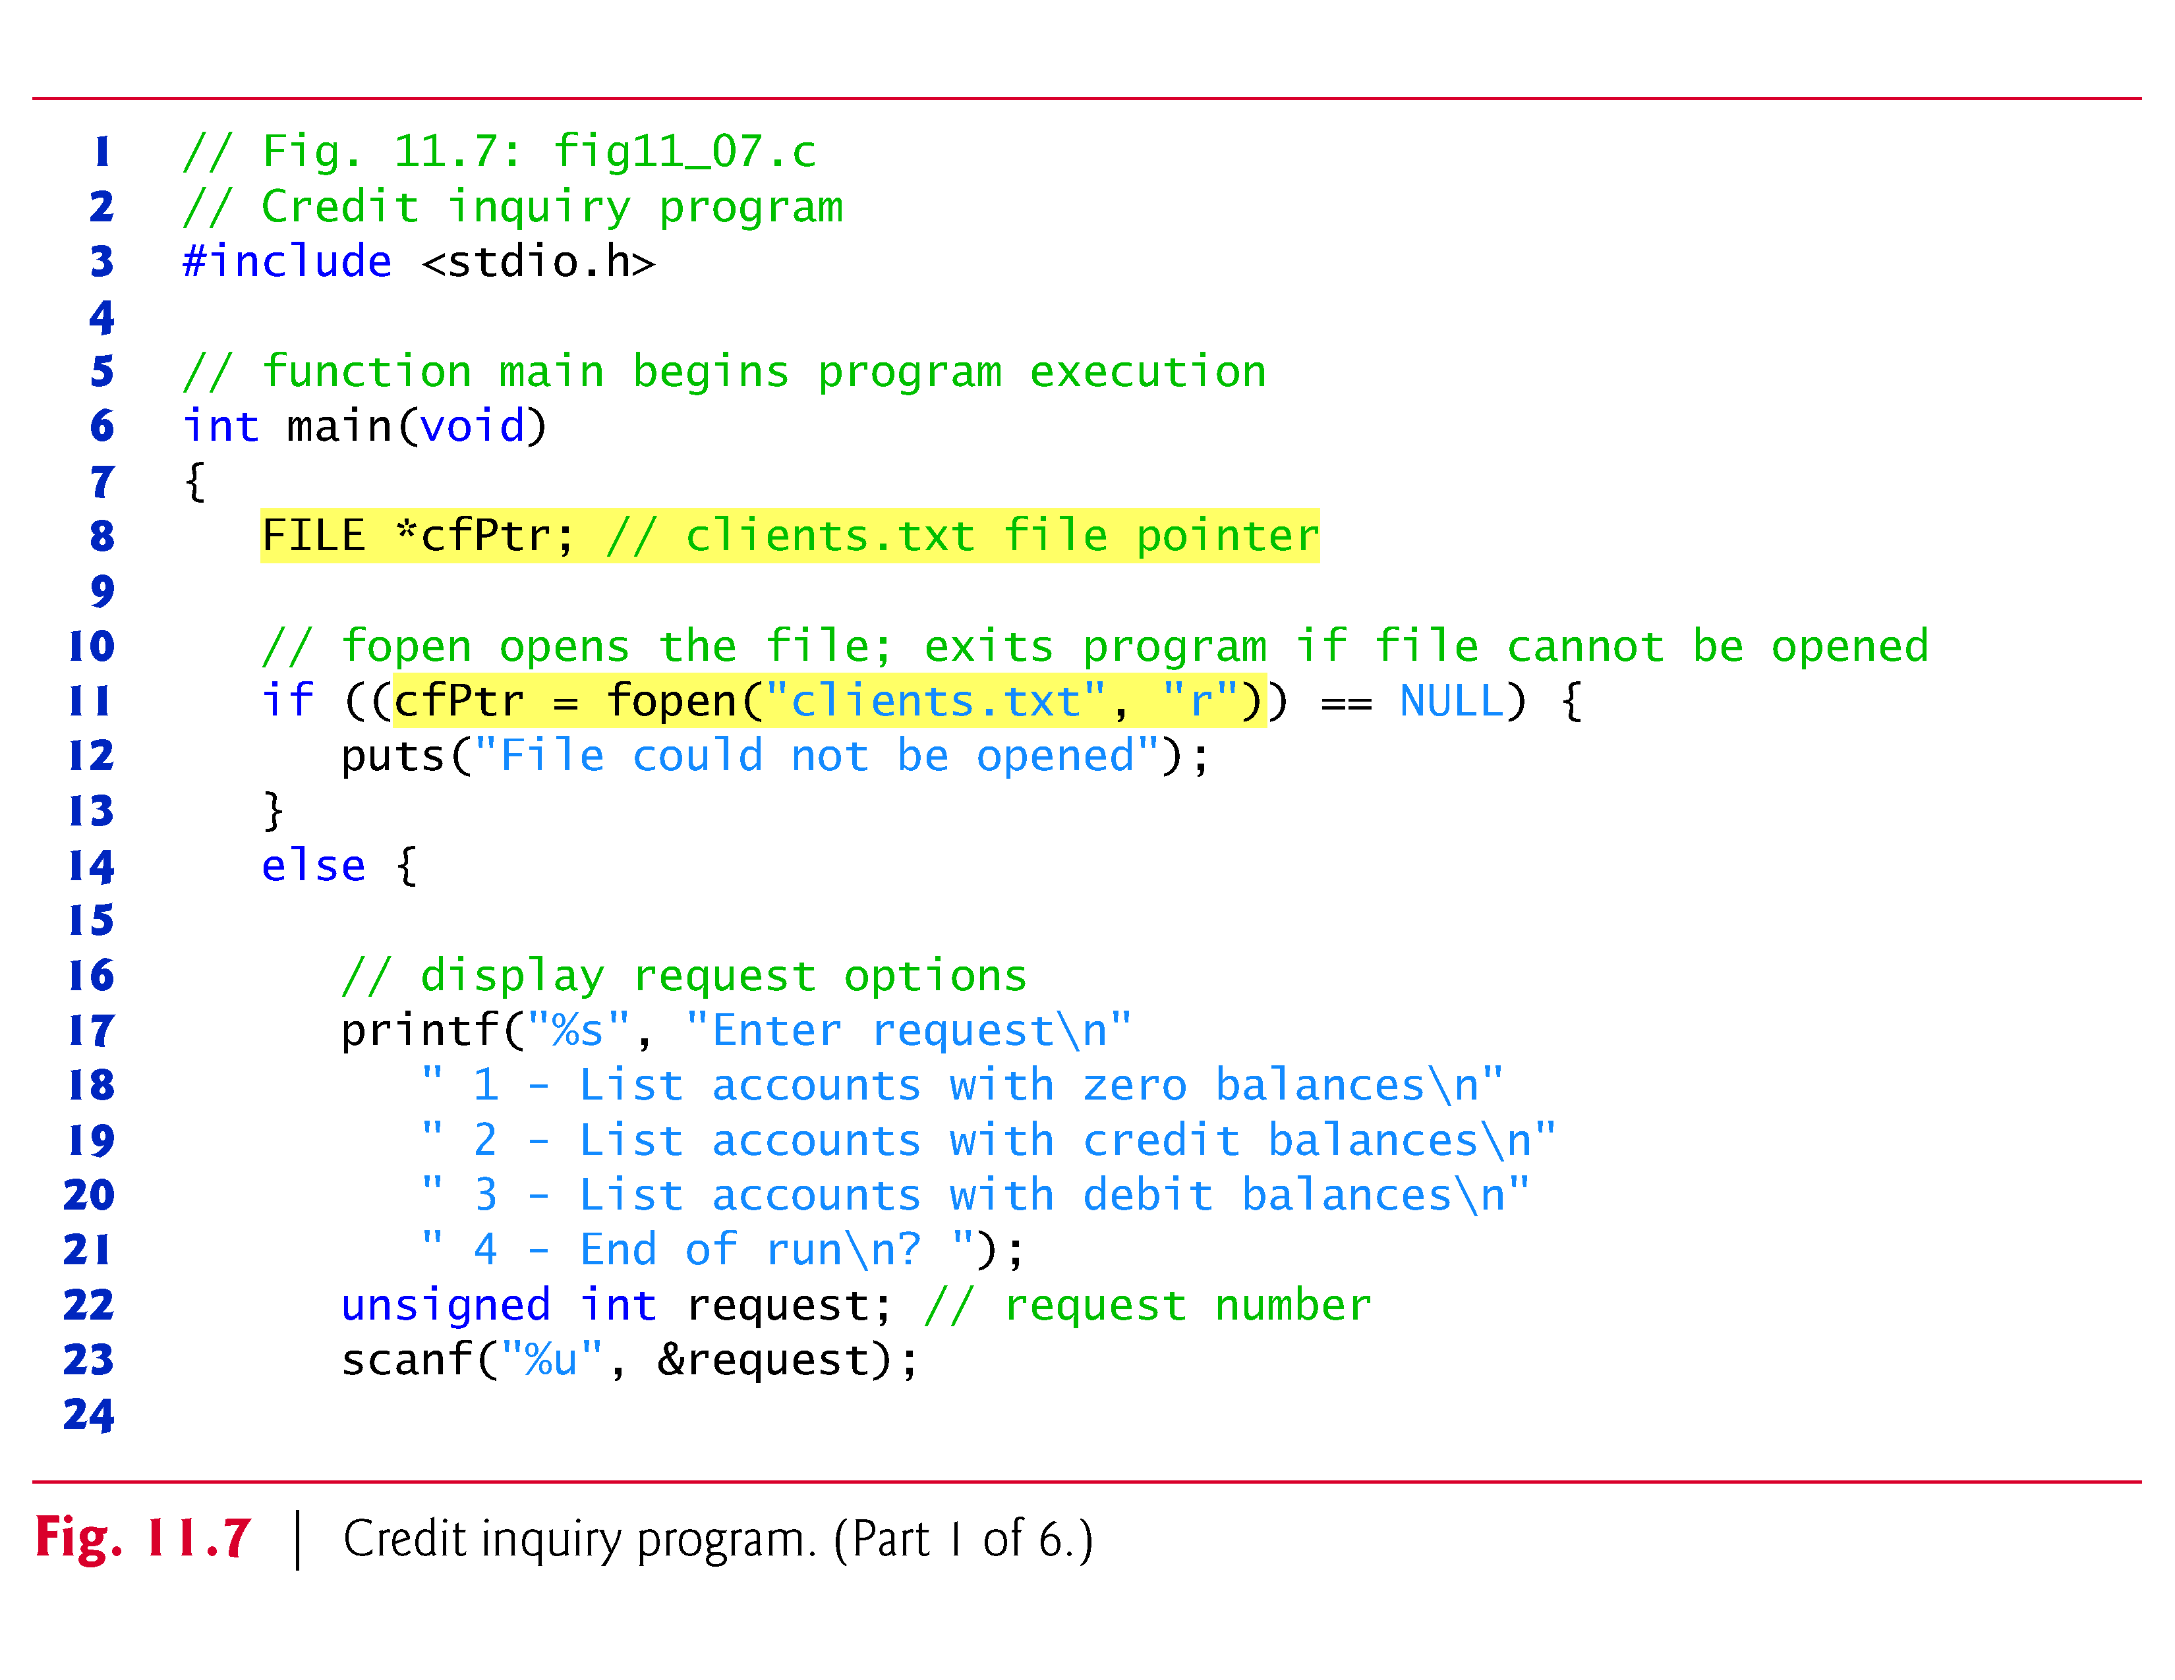

Slide 47
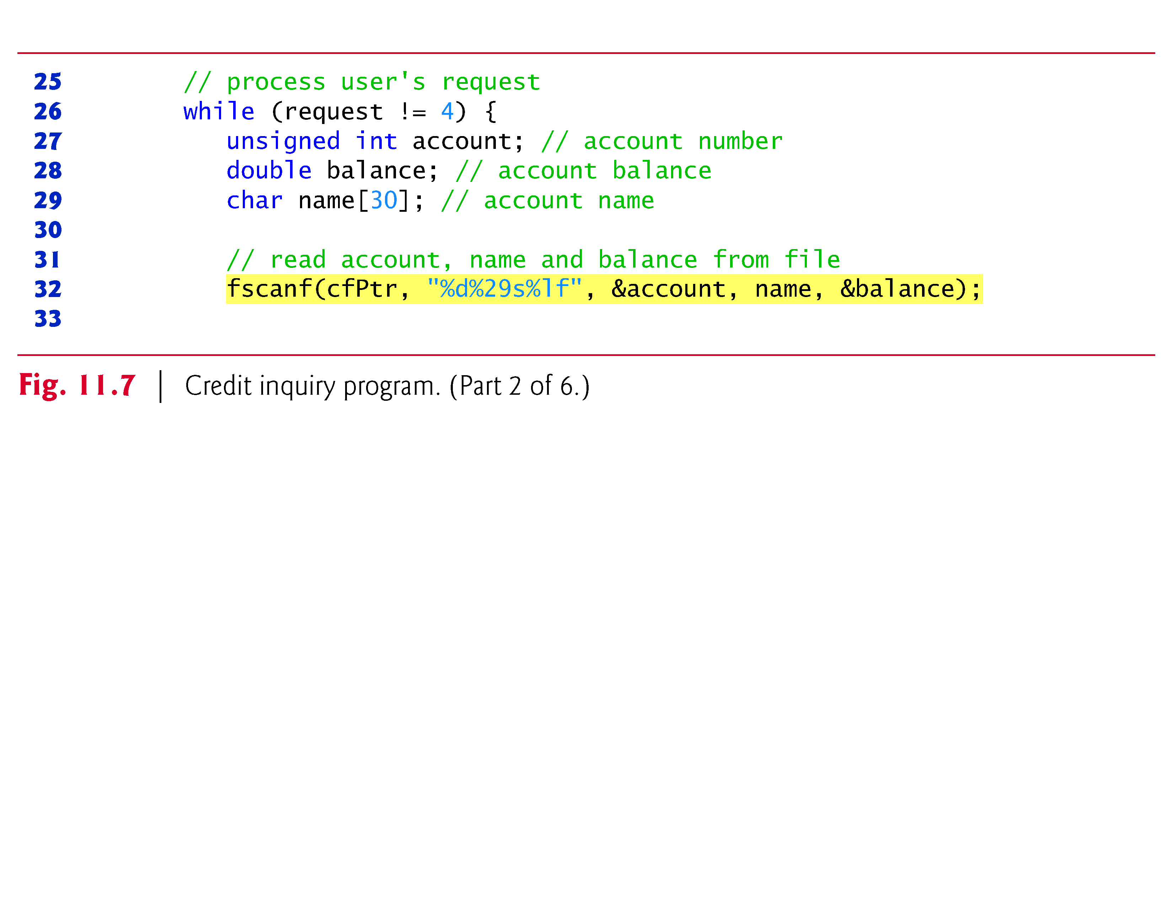

Slide 48
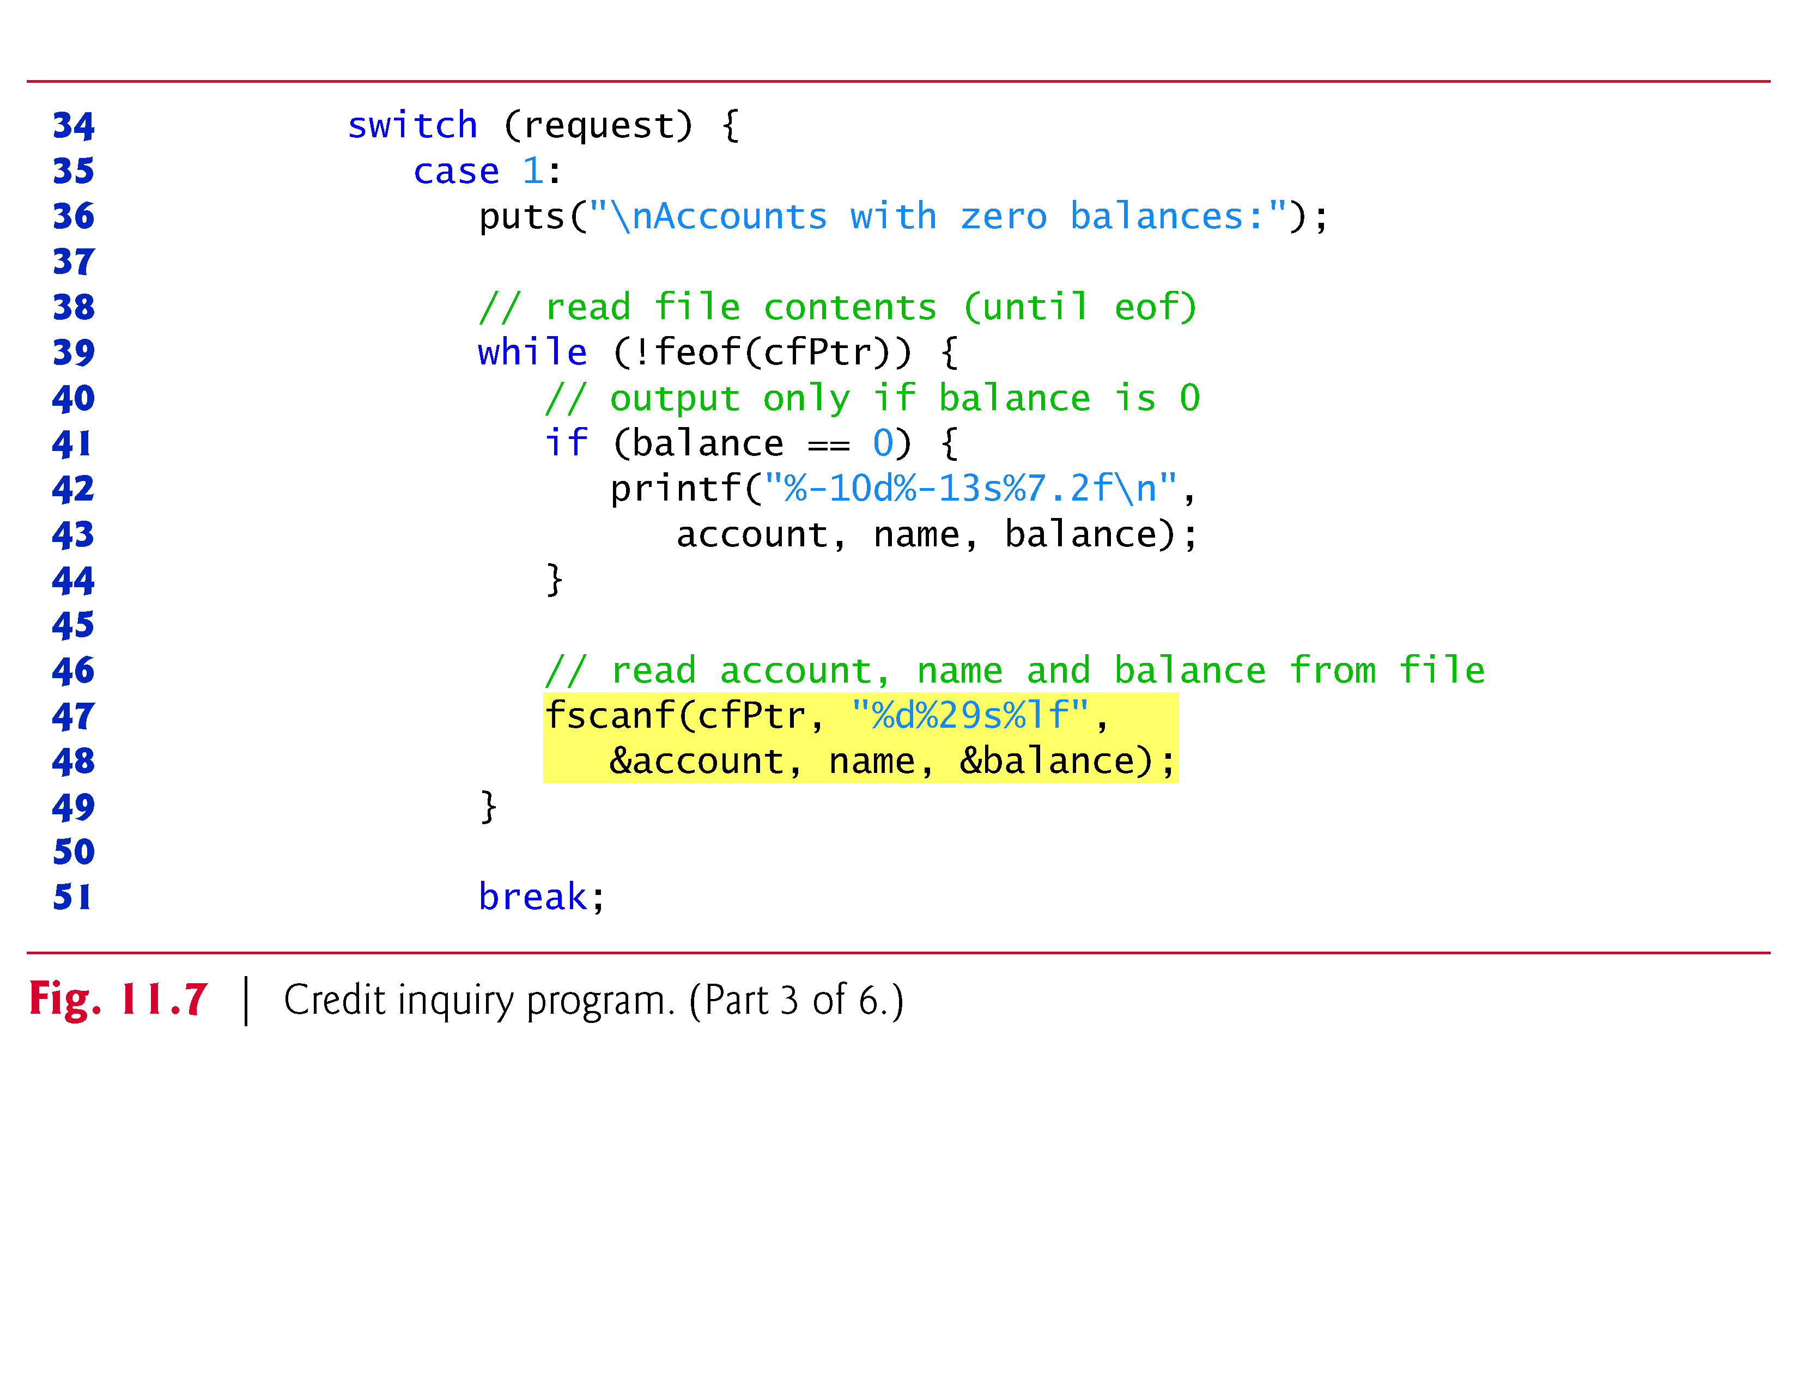

Slide 49
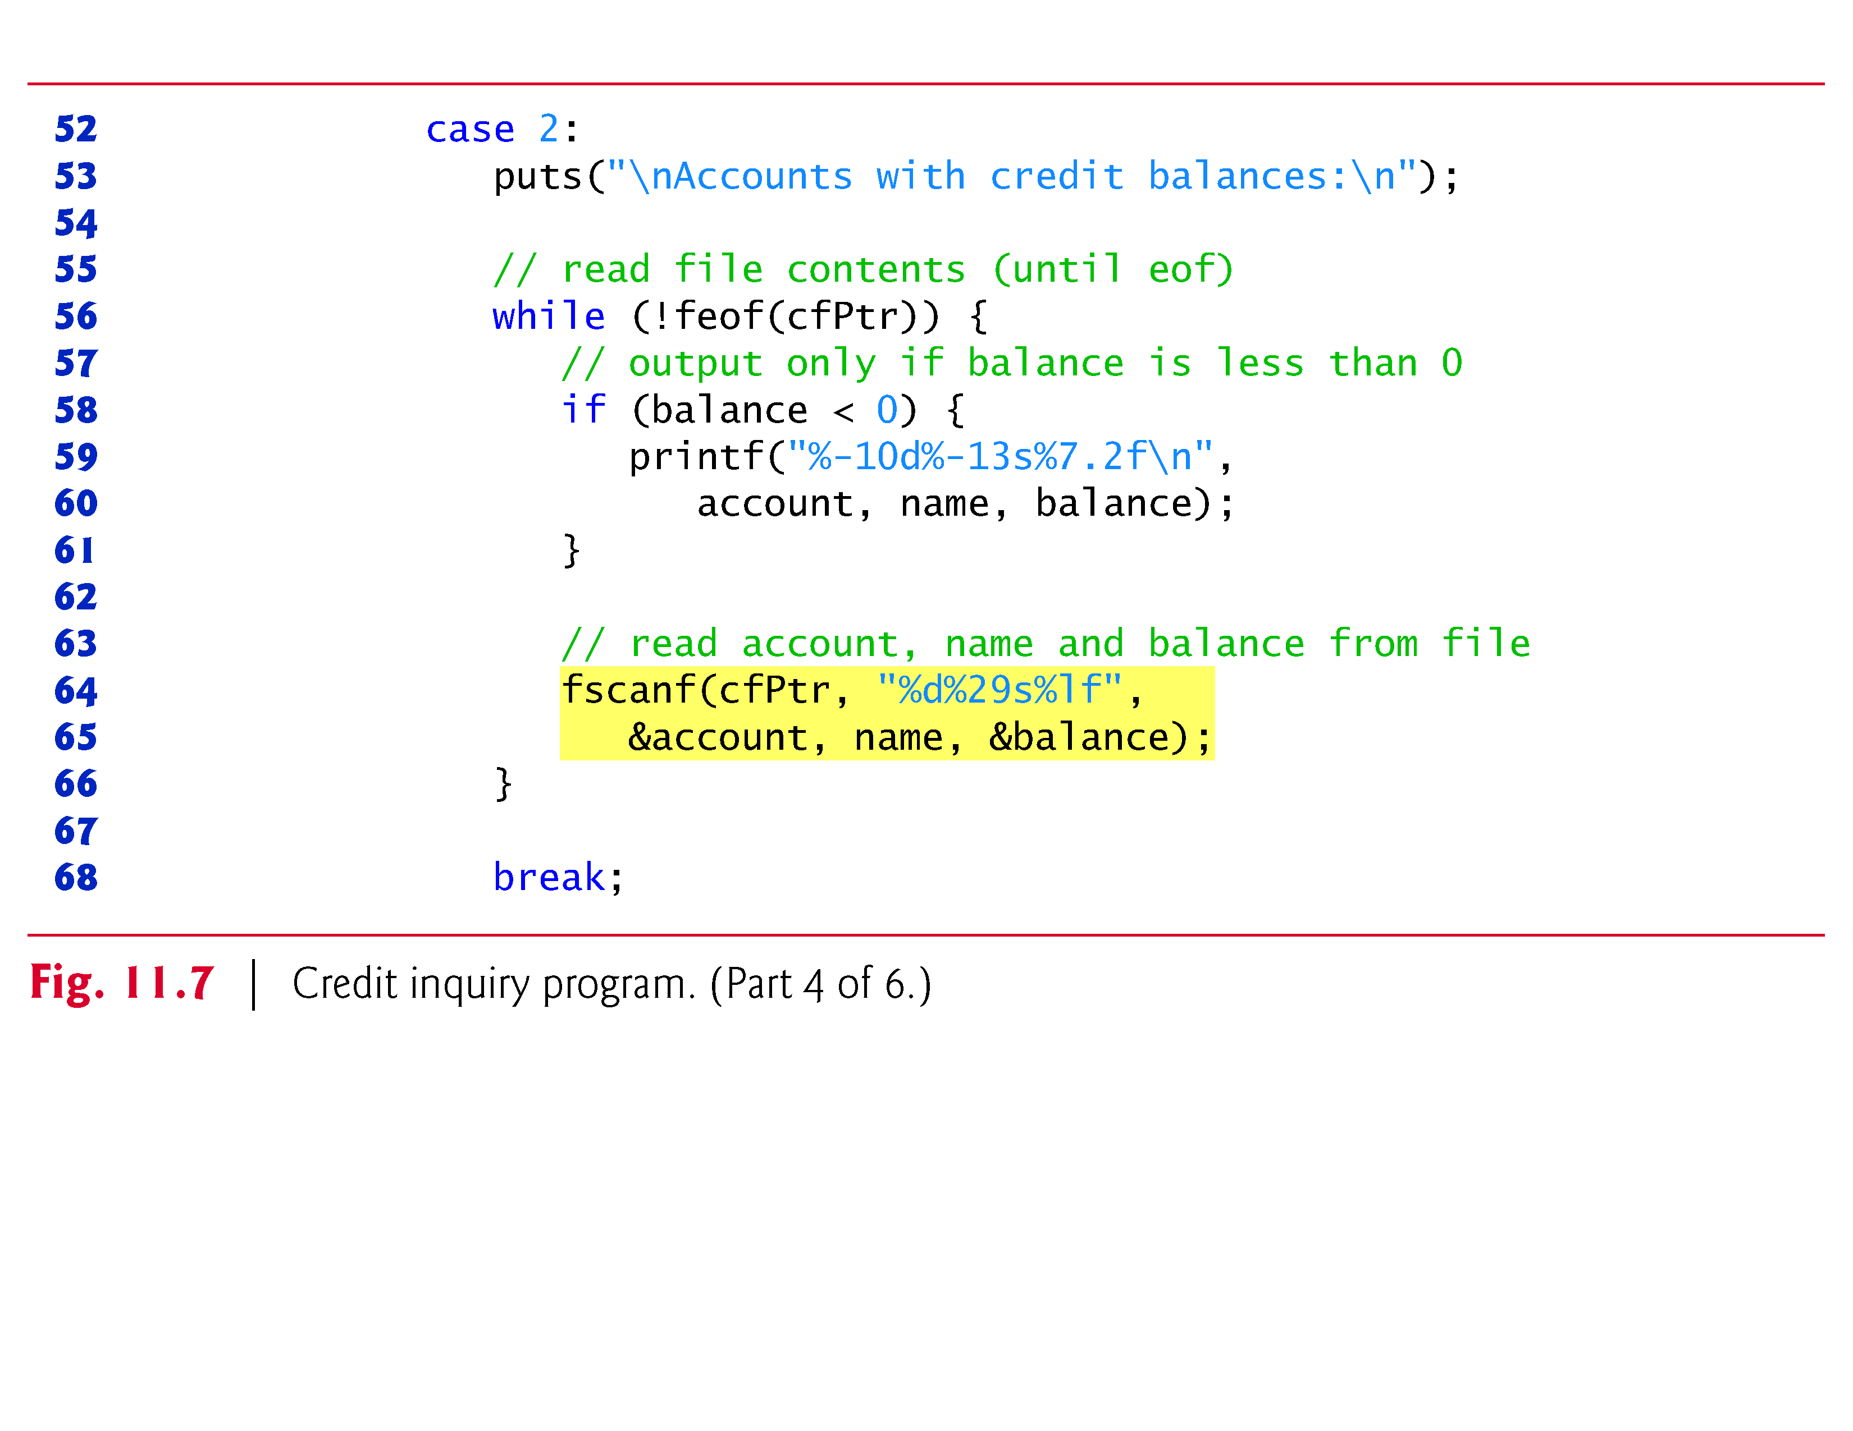

Slide 50
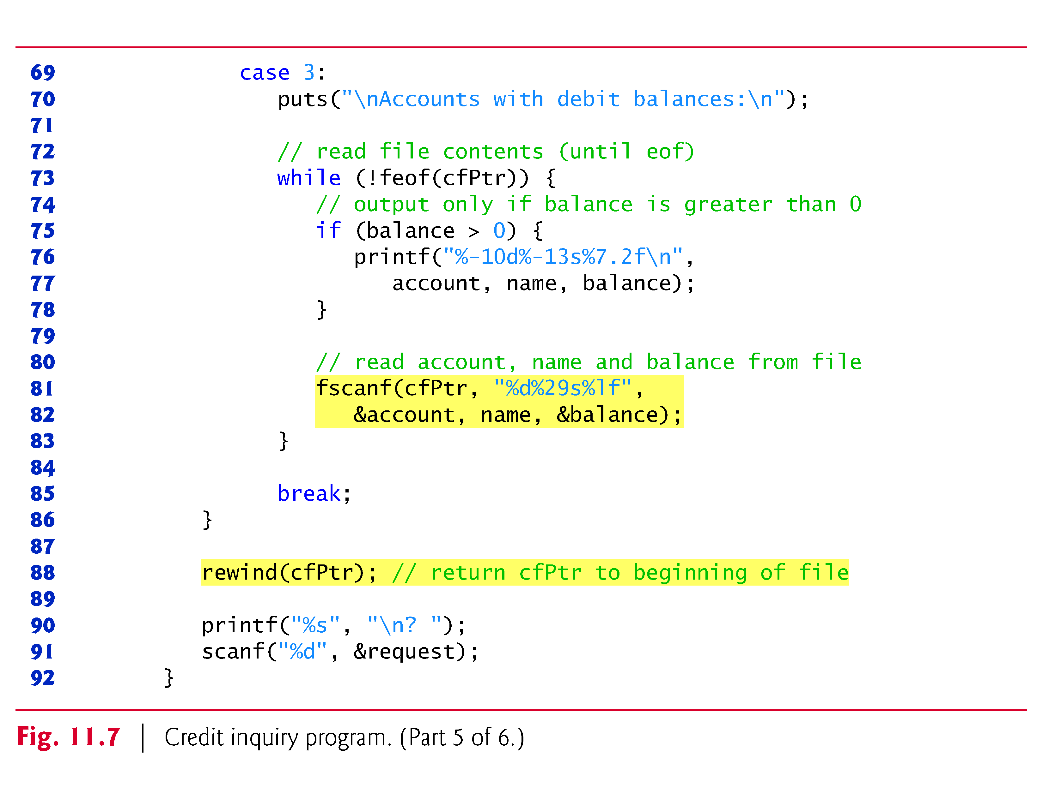

Slide 51
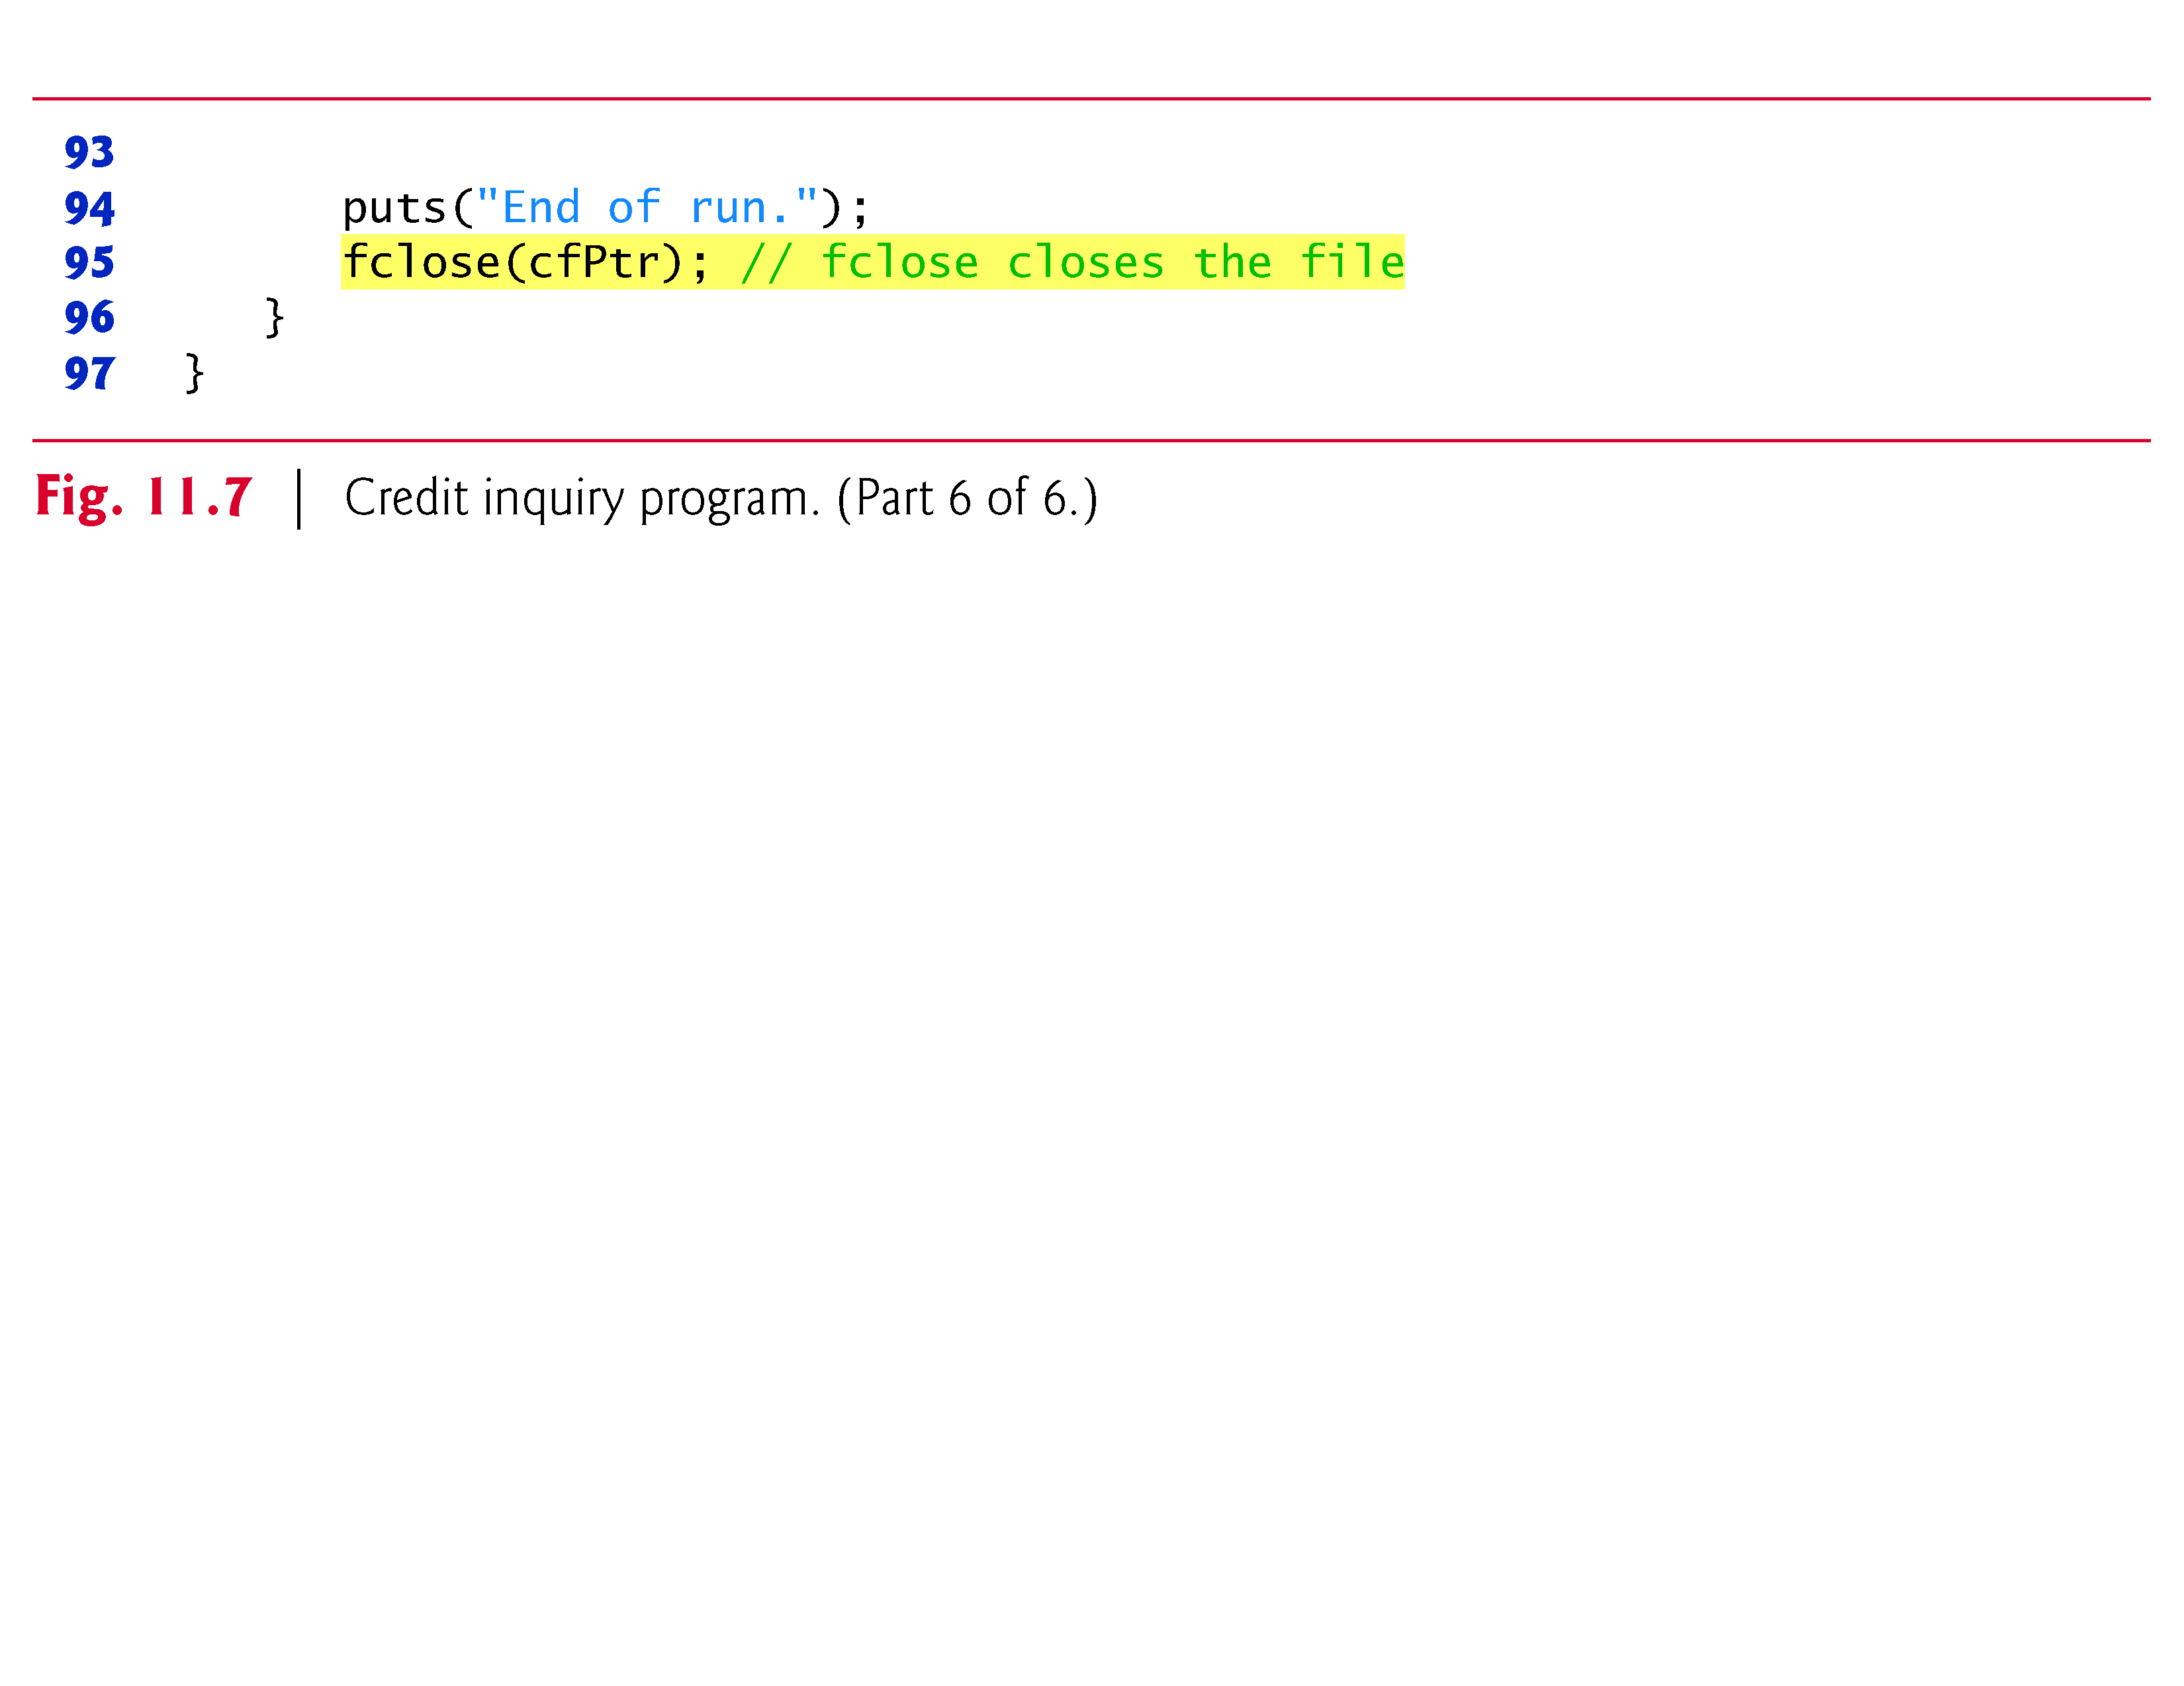

Slide 52
11.4 Reading Data from a Sequential-Access File (Cont.)
The program displays a menu and allows the credit manager to enter one of three options to obtain credit information.
Option 1 produces a list of accounts with zero balances.
Option 2 produces a list of accounts with credit balances.
Option 3 produces a list of accounts with debit balances.
Option 4 terminates program execution.
A sample output is shown in Fig. 11.8.

Slide 53
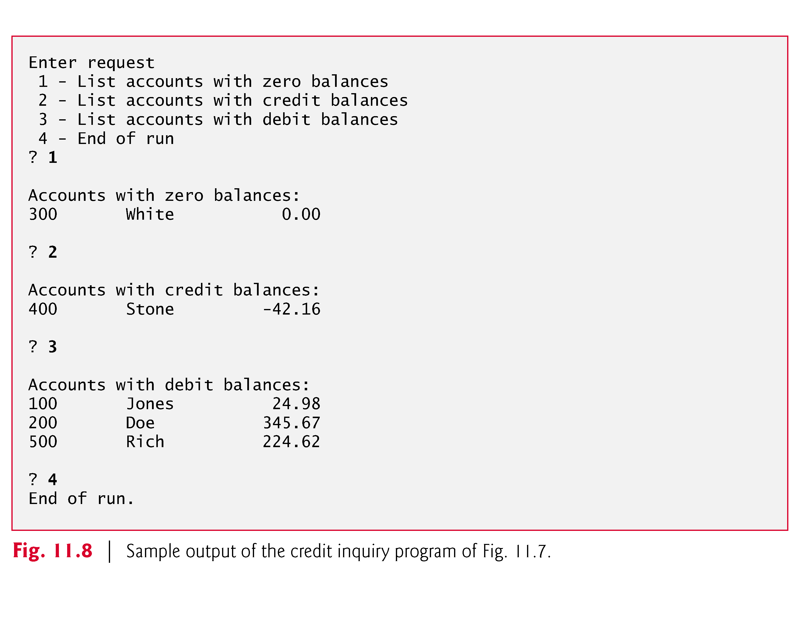

Slide 54
11.4 Reading Data from a Sequential-Access File (Cont.)
Data in this type of sequential file cannot be modified without the risk of destroying other data.
For example, if the name “White” needs to be changed to “Worthington,” the old name cannot simply be overwritten.
The record for White was written to the file as

Slide 55
11.4 Reading Data from a Sequential-Access File (Cont.)
If the record is rewritten beginning at the same location in the file using the new name, the record will be
300 Worthington 0.00
The new record is larger (has more characters) than the original record.
The characters beyond the second “o” in “Worthington” will overwrite the beginning of the next sequential record in the file.
The problem here is that in the formatted input/output model using fprintf and fscanf, fields—and hence records—can vary in size.

Slide 56
11.4 Reading Data from a Sequential-Access File (Cont.)
For example, the values 7, 14, –117, 2074 and 27383 are all ints stored in the same number of bytes internally, but they’re different-sized fields when displayed on the screen or written to a file as text.
Therefore, sequential access with fprintf and fscanf is not usually used to update records in place.
Instead, the entire file is usually rewritten.

Slide 57
11.4 Reading Data from a Sequential-Access File (Cont.)
To make the preceding name change, the records before 300 White 0.00 in such a sequential-access file would be copied to a new file, the new record would be written and the records after 300 White 0.00 would be copied to the new file.
This requires processing every record in the file to update one record.

Slide 58
11.5 Random-Access Files
As we stated previously, records in a file created with the formatted output function fprintf are not necessarily the same length.
However, individual records of a random-access file are normally fixed in length and may be accessed directly (and thus quickly) without searching through other records.
This makes random-access files appropriate for airline reservation systems, banking systems, point-of-sale systems, and other kinds of transaction-processing systems that require rapid access to specific data.

Slide 59
11.5 Random-Access Files (Cont.)
There are other ways of implementing random-access files, but we’ll limit our discussion to this straightforward approach using fixed-length records.
Because every record in a random-access file normally has the same length, the exact location of a record relative to the beginning of the file can be calculated as a function of the record key.
We’ll soon see how this facilitates immediate access to specific records, even in large files.
Figure 11.9 illustrates one way to implement a random-access file.
Such a file is like a freight train with many cars—some empty and some with cargo.

Slide 60
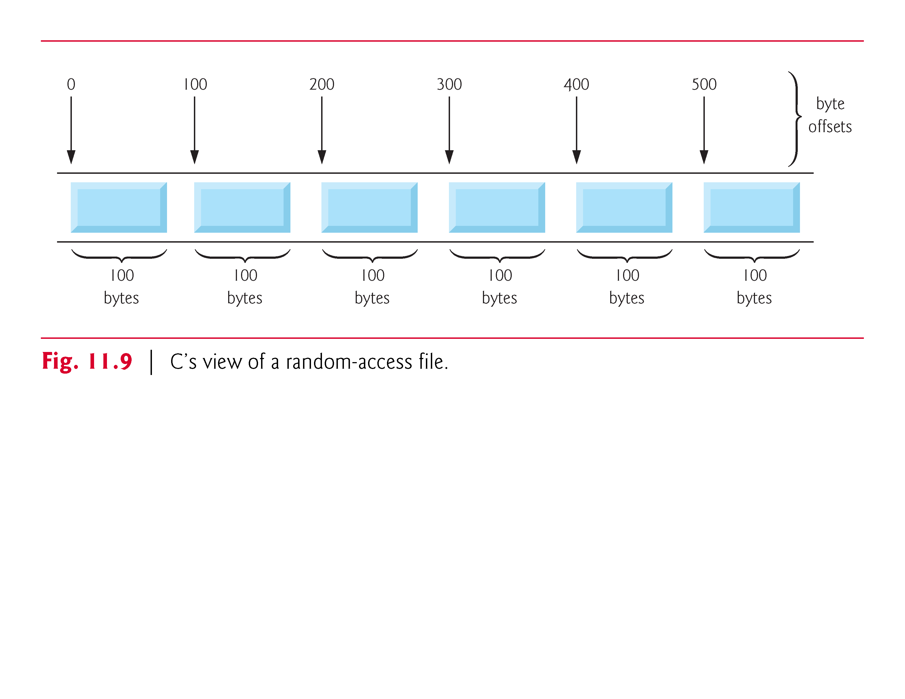

Slide 61
11.5 Random-Access Files (Cont.)
Fixed-length records enable data to be inserted in a random-access file without destroying other data in the file.
Data stored previously can also be updated or deleted without rewriting the entire file.

Slide 62
11.6 Creating a Random-Access File
Function fwrite transfers a specified number of bytes beginning at a specified location in memory to a file.
The data is written beginning at the location in the file indicated by the file position pointer.
Function fread transfers a specified number of bytes from the location in the file specified by the file position pointer to an area in memory beginning with a specified address.

Slide 63
11.6 Creating a Random-Access File (Cont.)
Now, when writing an integer, instead of using
fprintf(fPtr, "%d", number);
which could print a single digit or as many as 11 digits (10 digits plus a sign, each of which requires 1 byte of storage) for a four-byte integer, we can use
fwrite(&number, sizeof(int), 1, fPtr);
which always writes four bytes on a system with four-byte integers from a variable number to the file represented by fPtr (we’ll explain the 1 argument shortly).

Slide 64
11.6 Creating a Random-Access File (Cont.)
Later, fread can be used to read those four bytes into an integer variable number.
Although fread and fwrite read and write data, such as integers, in fixed-size rather than variable-size format, the data they handle are processed in computer “raw data” format (i.e., bytes of data) rather than in printf’s and scanf’s human-readable text format.
Because the “raw” representation of data is system dependent, “raw data” may not be readable on other systems, or by programs produced by other compilers or with other compiler options.

Slide 65
11.6 Creating a Random-Access File (Cont.)
Functions fwrite and fread are capable of reading and writing arrays of data to and from disk.
The third argument of both fread and fwrite is the number of elements in the array that should be read from or written to disk.
The preceding fwrite function call writes a single integer to disk, so the third argument is 1 (as if one element of an array is being written).
File-processing programs rarely write a single field to a file.
Normally, they write one struct at a time, as we show in the following examples.

Slide 66
11.6 Creating a Random-Access File (Cont.)
Consider the following problem statement:
Create a credit-processing system capable of storing up to 100 fixed-length records. Each record should consist of an account number that will be used as the record key, a last name, a first name and a balance. The resulting program should be able to update an account, insert a new account record, delete an account and list all the account records in a formatted text file for printing. Use a random-access file.
The next several sections introduce the techniques necessary to create the credit-processing program.

Slide 67
11.7 Creating a Random-Access File (Cont.)
Figure 11.10 shows how to open a random-access file, define a record format using a struct, write data to the disk and close the file.
This program initializes all 100 records of the file "credit.dat" with empty structs using the function fwrite.
Each empty struct contains 0 for the account number, "" (the empty string) for the last name, "" for the first name and 0.0 for the balance.
The file is initialized in this manner to create space on the disk in which the file will be stored and to make it possible to determine whether a record contains data.

Slide 68
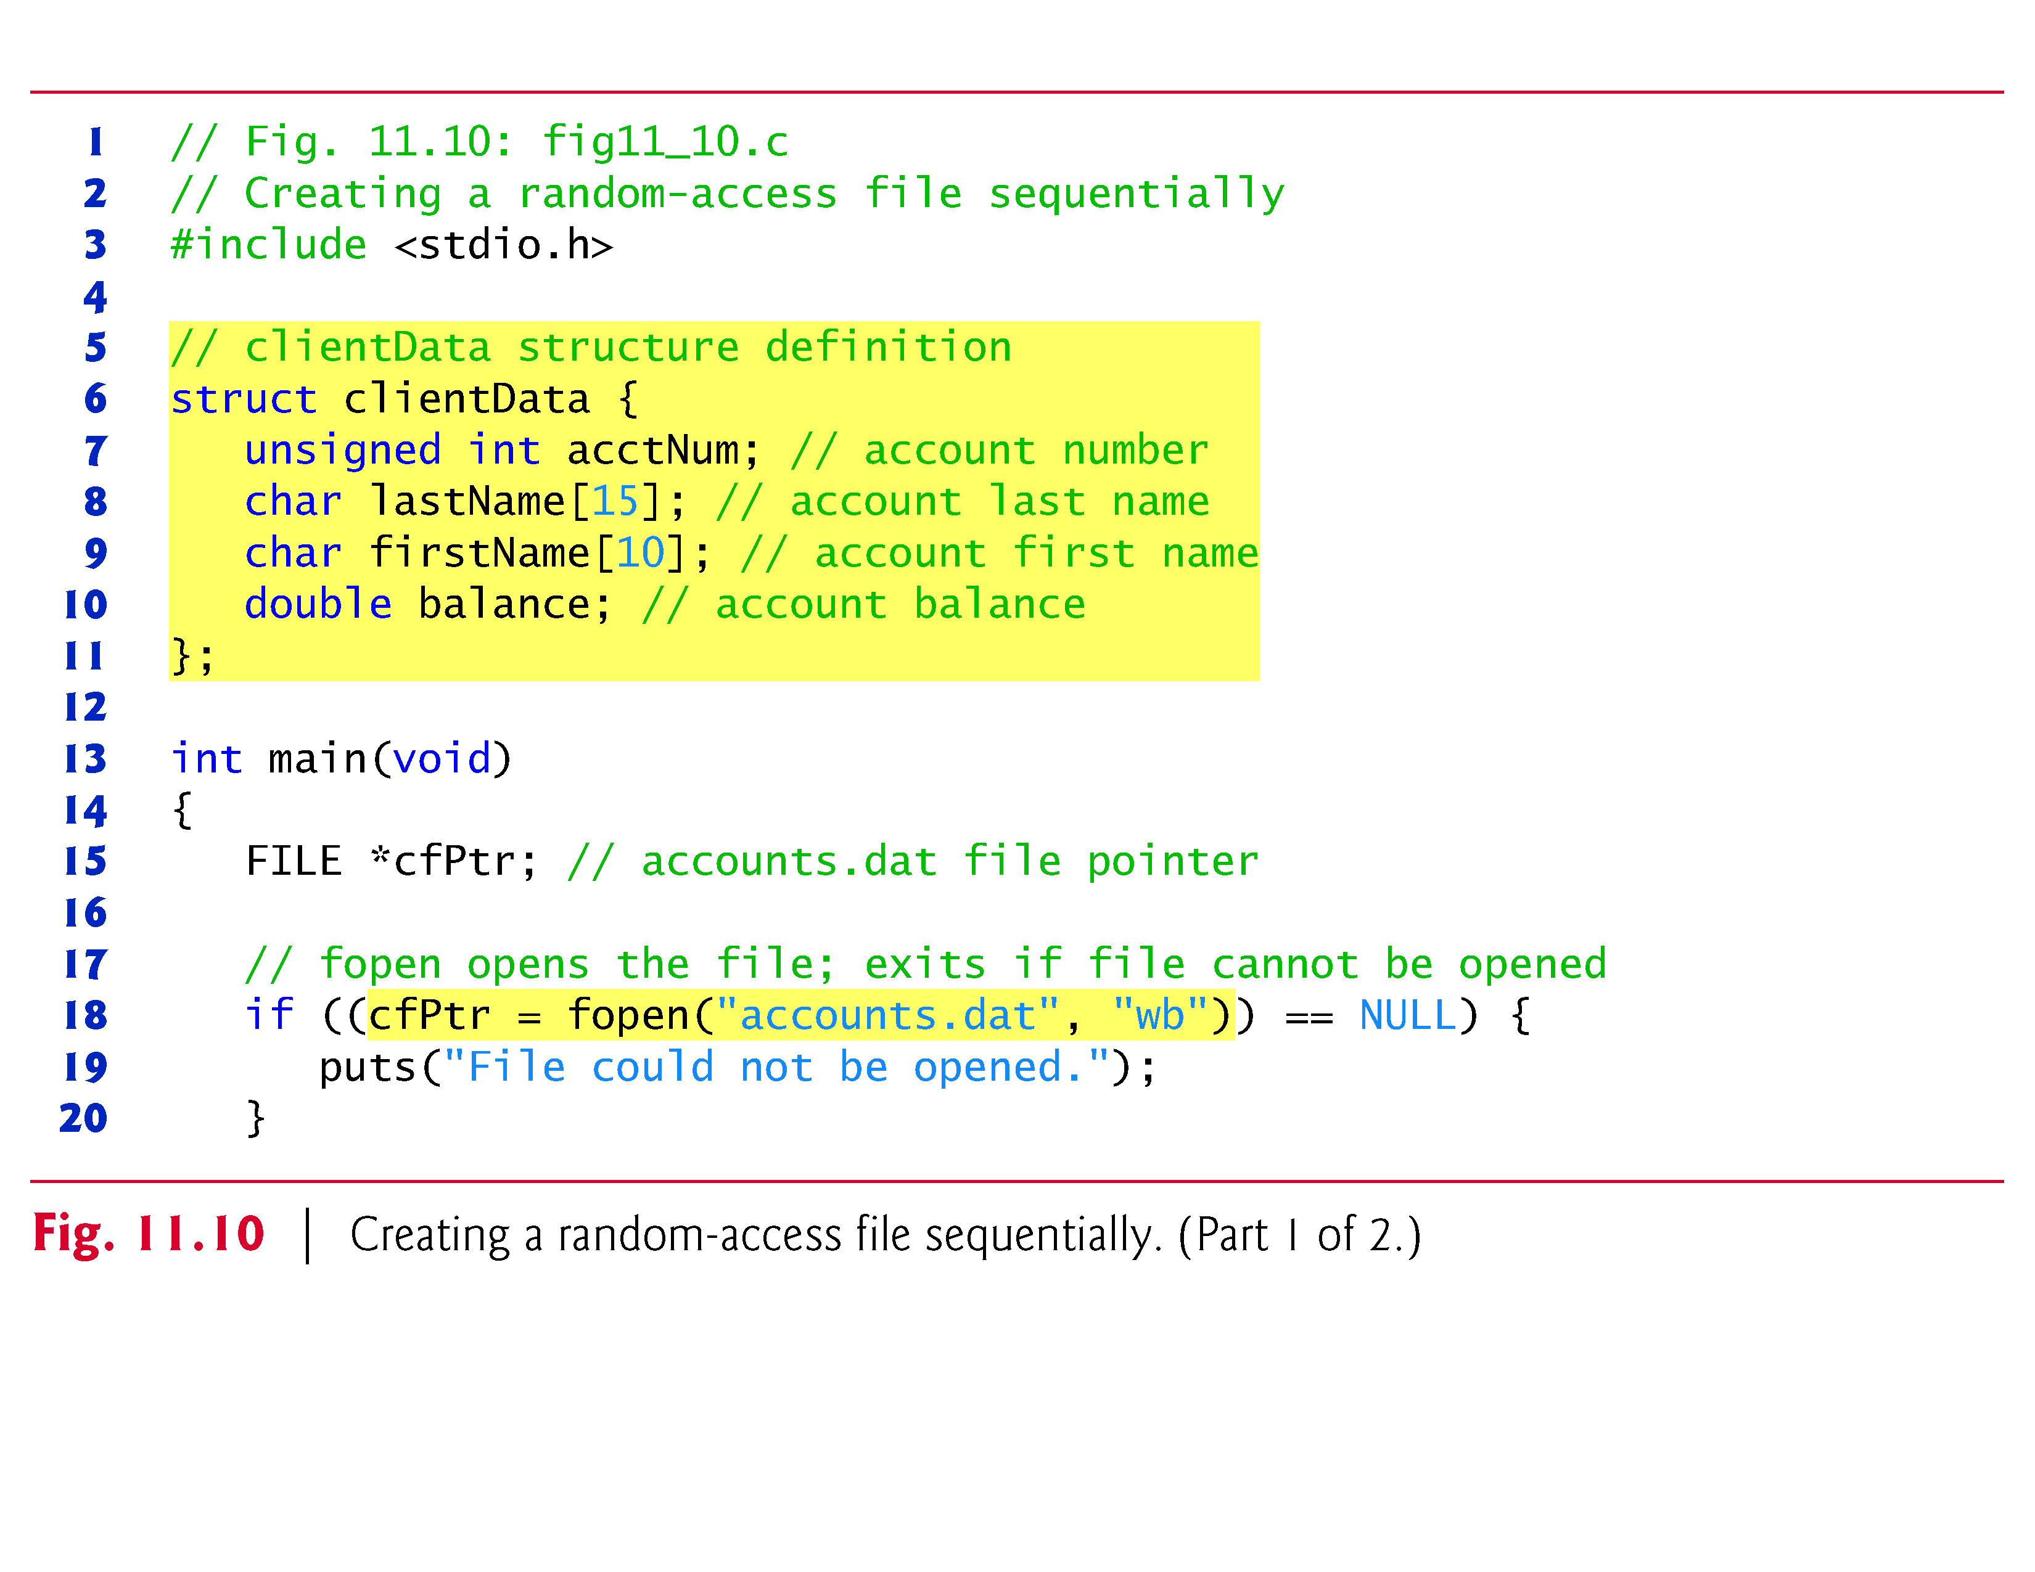

Slide 69
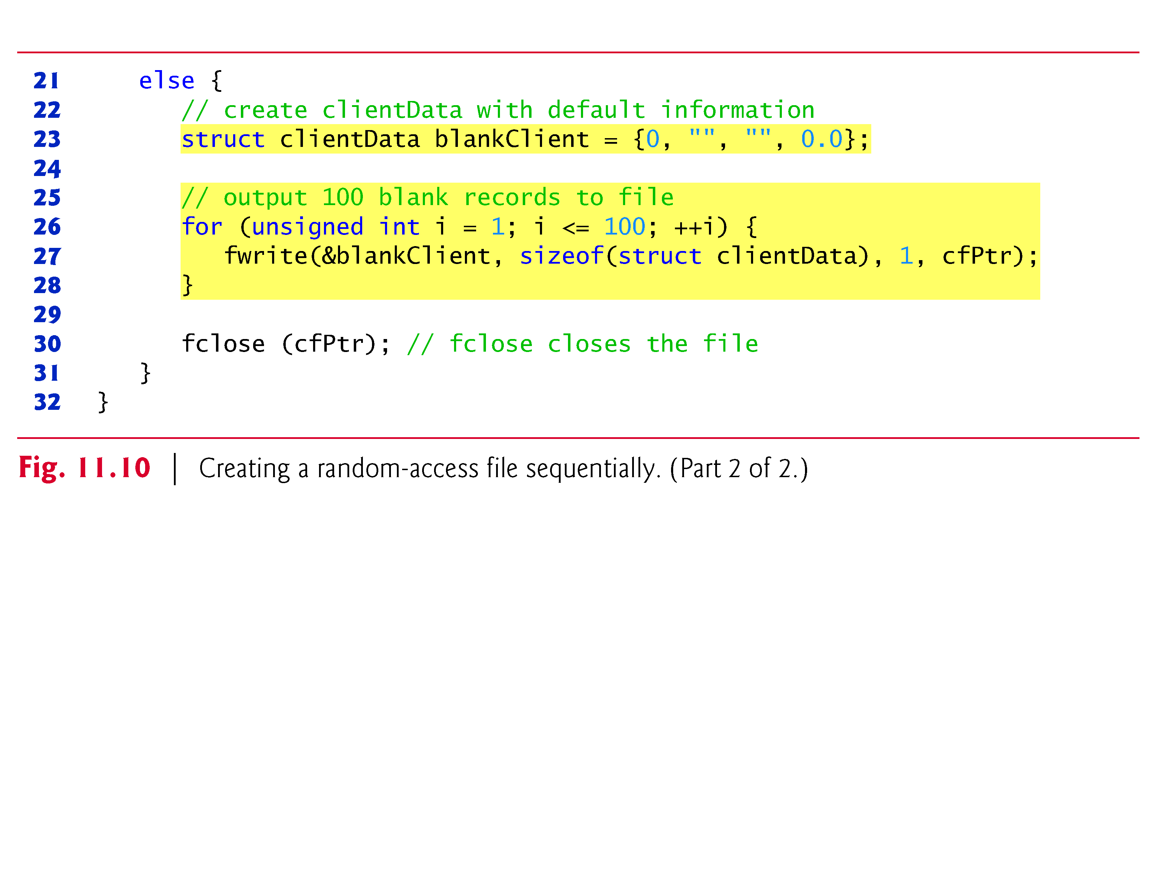

Slide 70
11.6 Creating a Random-Access File (Cont.)
Function fwrite writes a block bytes to a file.
Line 27 causes the structure blankClient of size sizeof(struct clientData) to be written to the file pointed to by cfPtr.
The operator sizeof returns the size in bytes of its operand in parentheses (in this case struct clientData).
Function fwrite can actually be used to write several elements of an array of objects.

Slide 71
11.6 Creating a Random-Access File (Cont.)
To do so, supply in the call to fwrite a pointer to an array as the first argument and the number of elements to be written as the third argument.
In the preceding statement, fwrite was used to write a single object that was not an array element.

Slide 72
11.6 Creating a Random-Access File (Cont.)
Writing a single object is equivalent to writing one element of an array, hence the 1 in the fwrite call.
[Note: Figures 11.11, 11.14 and 11.15 use the data file created in Fig. 11.10, so you must run Fig. 11.10 before Figs. 11.11, 11.14 and 11.15]

Slide 73
11.7 Writing Data Randomly to a Random-Access File
Figure 11.11 writes data to the file "credit.dat".
It uses the combination of fseek and fwrite to store data at specific locations in the file.
Function fseek sets the file position pointer to a specific position in the file, then fwrite writes the data.
A sample execution is shown in Fig. 11.12.

Slide 74
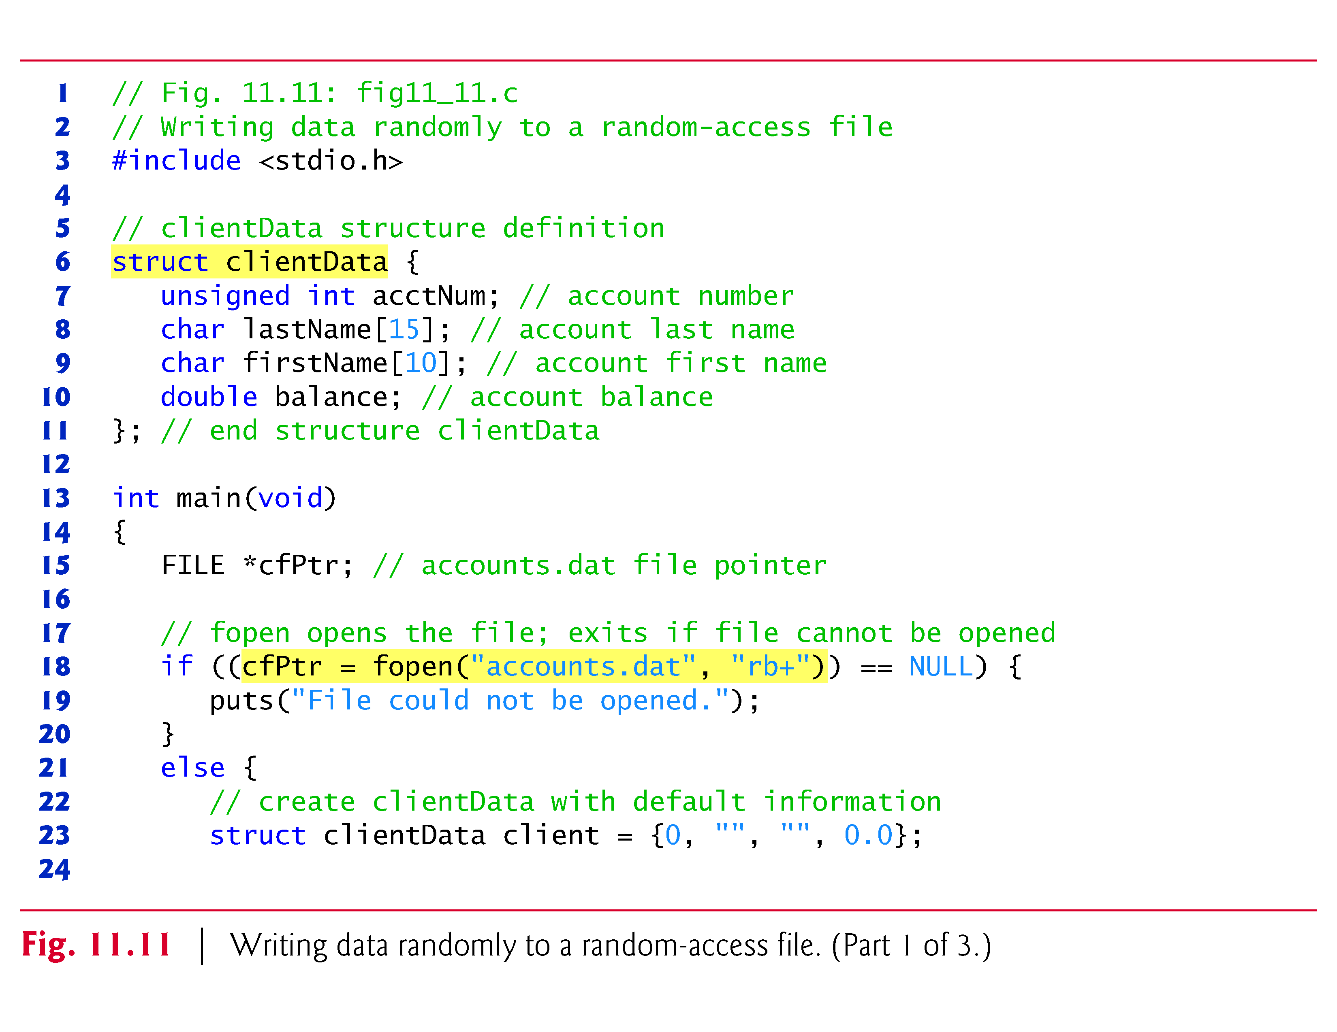

Slide 75
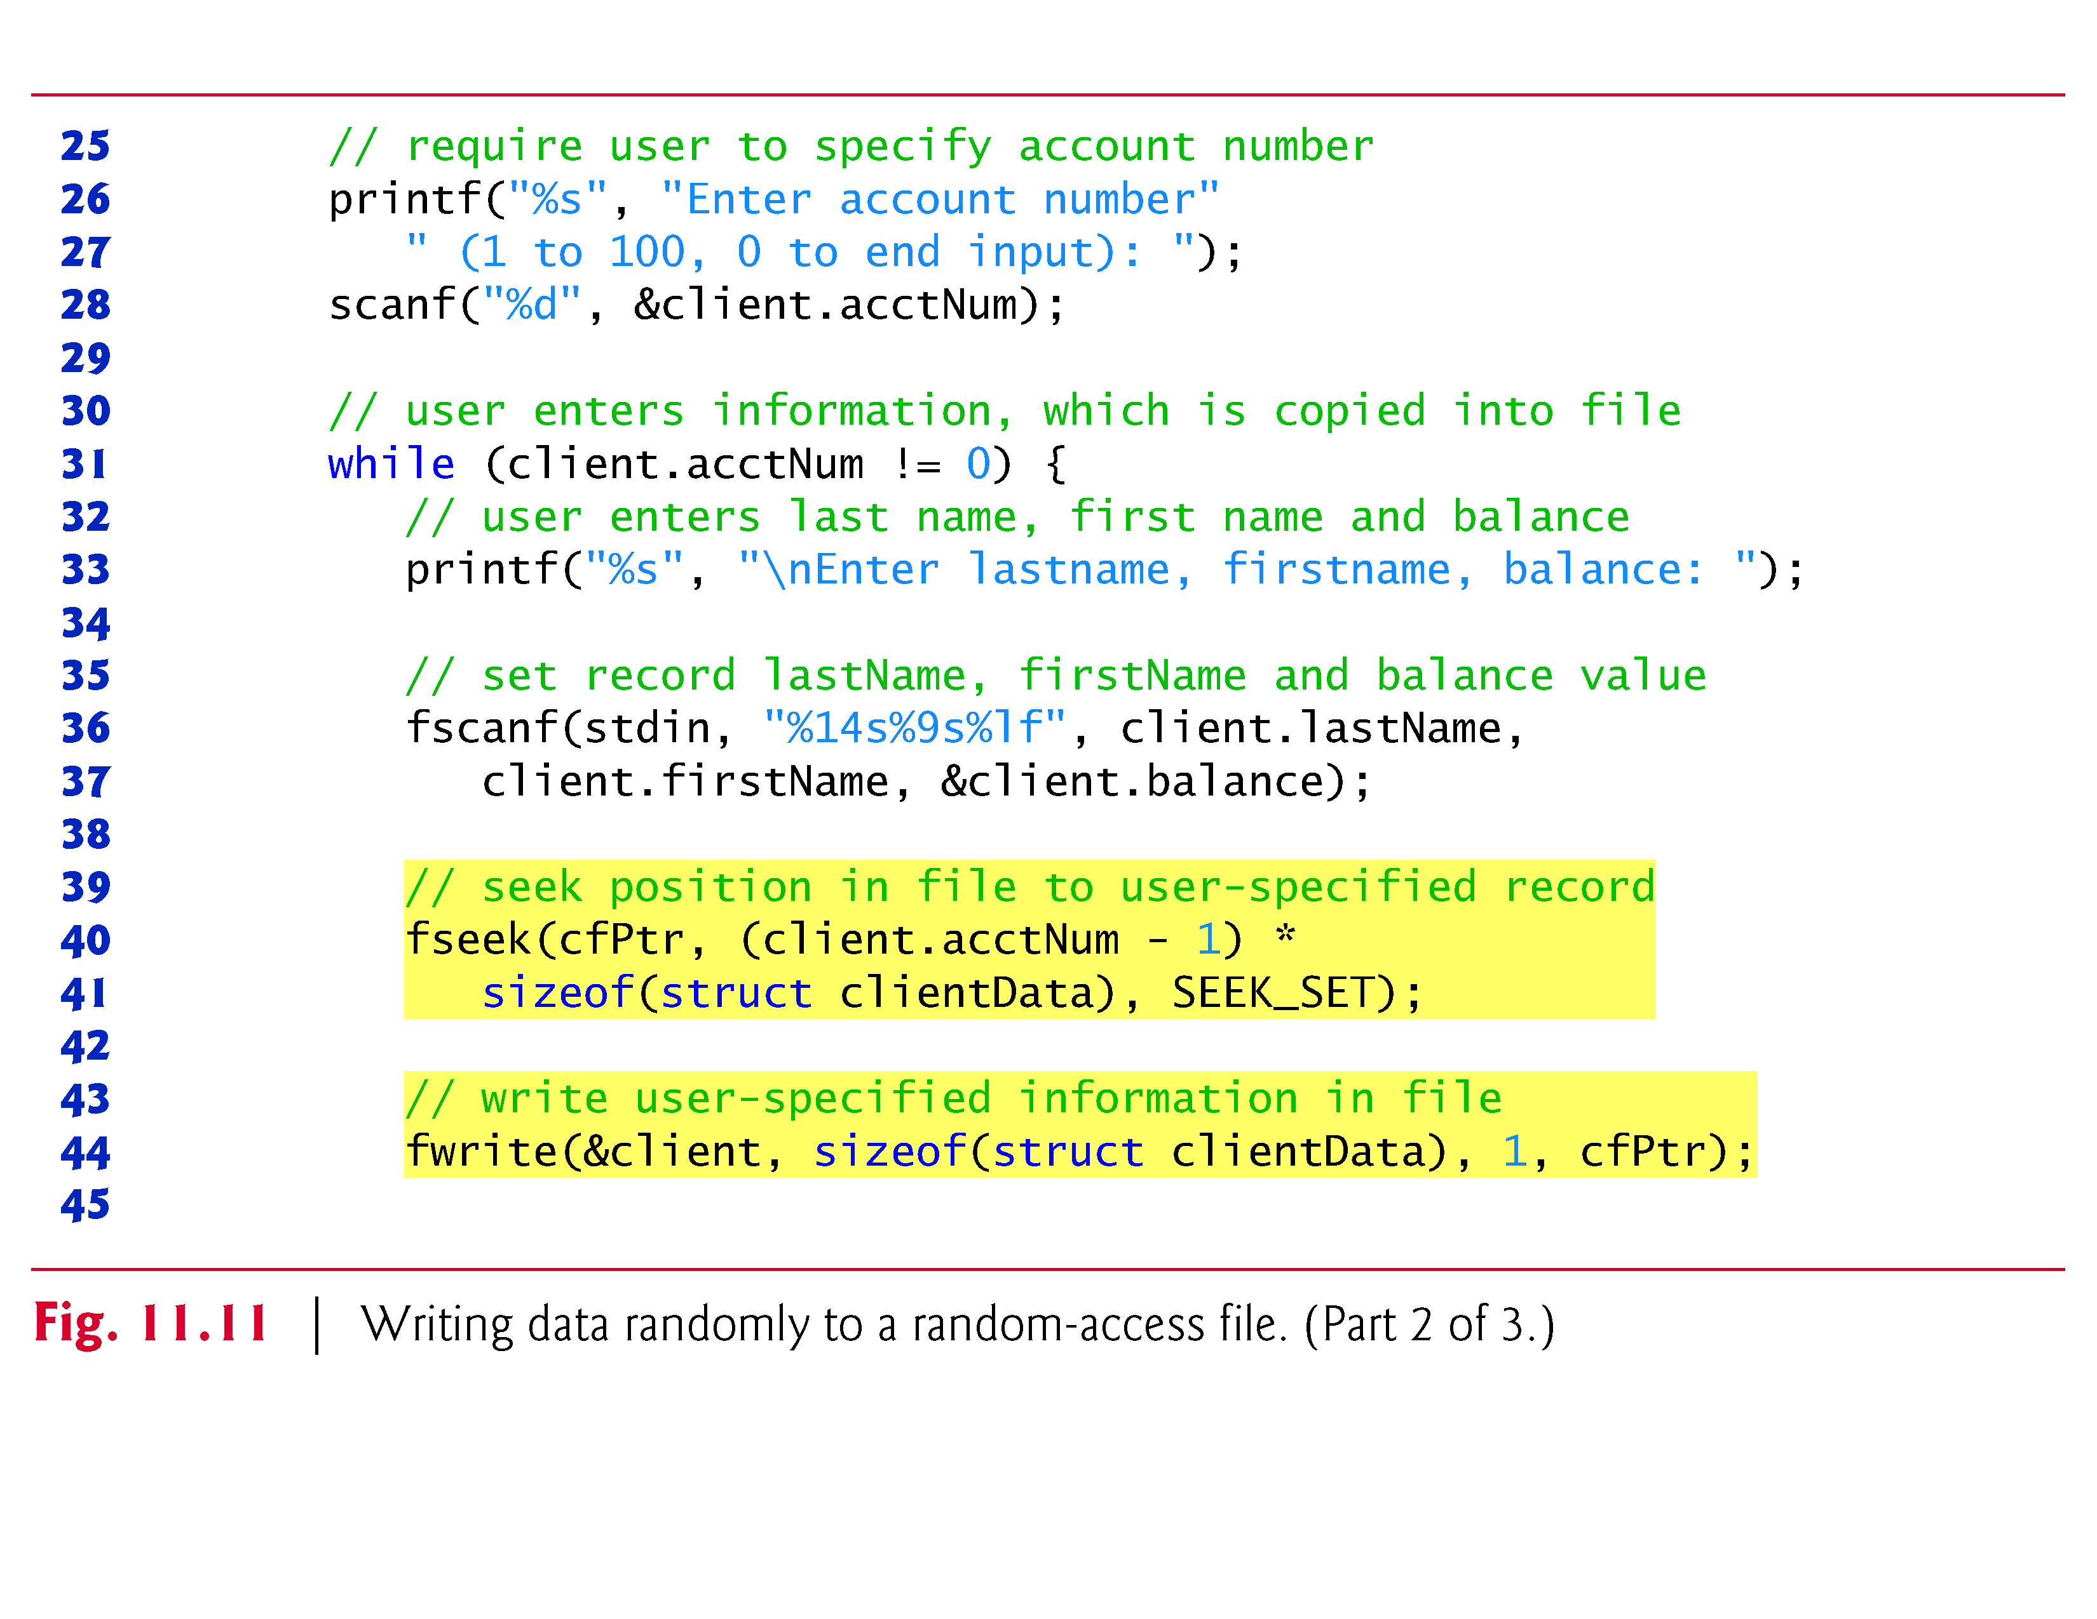

Slide 76
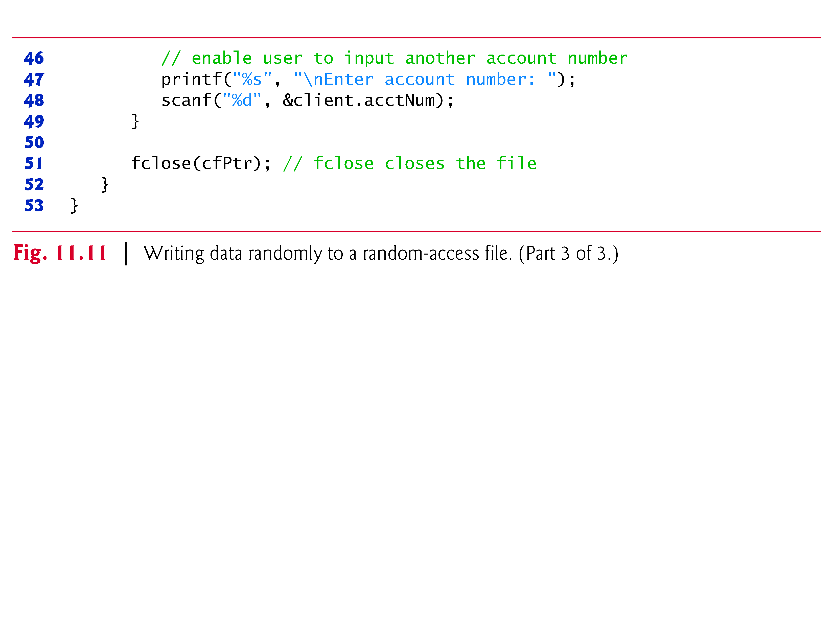

Slide 77
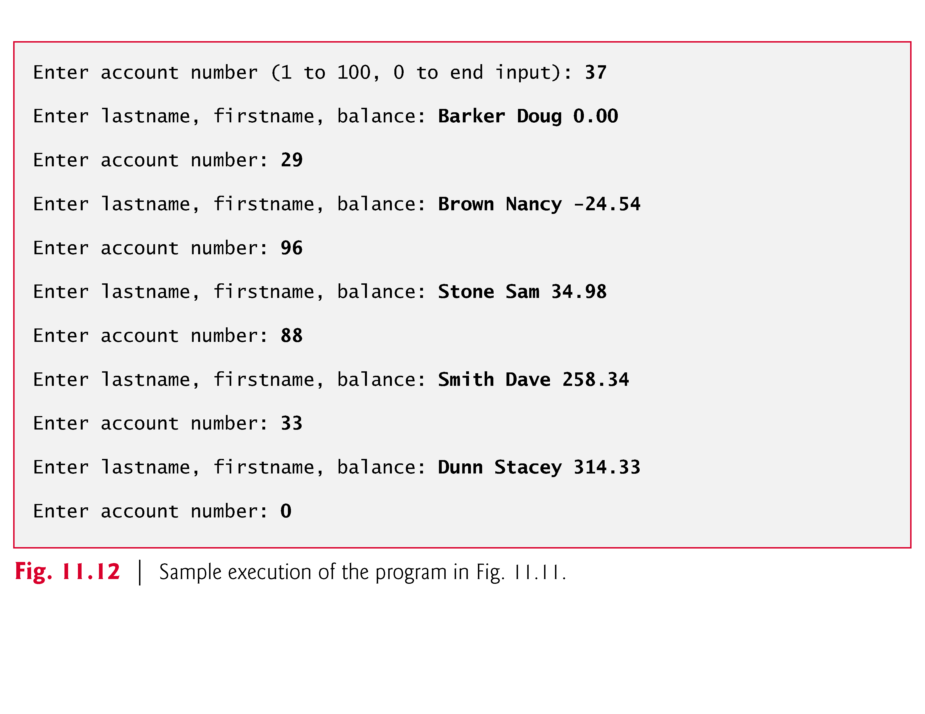

Slide 78
11.7 Writing Data Randomly to a Random-Access File (Cont.)
Lines 40–41 position the file position pointer for the file referenced by cfPtr to the byte location calculated by (client.accountNum - 1) * sizeof(struct clientData).
The value of this expression is called the offset or the displacement.
Because the account number is between 1 and 100 but the byte positions in the file start with 0, 1 is subtracted from the account number when calculating the byte location of the record.

Slide 79
11.7 Writing Data Randomly to a Random-Access File (Cont.)
Thus, for record 1, the file position pointer is set to byte 0 of the file.
The symbolic constant SEEK_SET indicates that the file position pointer is positioned relative to the beginning of the file by the amount of the offset.
As the above statement indicates, a seek for account number 1 in the file sets the file position pointer to the beginning of the file because the byte location calculated is 0.
Figure 11.13 illustrates the file pointer referring to a FILE structure in memory.
The file position pointer here indicates that the next byte to be read or written is 5 bytes from the beginning of the file.

Slide 80
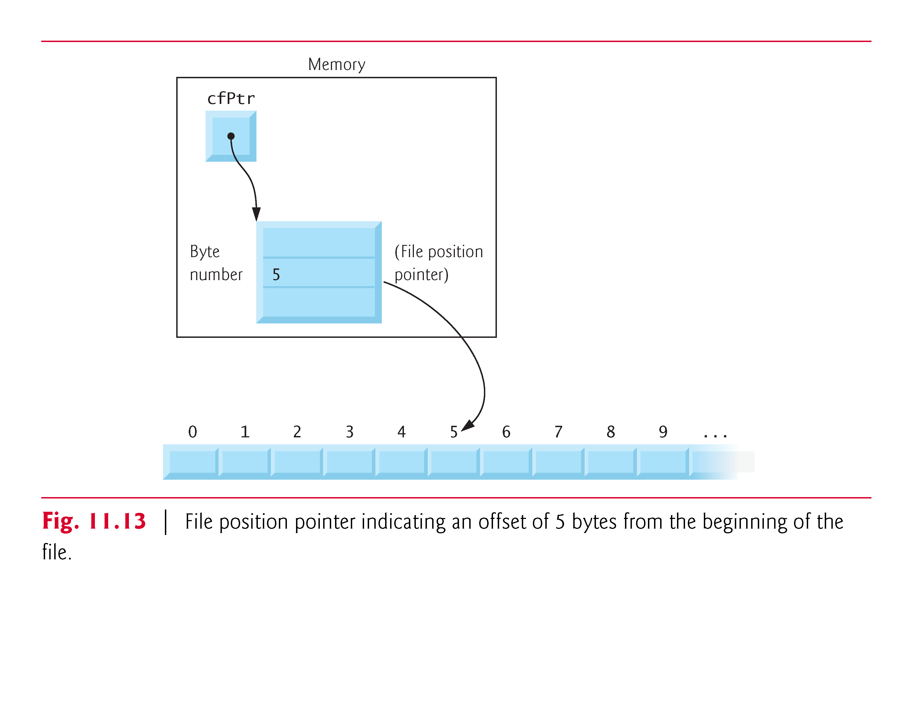

Slide 81
11.7 Writing Data Randomly to a Random-Access File (Cont.)
The function prototype for fseek is
int fseek(FILE *stream, long int offset, int whence);
where offset is the number of bytes to seek from whence in the file pointed to by stream—a positive offset seeks forward and a negative one seeks backward.
Argument whence is one of the values SEEK_SET, SEEK_CUR or SEEK_END (all defined in <stdio.h>), which indicate the location from which the seek begins.

Slide 82
11.7 Writing Data Randomly to a Random-Access File (Cont.)
SEEK_SET indicates that the seek starts at the beginning of the file; SEEK_CUR indicates that the seek starts at the current location in the file; and SEEK_END indicates that the seek starts at the end of the file.
For simplicity, the programs in this chapter do not perform error checking.
Industrial-strength programs should determine whether functions such as fscanf, fseek and fwrite operate correctly by checking their return values.

Slide 83
11.7 Writing Data Randomly to a Random-Access File (Cont.)
Function fscanf returns the number of data items successfully read or the value EOF if a problem occurs while reading data.
Function fseek returns a nonzero value if the seek operation cannot be performed.
Function fwrite returns the number of items it successfully output.
If this number is less than the third argument in the function call, then a write error occurred.

Slide 84
11.8 Reading Data from a Random-Access File
Function fread reads a specified number of bytes from a file into memory.
For example,
fread(&client, sizeof(struct clientData), 1, cfPtr);
reads the number of bytes determined by sizeof(struct clientData) from the file referenced by cfPtr, stores the data in client and returns the number of bytes read.
The bytes are read from the location specified by the file position pointer.

Slide 85
11.8 Reading Data from a Random-Access File (Cont.)
Function fread can read several fixed-size array elements by providing a pointer to the array in which the elements will be stored and by indicating the number of elements to be read.
The preceding statement reads one element should be read.
To read more than one, specify the number of elements as fread’s third argument.
Function fread returns the number of items it successfully input.

Slide 86
11.8 Reading Data from a Random-Access File (Cont.)
If this number is less than the third argument in the function call, then a read error occurred.
Figure 11.14 reads sequentially every record in the "credit.dat" file, determines whether each record contains data and displays the formatted data for records containing data.
Function feof determines when the end of the file is reached, and the fread function transfers data from the file to the clientData structure client.

Slide 87
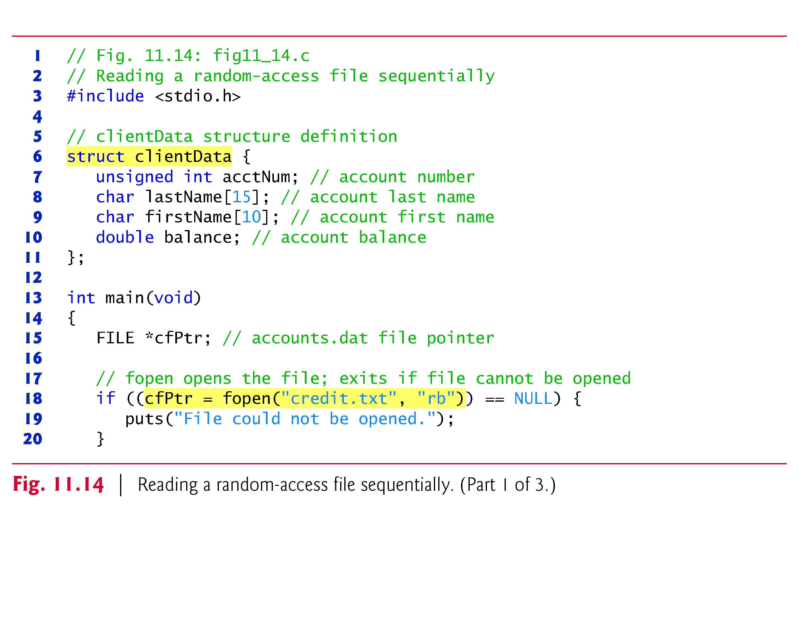

Slide 88
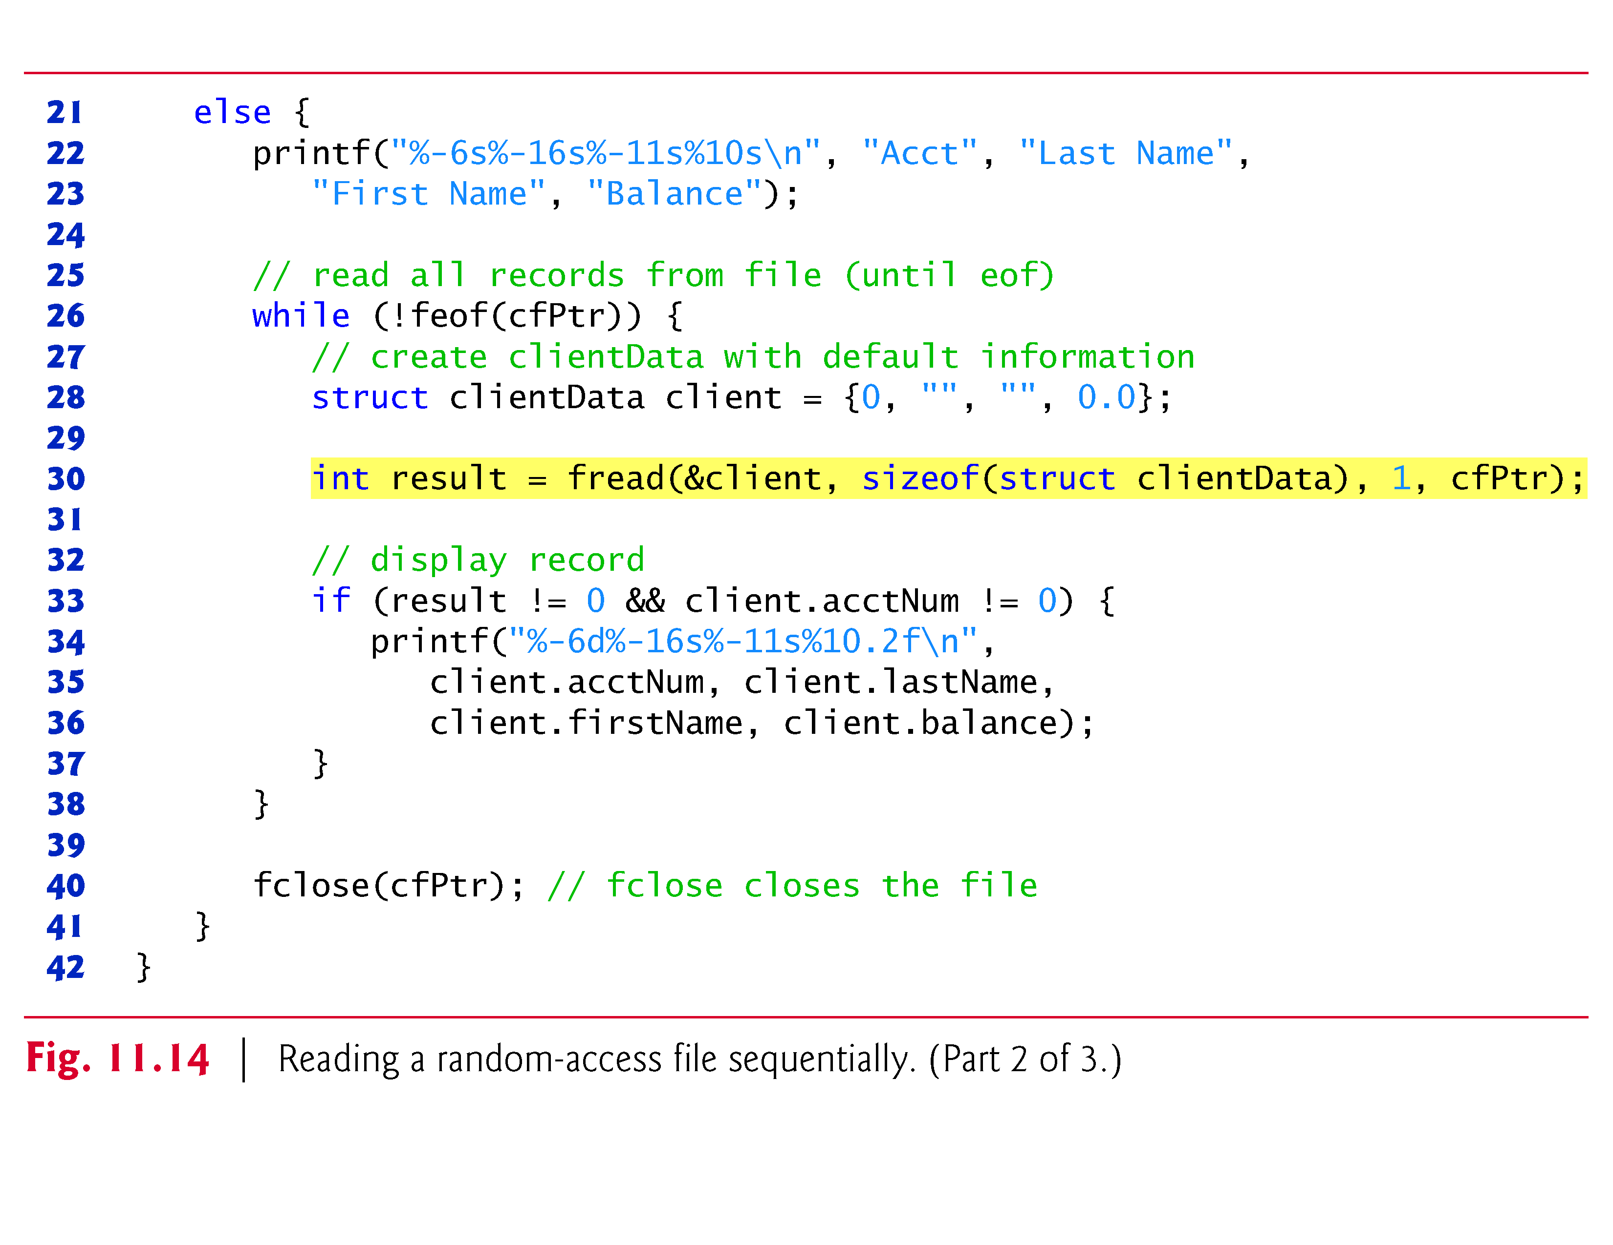

Slide 89
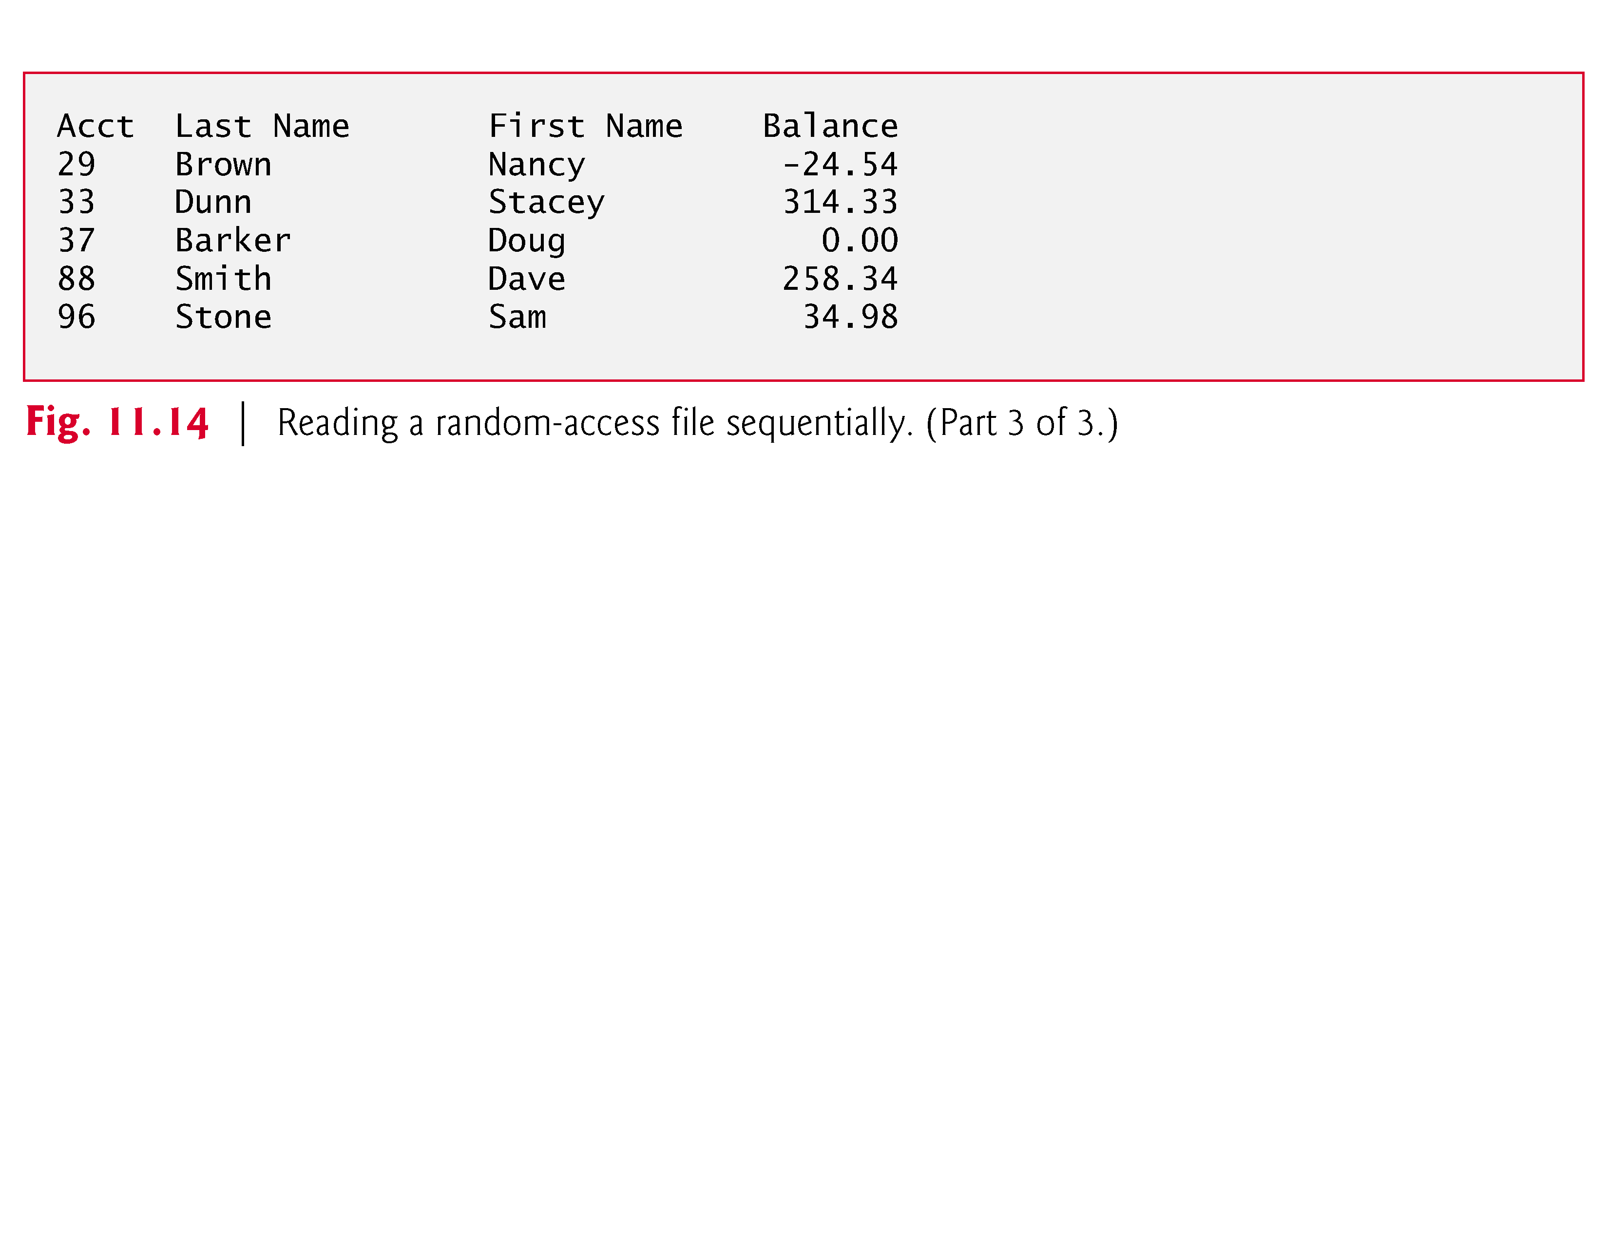

Slide 90
11.9 Case Study: Transaction-Processing Program
We now present a substantial transaction-processing program (Fig. 11.15) using random-access files.
The program maintains a bank’s account information—updating existing accounts, adding new accounts, deleting accounts and storing a listing of all the current accounts in a text file for printing.
We assume that the program of Fig. 11.10 has been executed to create the file credit.dat.

Slide 91
11.9 Case Study: Transaction-Processing Program (Cont.)
The program has five options.
Option 1 calls function textFile to store a formatted list of all the accounts (typically called a report) in a text file called accounts.txt that may be printed later.
The function uses fread and the sequential file access techniques used in the program of Fig. 11.14.

Slide 92
11.9 Case Study: Transaction-Processing Program (Cont.)
Option 2 calls the function updateRecord to update an account.
The function will update only a record that already exists, so the function first checks whether the record specified by the user is empty.
The record is read into structure client with fread, then member acctNum is compared to 0.
If it’s 0, the record contains no information, and a message is printed stating that the record is empty.
Then the menu choices are displayed.
If the record contains information, function updateRecord inputs the transaction amount, calculates the new balance and rewrites the record to the file.

Slide 93
11.9 Case Study: Transaction-Processing Program (Cont.)
Option 3 calls the function newRecord to add a new account to the file.
If the user enters an account number for an existing account, newRecord displays an error message indicating that the record already contains information, and the menu choices are printed again.
This function uses the same process to add a new account as does the program in Fig. 11.11.

Slide 94
11.9 Case Study: Transaction-Processing Program (Cont.)
Option 4 calls function deleteRecord to delete a record from the file.
Deletion is accomplished by asking the user for the account number and reinitializing the record.
If the account contains no information, deleteRecord displays an error message indicating that the account does not exist.
Option 5 terminates program execution.
The program is shown in Fig. 11.15.
The file "credit.dat" is opened for update (reading and writing) using "rb+" mode.

Slide 95
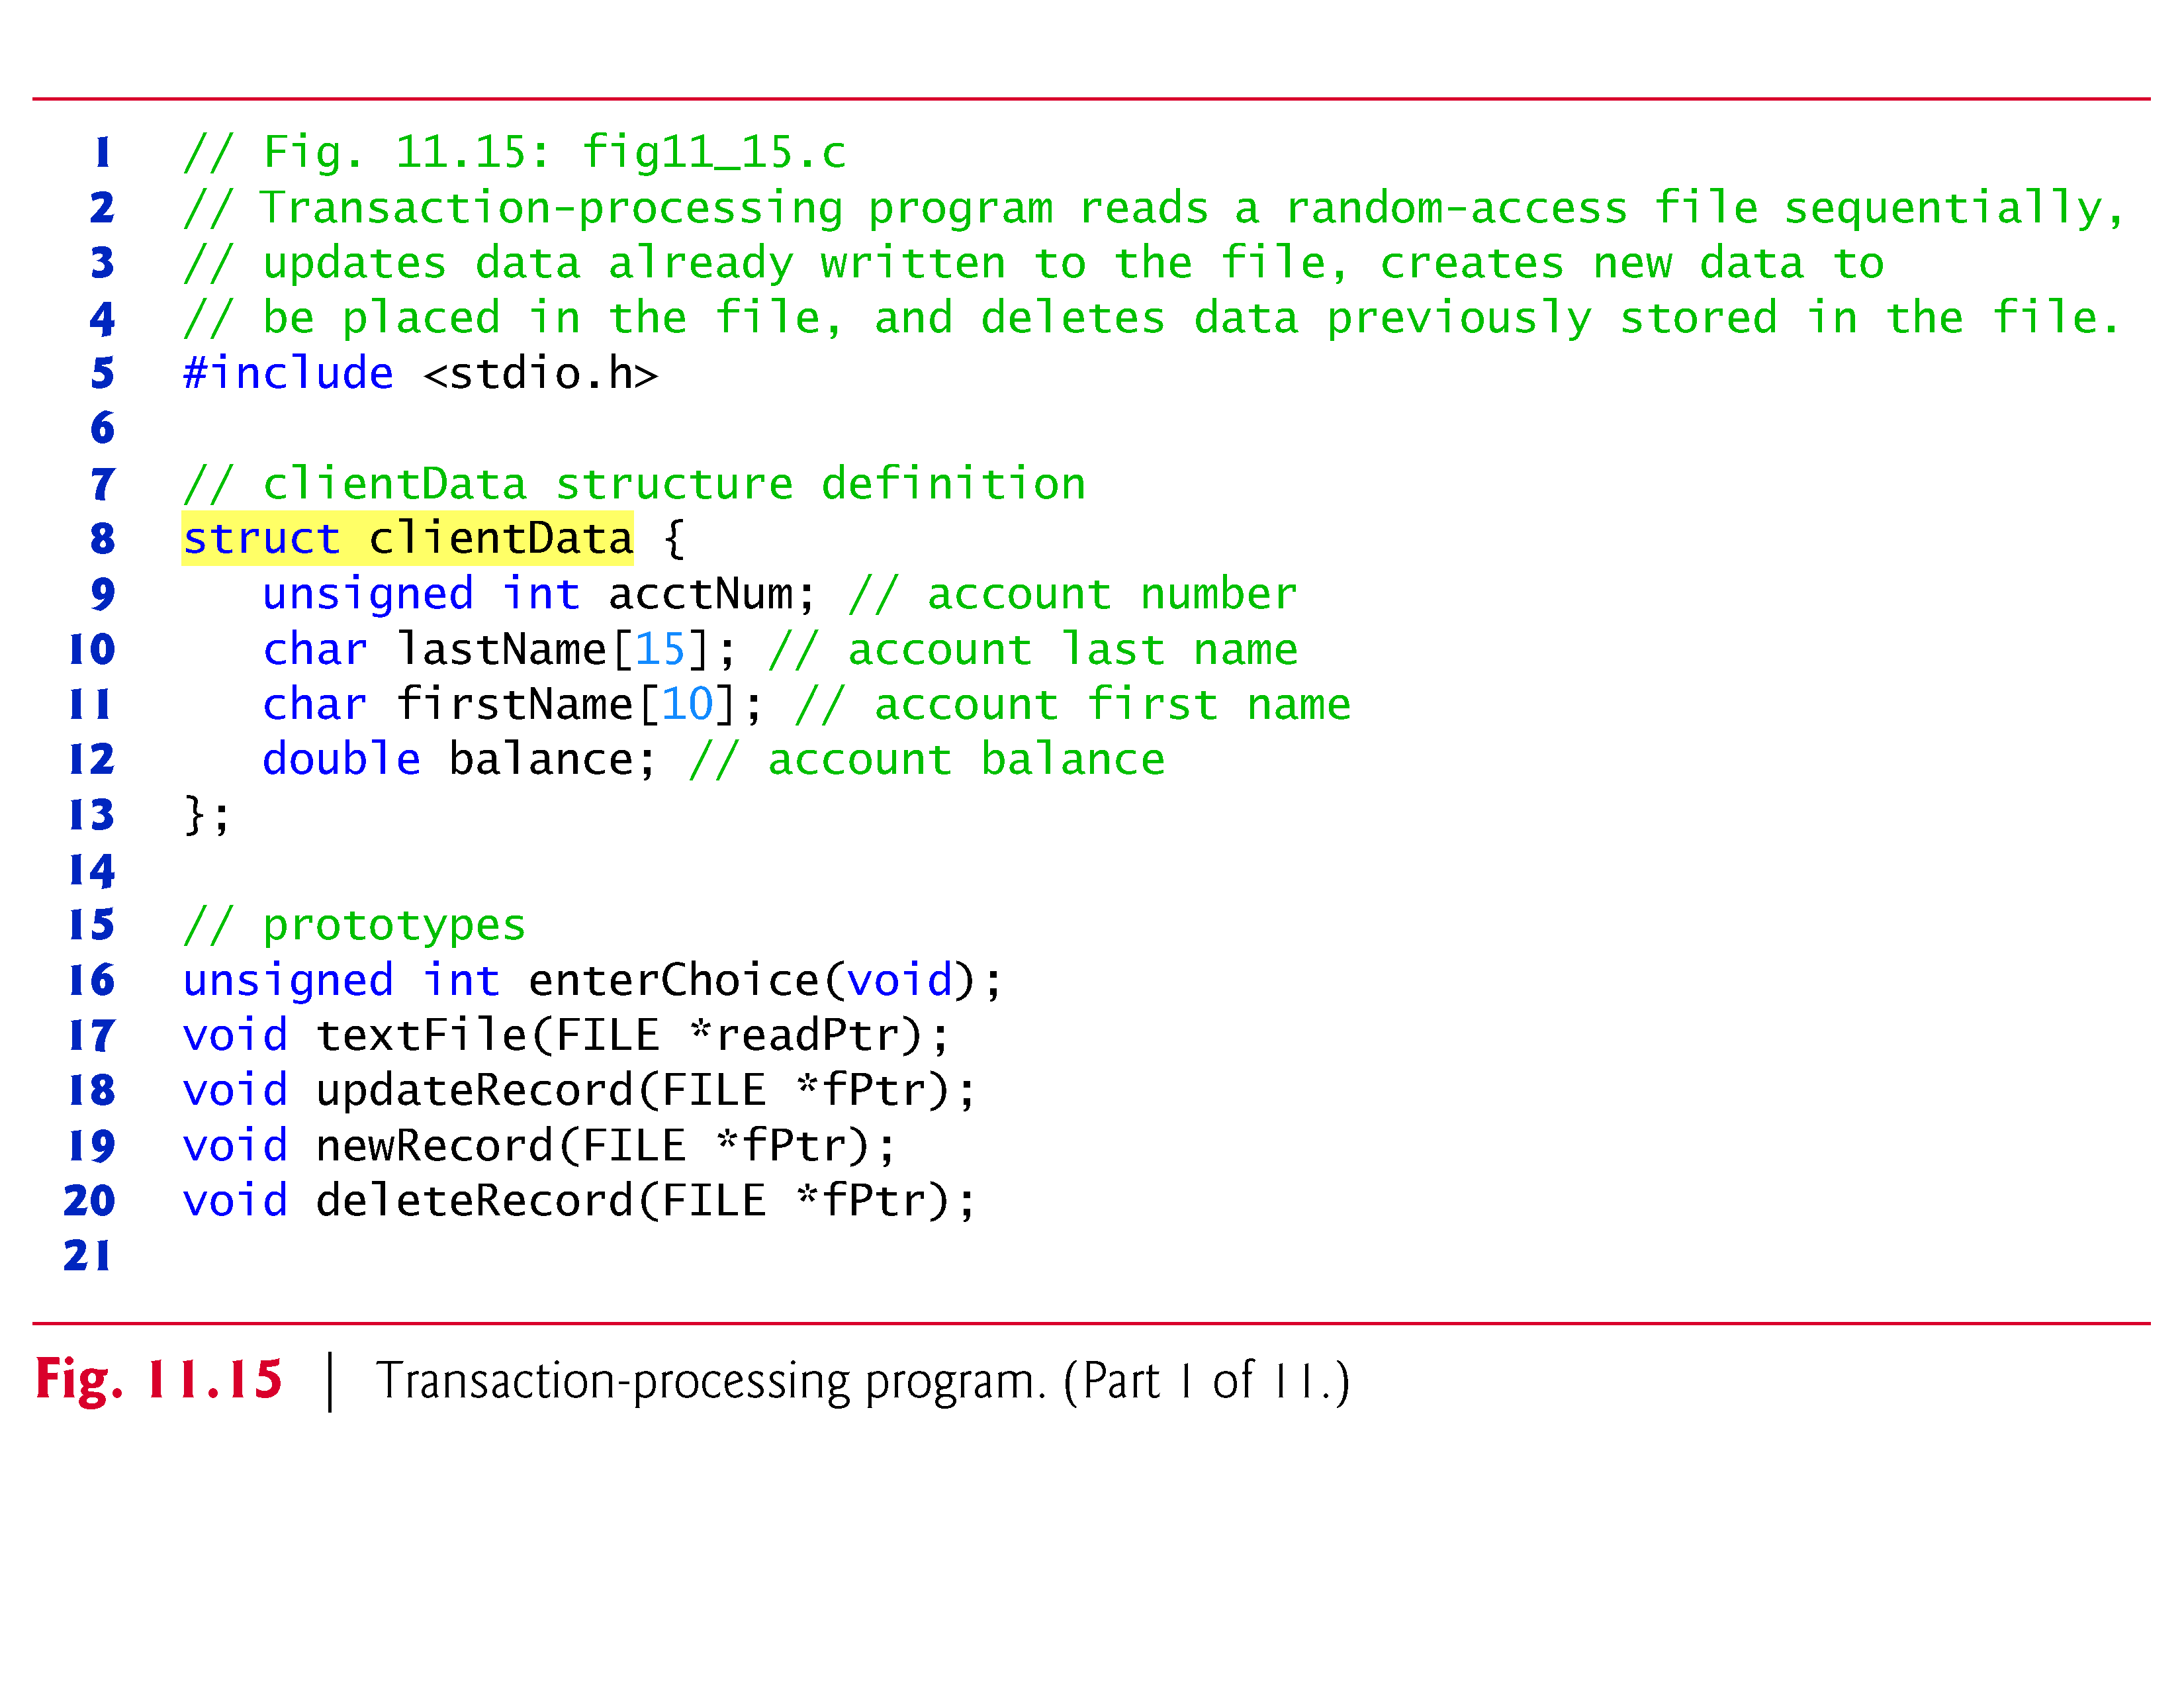

Slide 96
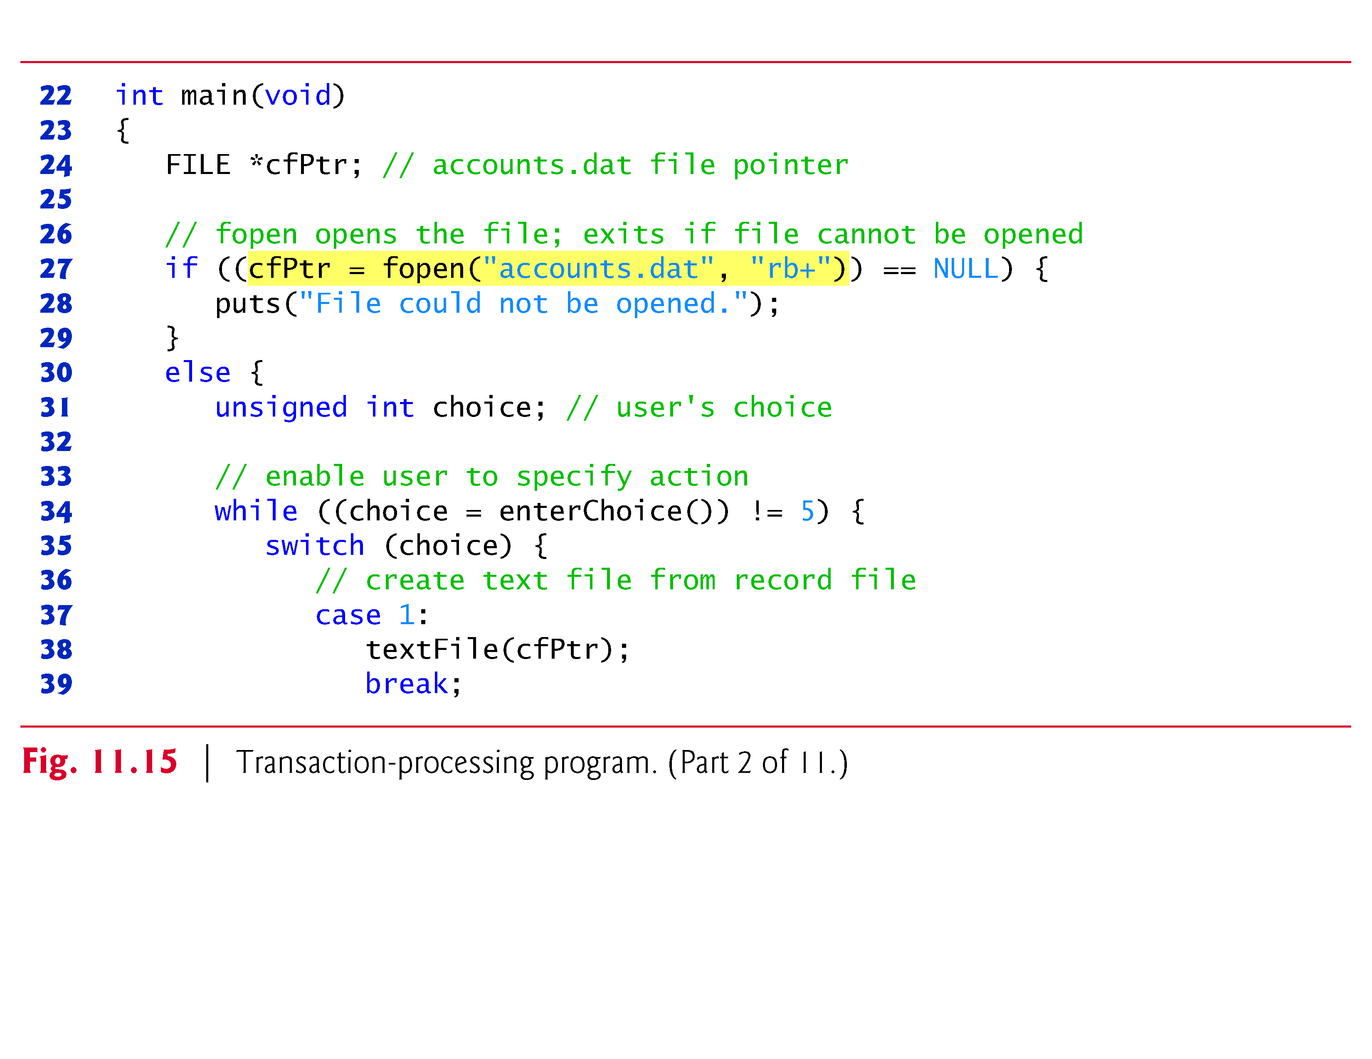

Slide 97
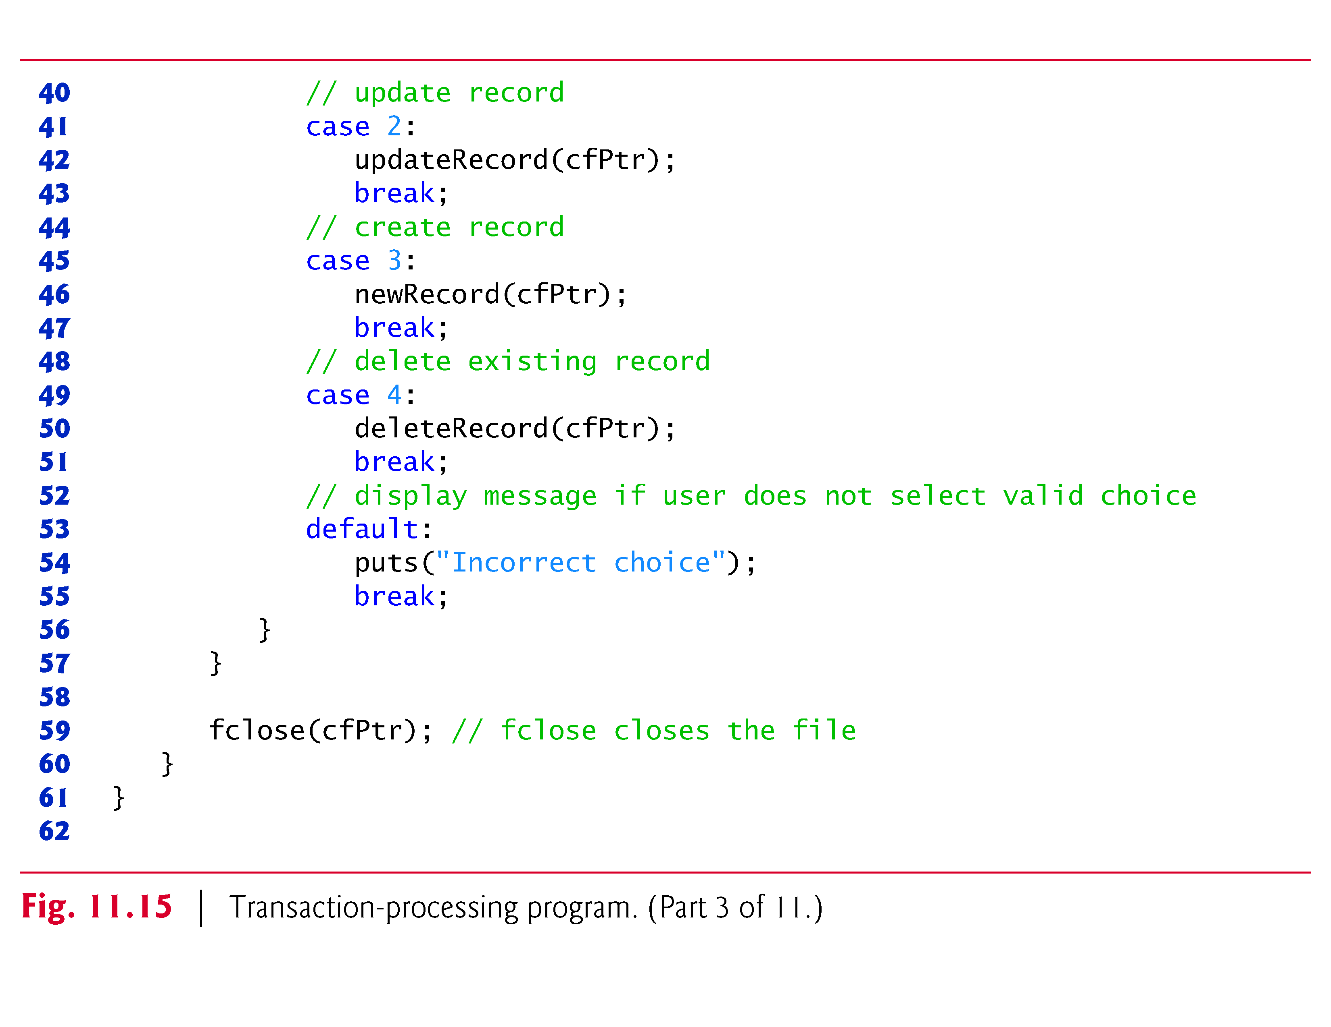

Slide 98
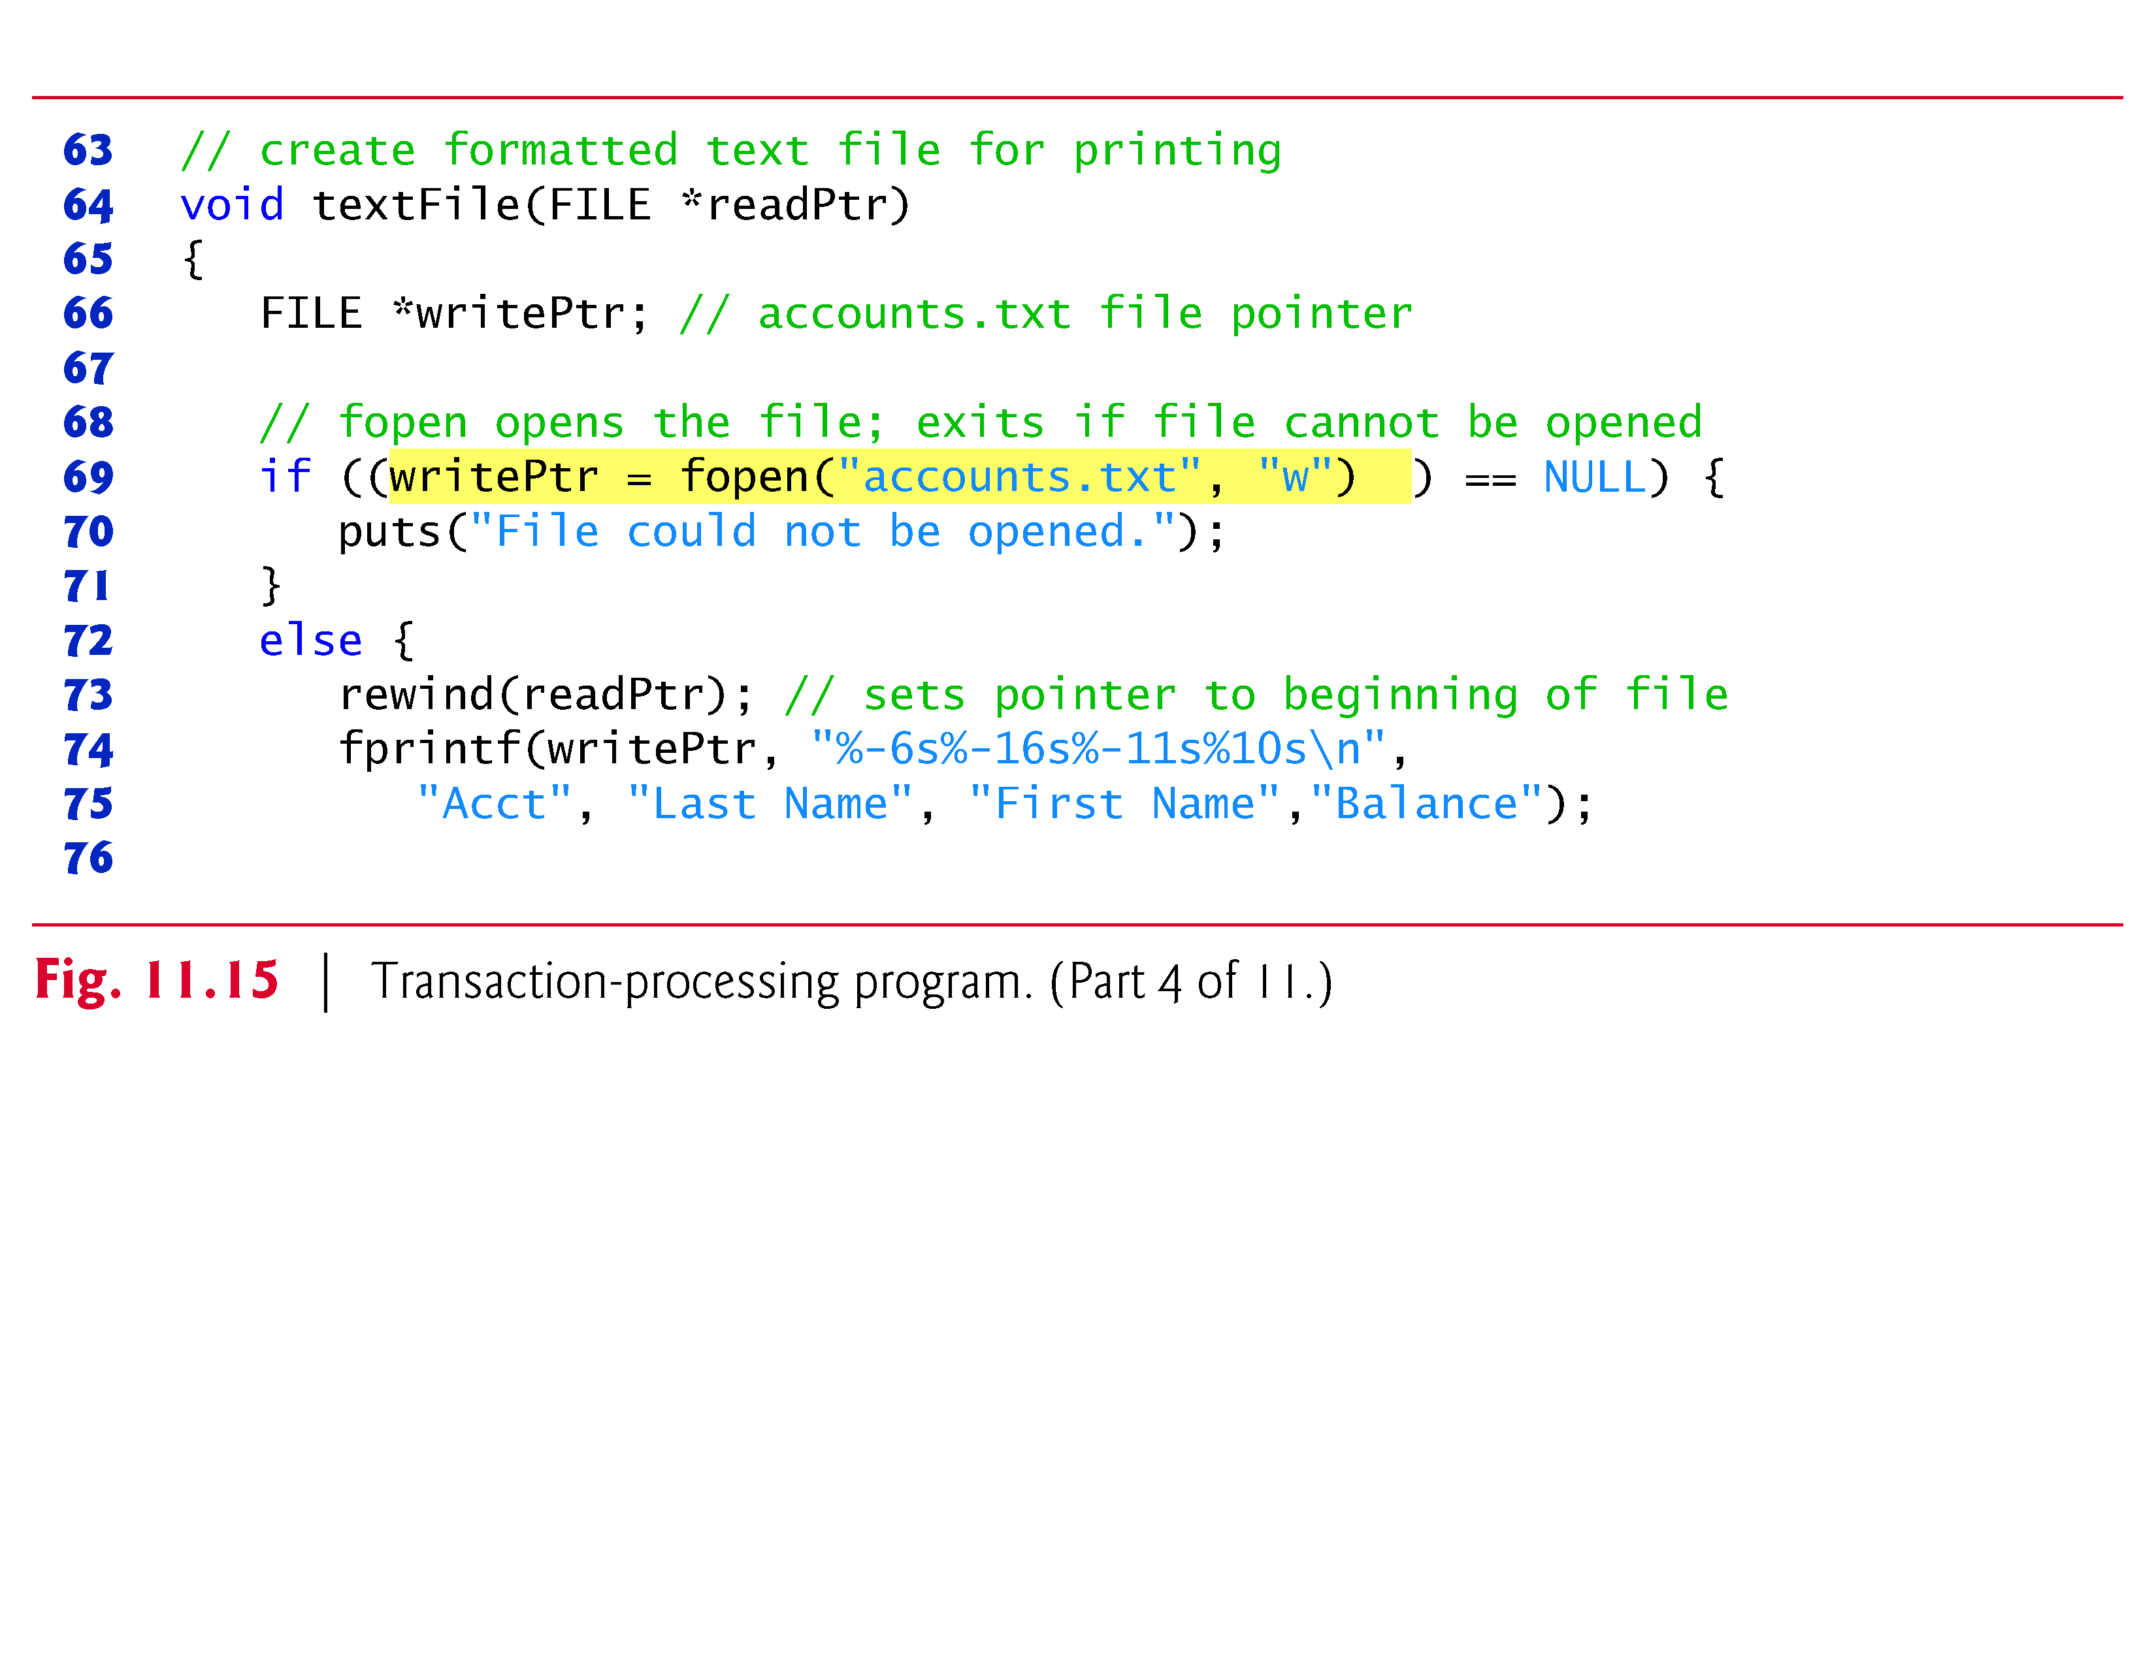

Slide 99
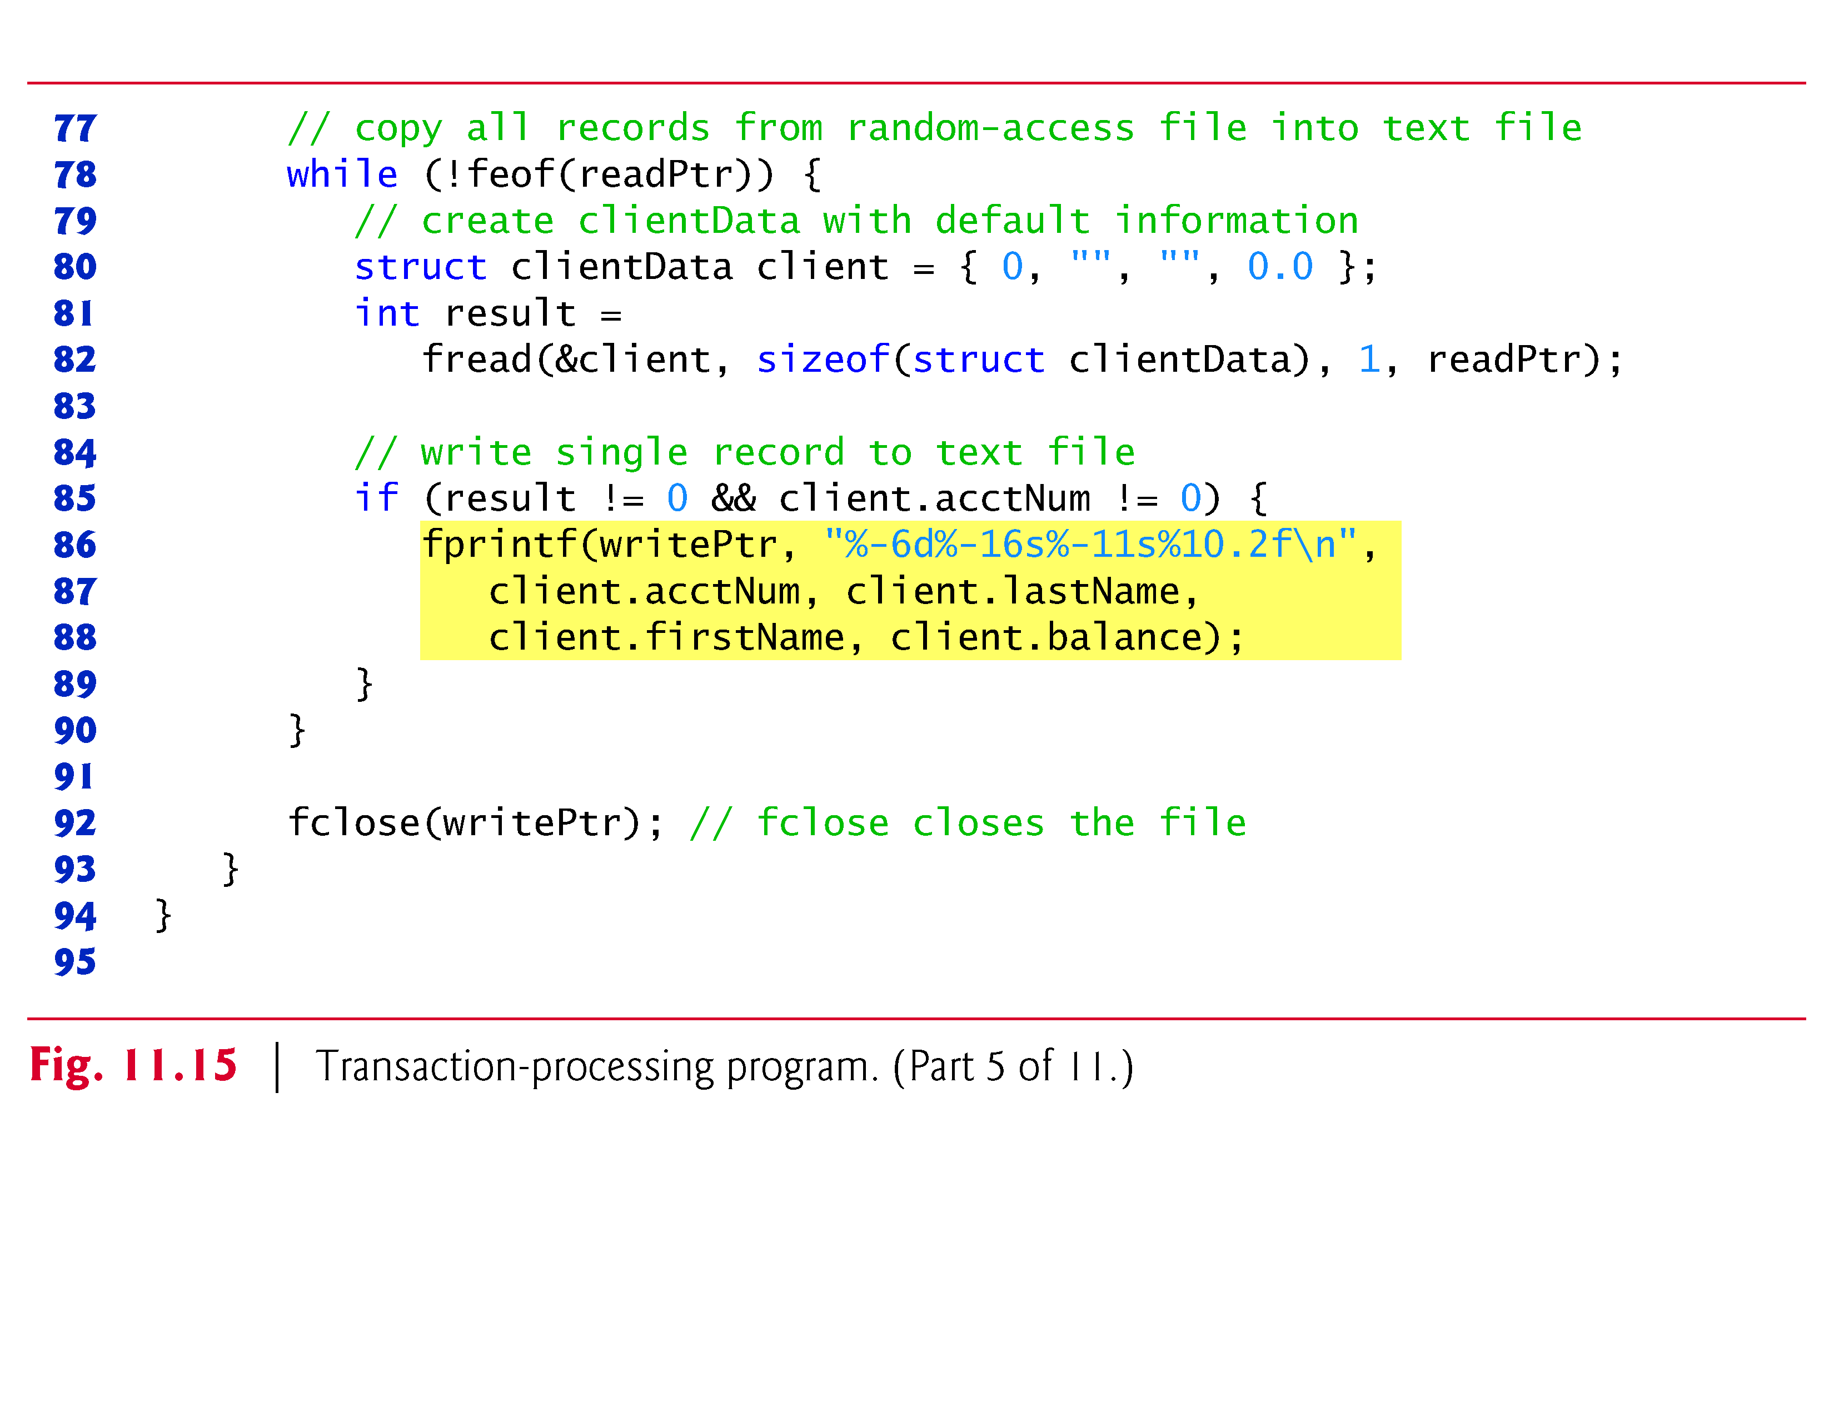

Slide 100
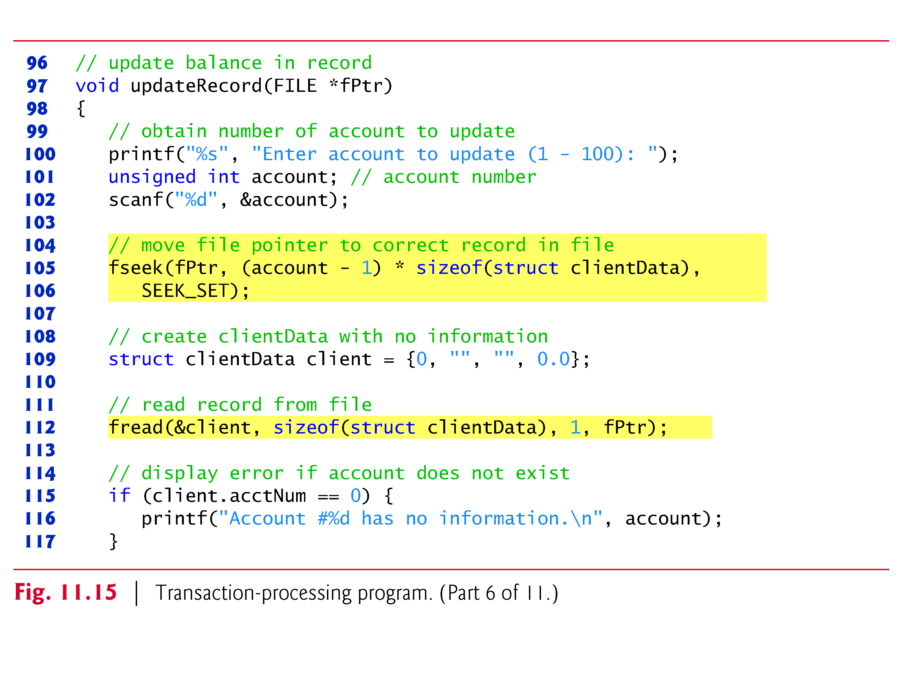

Slide 101
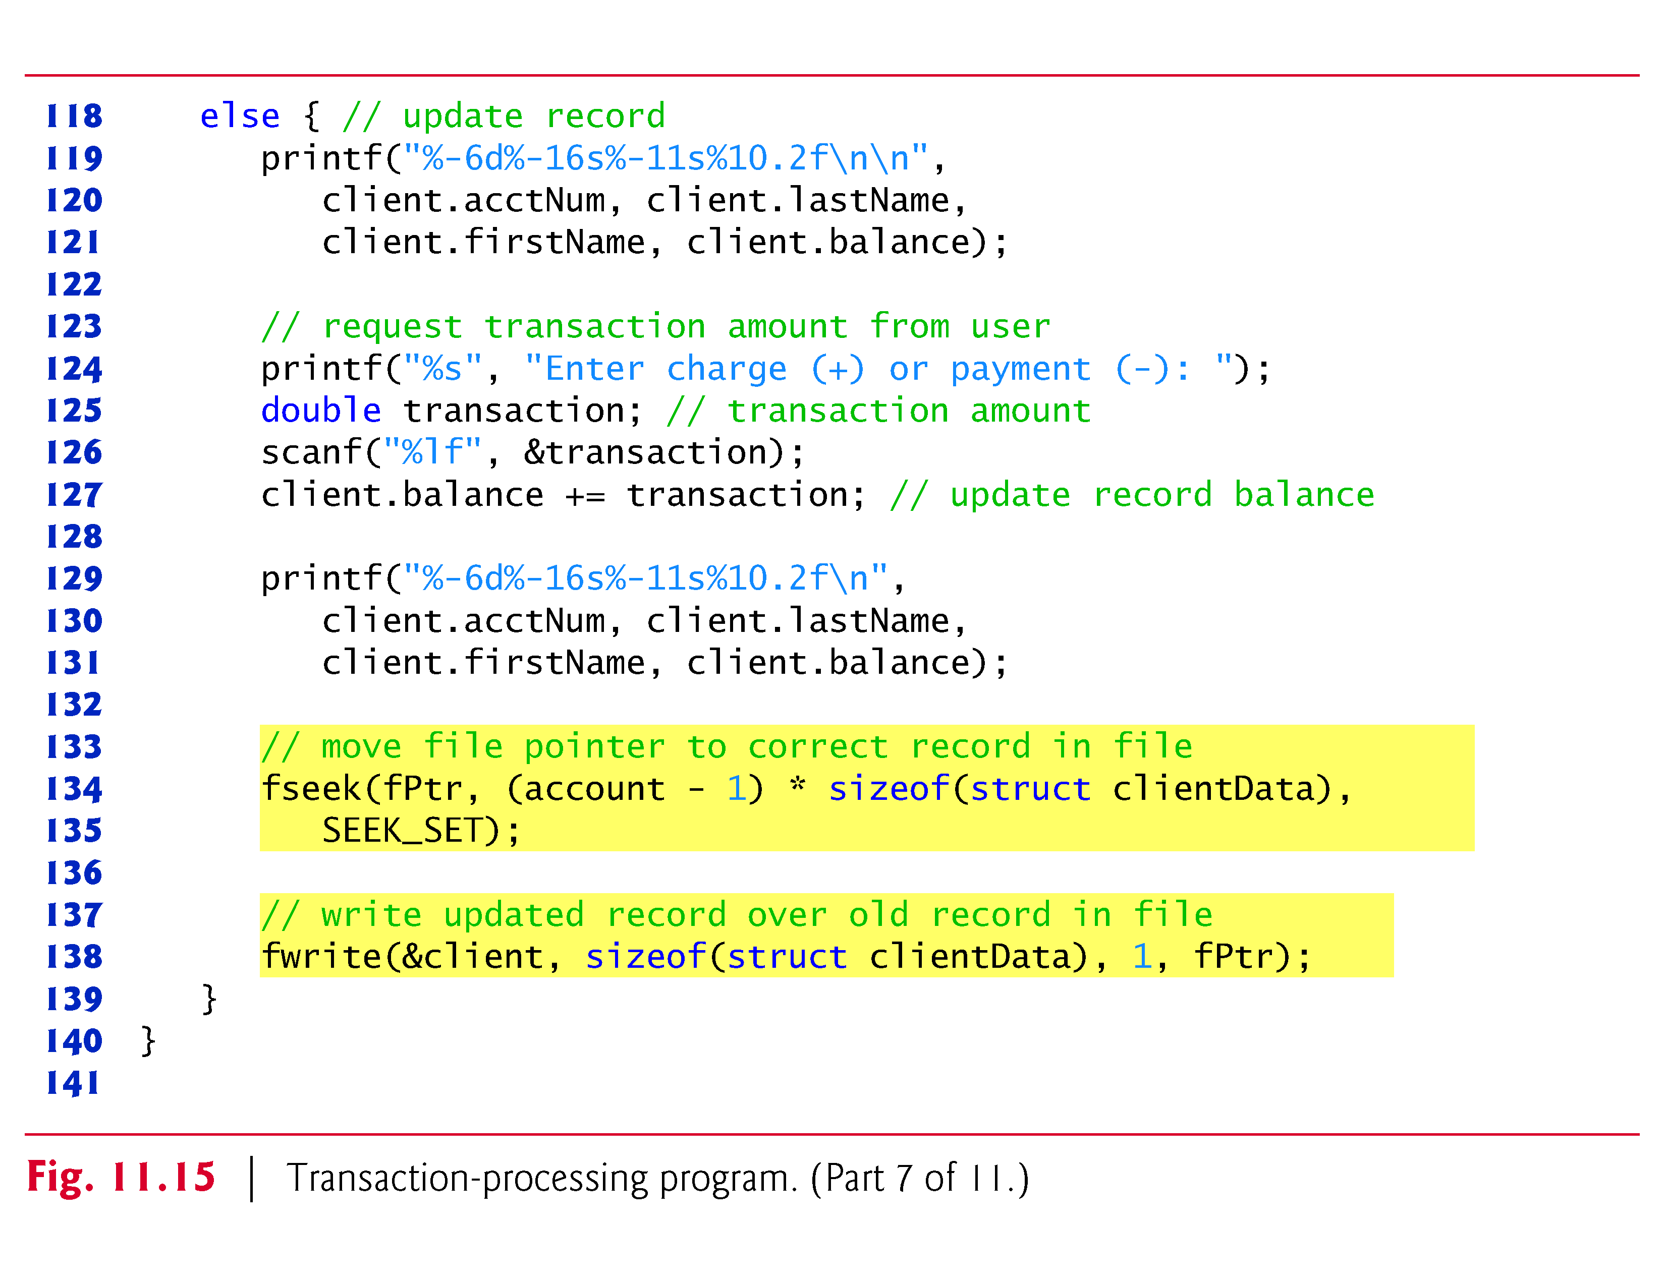

Slide 102
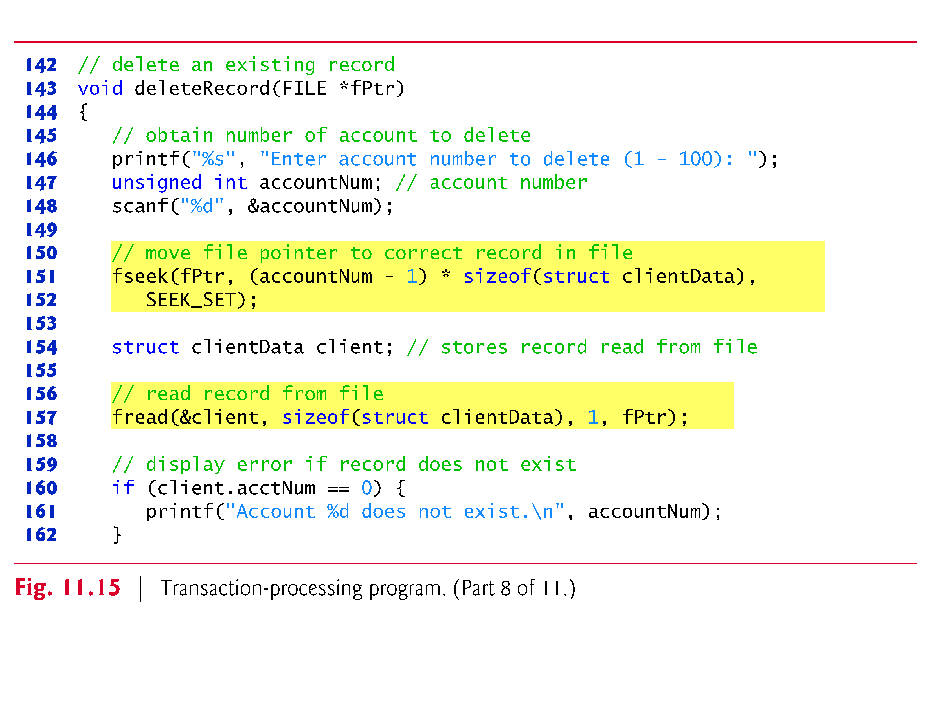

Slide 103
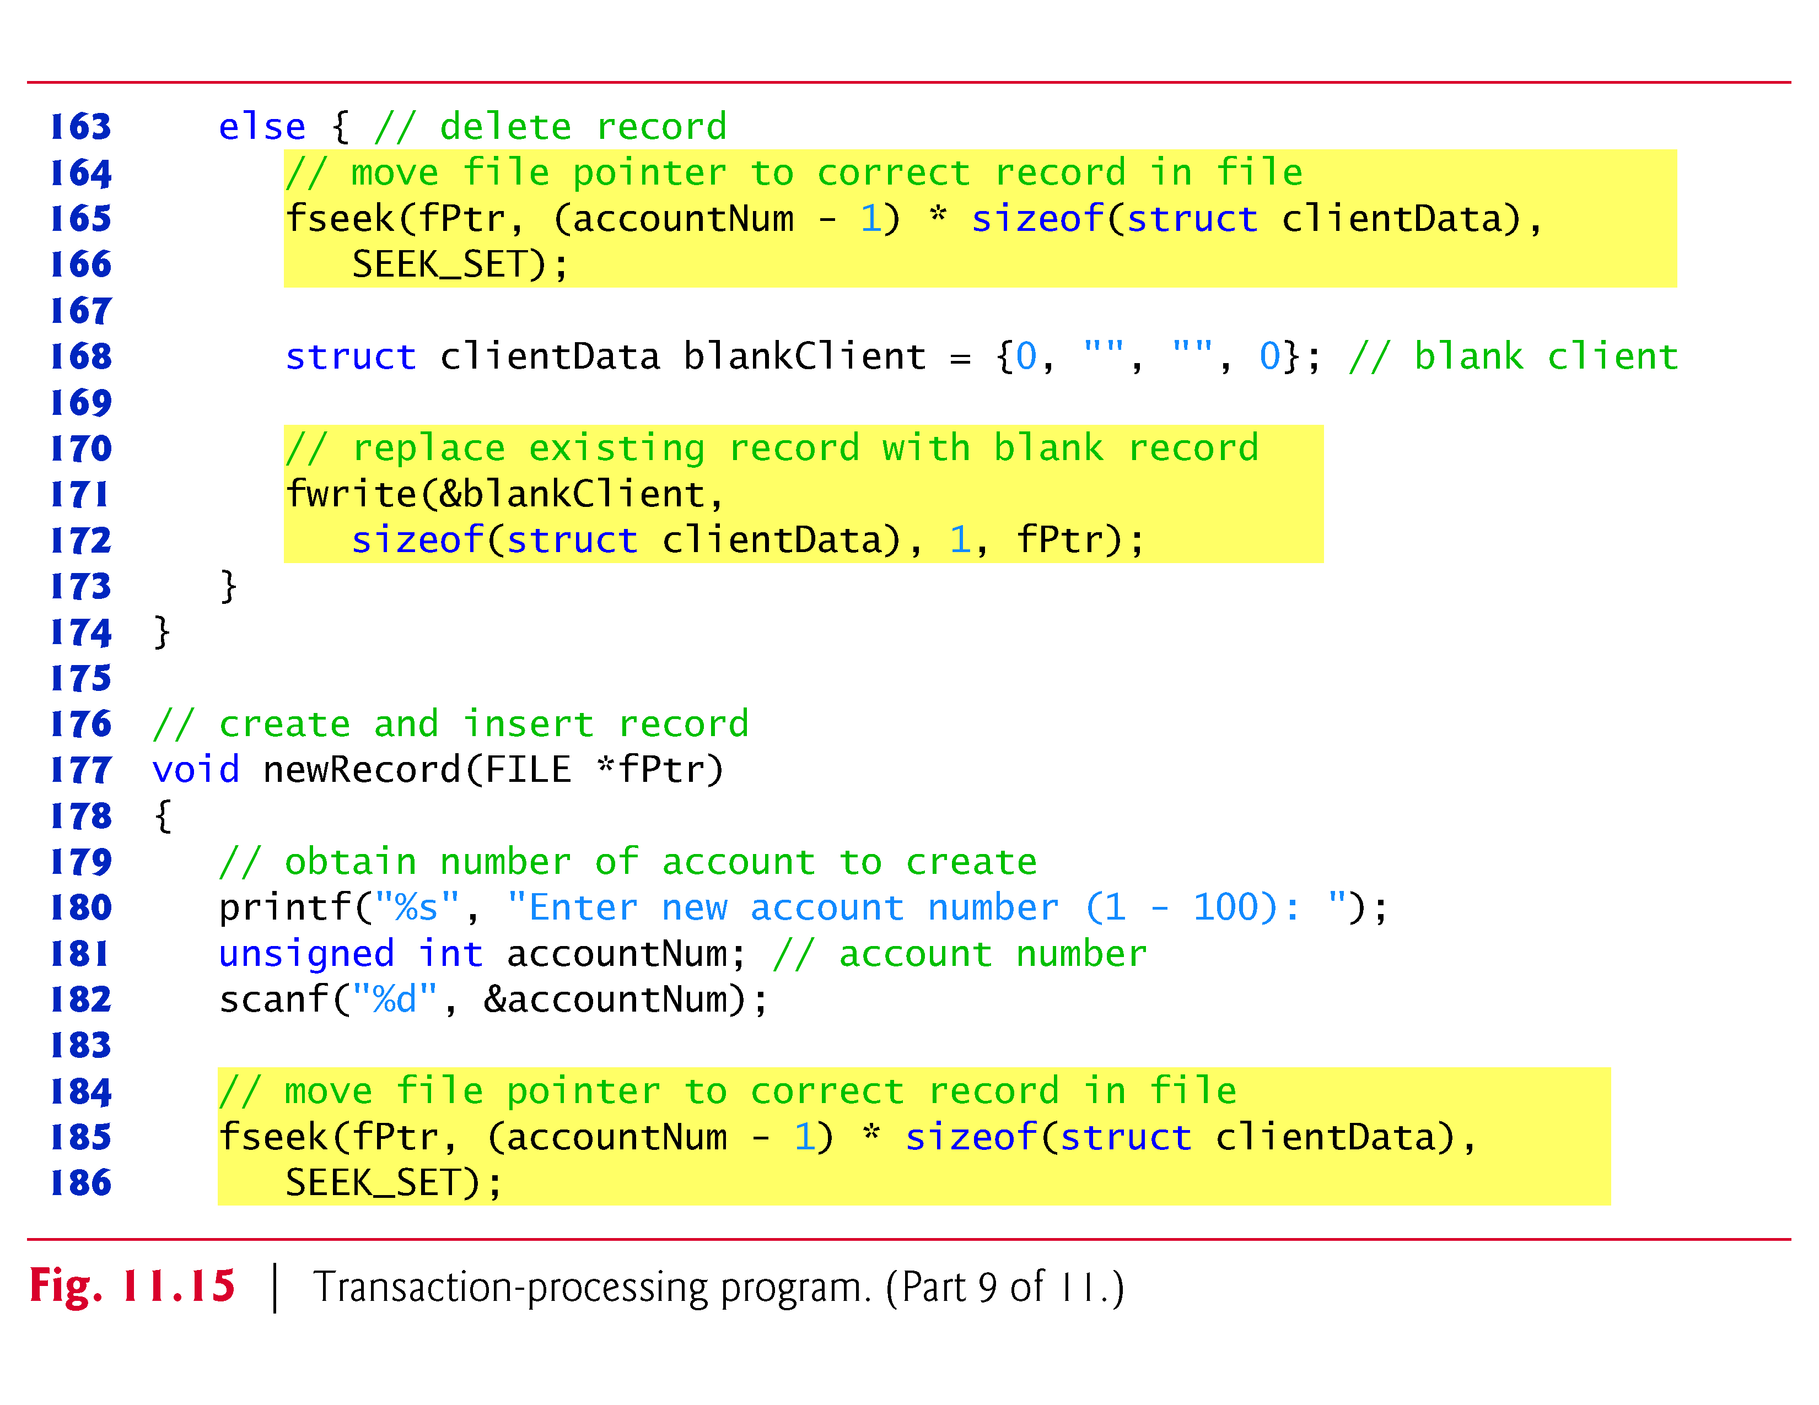

Slide 104
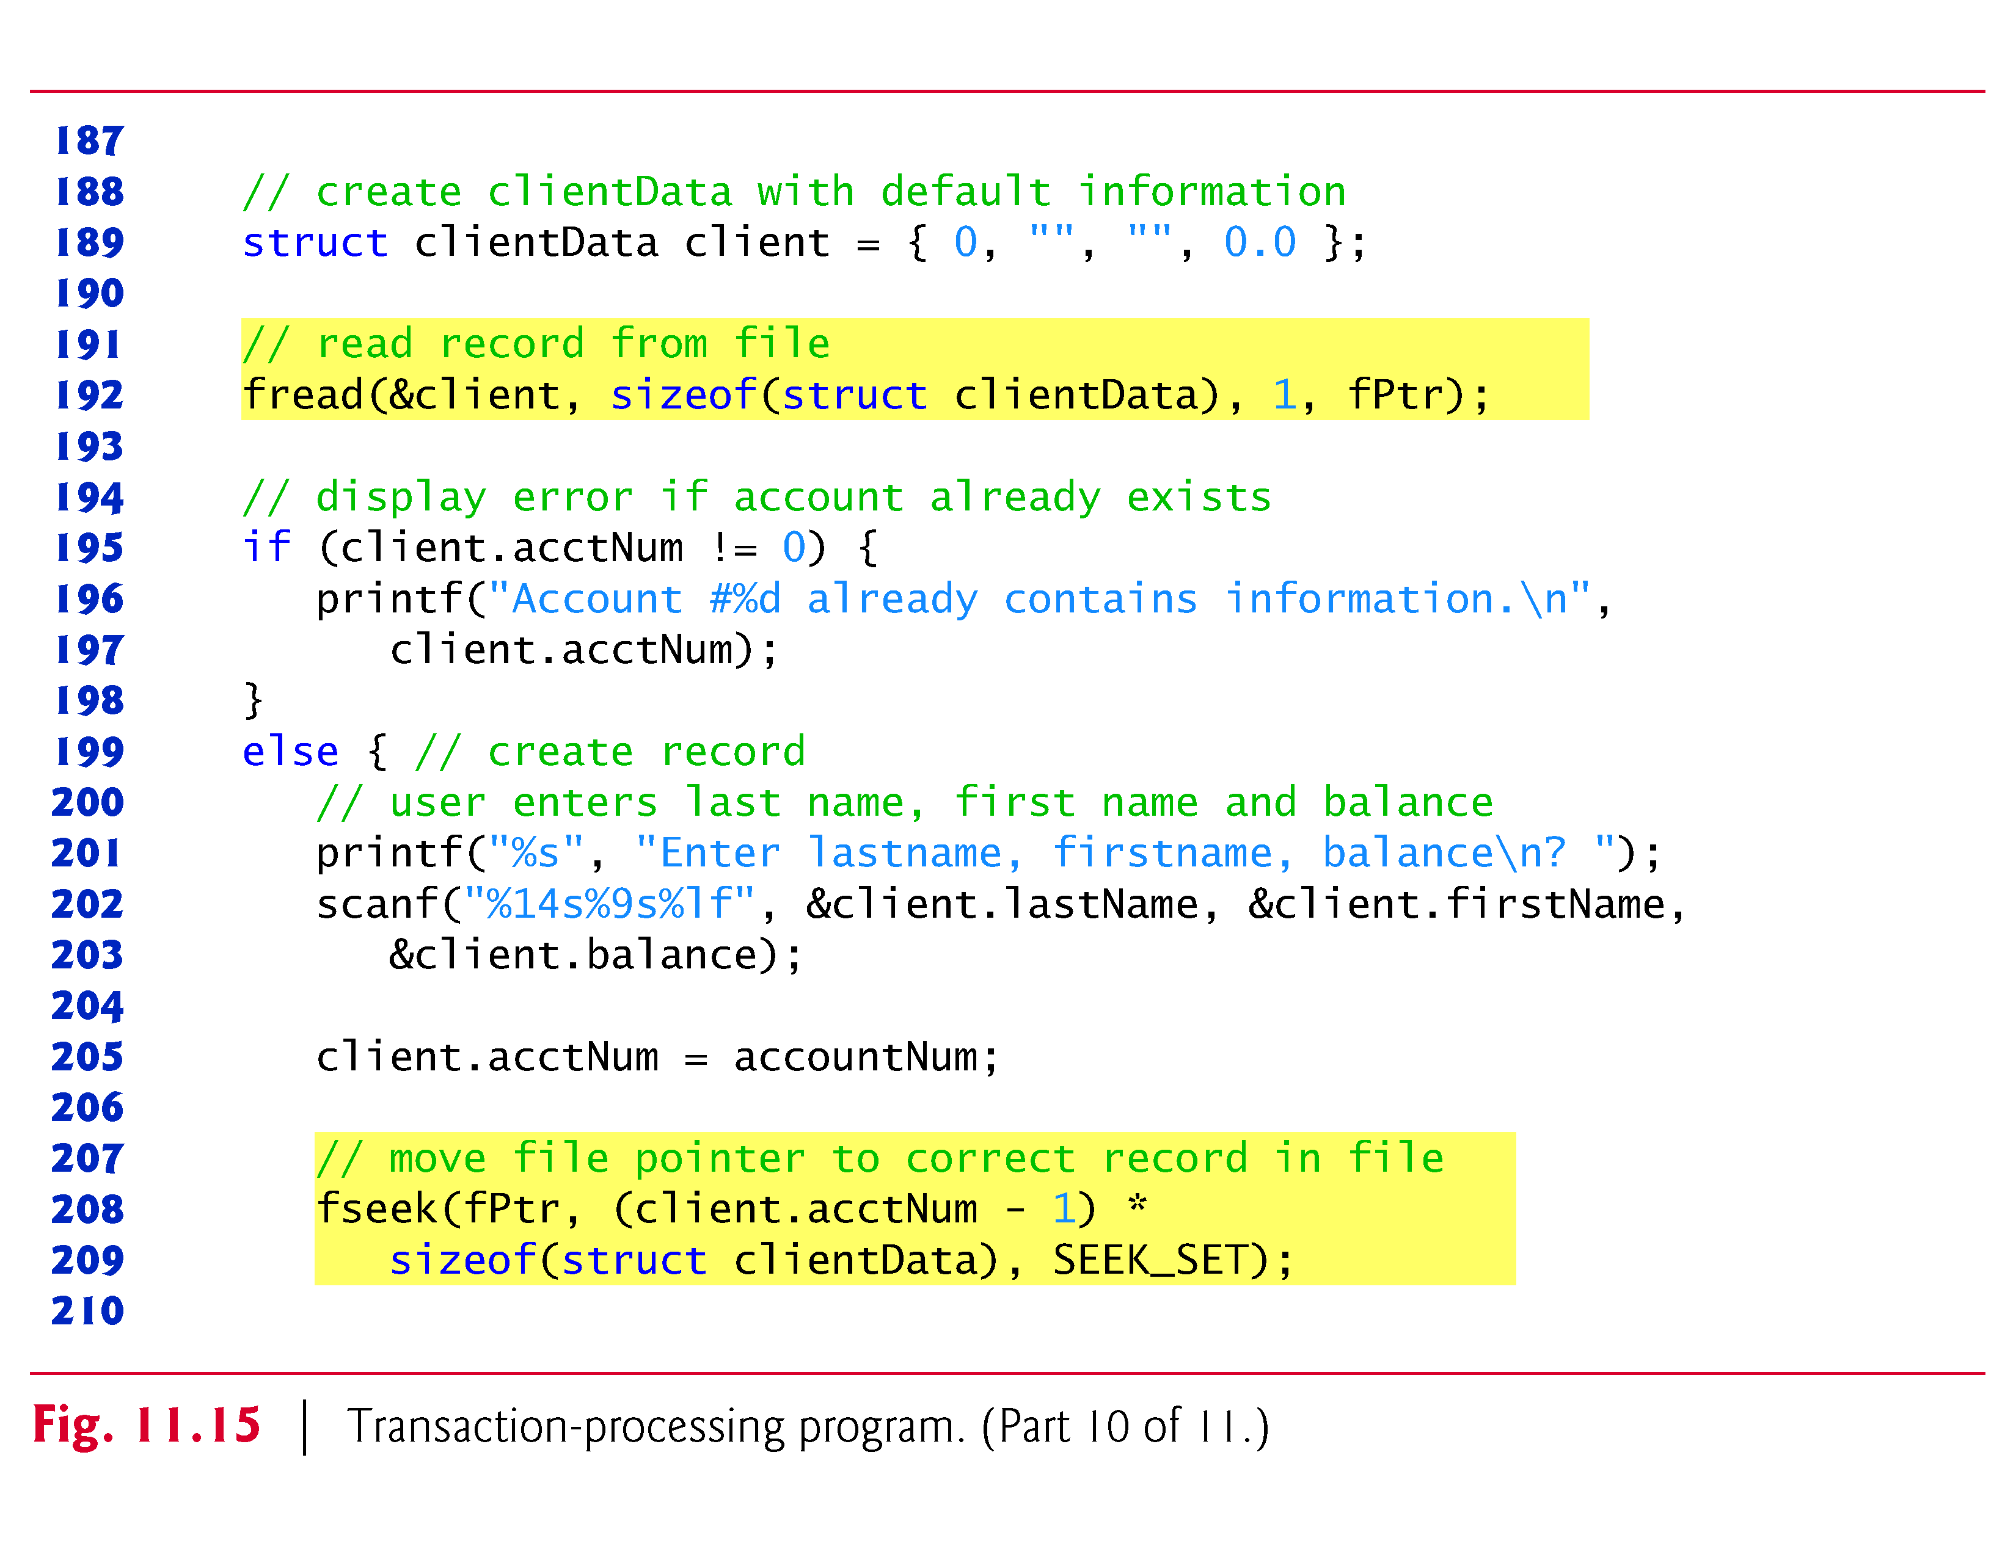

Slide 105
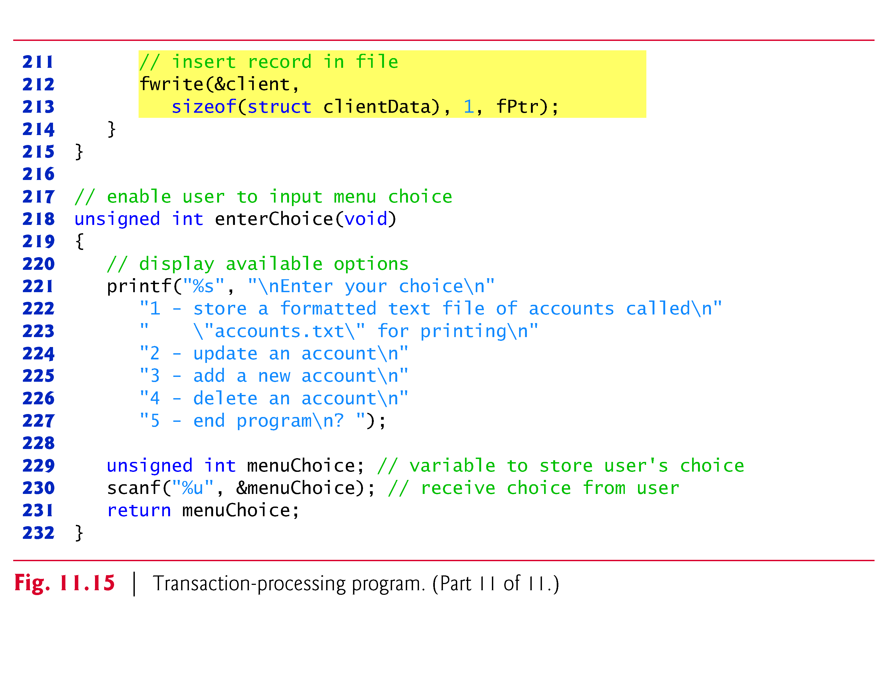

Slide 106
11.10 Secure C Programming
fprintf_s and fscanf_s
The examples in Sections 11.3–11.4 used functions fprintf and fscanf to write text to and read text from files, respectively.
The new standard’s Annex K provides more secure versions of these functions named fprintf_s and fscanf_s that are identical to the printf_s and scanf_s functions we’ve previously introduced, except that you also specify a FILE pointer argument indicating the file to manipulate.
If your C compiler’s standard libraries include these functions, you should use them instead of fprintf and fscanf.

Slide 107
11.10 Secure C Programming (Cont.)
Chapter 9 of the CERT Secure C Coding Standard
Chapter 9 of the CERT Secure C Coding Standard is dedicated to input/output recommendations and rules—many apply to file processing in general and several of these apply to the file-processing functions presented in this chapter.
For more information on each, visit www.securecoding.cert.org.

Slide 108
11.10 Secure C Programming (Cont.)
FIO03-C:
When opening a file for writing using the non-exclusive file-open modes (Fig. 11.5), if the file exists, function fopen opens it and truncates its contents, providing no indication of whether the file existed before the fopen call.
To ensure that an existing file is not opened and truncated, you can use C11’s new exclusive mode (discussed in Section 11.3), which allows fopen to open the file only if it does not already exist.

Slide 109
11.10 Secure C Programming (Cont.)
FIO04-C:
In industrial-strength code, you should always check the return values of file-processing functions that return error indicators to ensure that the functions performed their tasks correctly.
FIO07-C.
Function rewind does not return a value, so you cannot test whether the operation was successful.
It’s recommended instead that you use function fseek, because it returns a non-zero value if it fails.

Slide 110
11.10 Secure C Programming (Cont.)
FIO09-C:
We demonstrated both text files and binary files in this chapter.
Due to differences in binary data representations across platforms, files written in binary format often are not portable.
For more portable file representations, consider using text files or a function library that can handle the differences in binary file representations across platforms.

Slide 111
11.10 Secure C Programming (Cont.)
FIO14-C.
Some library functions do not operate identically on text files and binary files.
In particular, function fseek is not guaranteed to work correctly with binary files if you seek from SEEK_END, so SEEK_SET should be used.
FIO42-C.
On many platforms, you can have only a limited number of files open at once. For this reason, you should always close a file as soon as it’s no longer needed by your program.

